Slide 1
Substation and Distribution Automation Module 2
Three Phase Transformer Models
Center –Tapped Transformers and Secondaries
IEEE Test Systems

Slide 2
Module 1 Overview
Part 1: Overhead Lines
Part 2: Underground lines
Part 3: Three Phase Transformer Models
Part 4: Center –Tapped Transformers and Secondaries
Part 5: IEEE Test Systems

Slide 3
Part 3: Three Phase Transformer Models
Three Phase Transformer Models
General Three Phase Transformer Banks
Generalized Matrices
Symmetrical Components
The Delta-Grounded Wye Step Down Connection
The Ungrounded Wye-Delta Step Down Connection
The Grounded Wye-Grounded Wye Connection
The Delta-Delta Connection
Open Wye-Open Delta
Thevenin Equivalent Circuit

Slide 4
Three Phase Transformer Models
Three-phase transformer banks in the distribution substation transform the transmission or sub-transmission level voltages to the distribution feeder level voltage.
Different substations transformer connections exist, like the Delta-grounded wye, the delta-delta transformer,… etc.
The connection used depends on the configuration of the distribution feeder.

Slide 5
Three Phase Transformer Models
Three-phase transformer banks on the feeder will provide the final voltage transformation to the customer’s load.
Again, different transformer connections can be applied depending on the load characteristics (whether a pure 3 phase load or a combination of single phase and three phase loads).

Slide 6
Quick Review of Wye and Delta Connection
Figure 1.0: Wye and delta source connections
Figure 2.0: The line-neutral voltages in terms of the line-line voltages

Slide 7
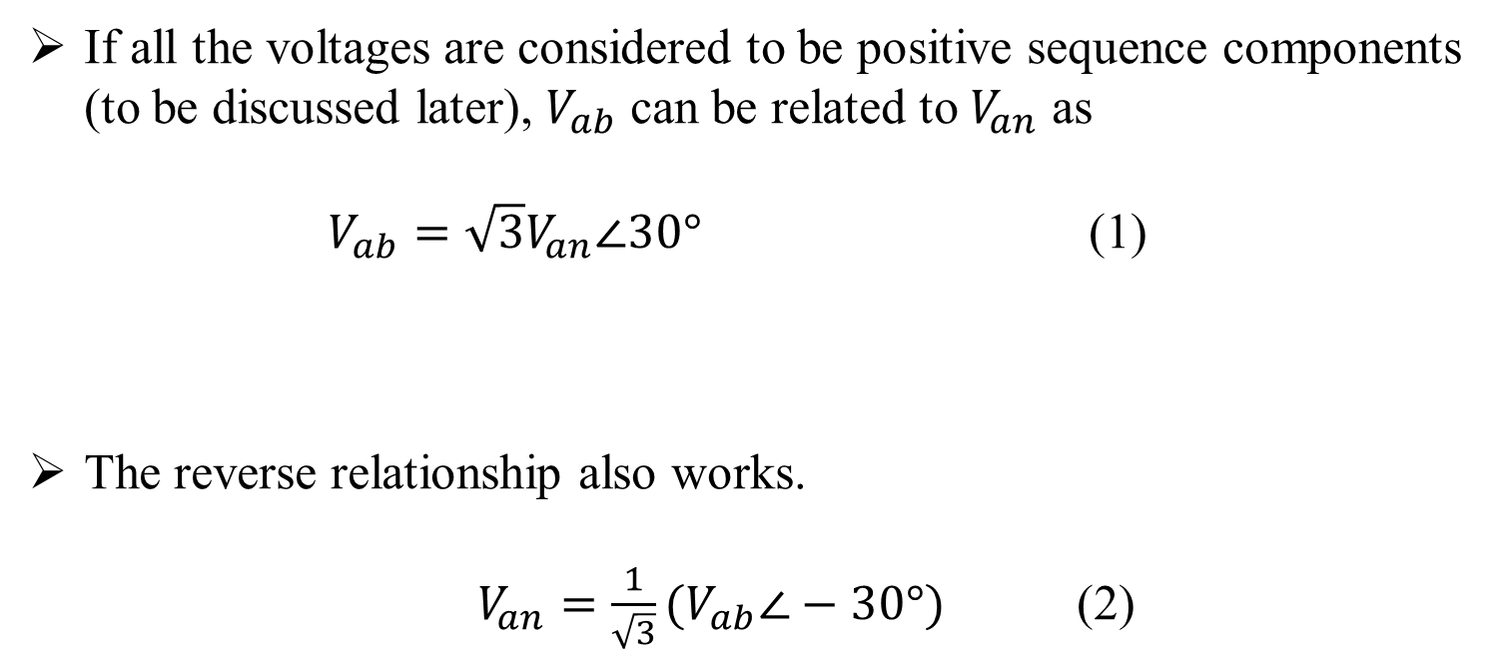
Quick Review of Wye and Delta Connection
If all the voltages are considered to be positive sequence components (to be discussed later), $V_{ab}$ can be related to $V_{an}$ as
$V_{ab}=\sqrt{3}V_{an}∠30°$ (1)
The reverse relationship also works.
$V_{an}=\frac{1}{\sqrt{3}}(V_{ab}∠−30°)$ (2)

Slide 8
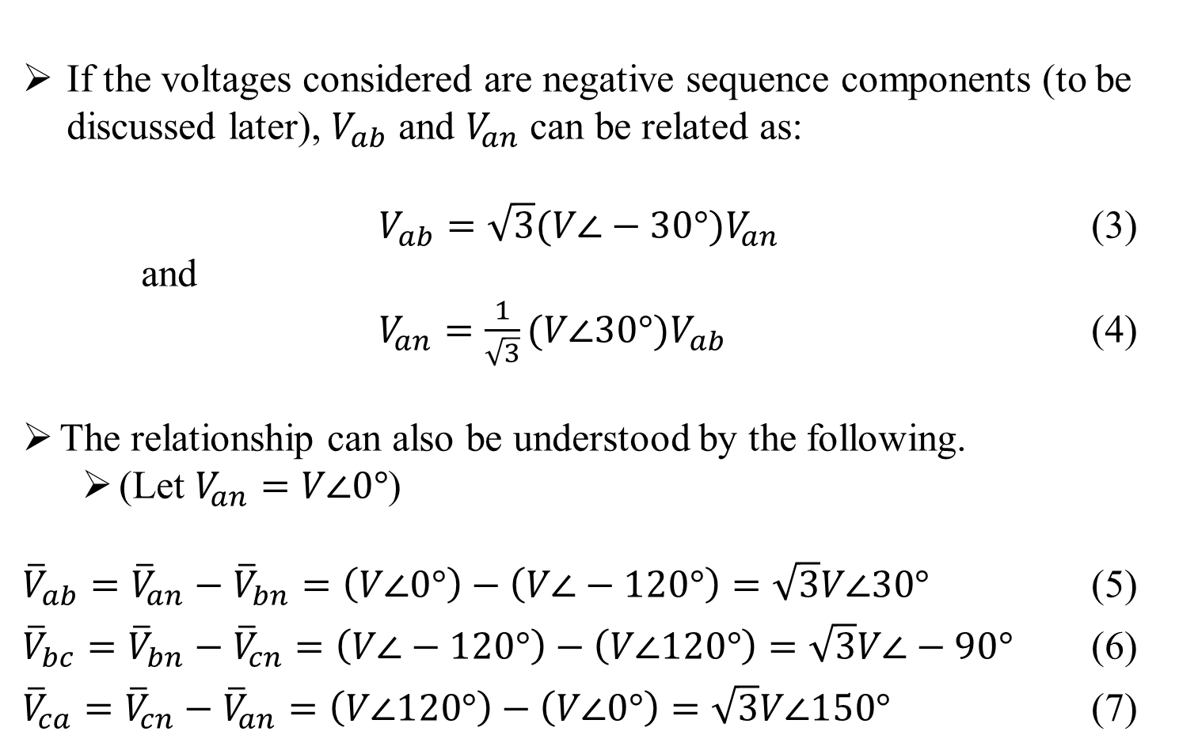
Quick Review of Wye and Delta Connection
If the voltages considered are negative sequence components (to be discussed later), $V_{ab}$ and $V_{an}$ can be related as:
$V_{ab}=\sqrt{3}(V∠−30°)V_{an}$ (3)
and
$V_{an}=\frac{1}{\sqrt{3}}(V∠30°)V_{ab}$ (4)
The relationship can also be understood by the following.
(Let $V_{an}=V∠0°$)
${\overline{V}}_{ab}={\overline{V}}_{an}−{\overline{V}}_{bn}=\left(V∠0°\right)−\left(V∠−120°\right)=\sqrt{3}V∠30°$ (5)
${\overline{V}}_{bc}={\overline{V}}_{bn}−{\overline{V}}_{cn}=\left(V∠−120°\right)−\left(V∠120°\right)=\sqrt{3}V∠−90°$ (6)
${\overline{V}}_{ca}={\overline{V}}_{cn}−{\overline{V}}_{an}=\left(V∠120°\right)−\left(V∠0°\right)=\sqrt{3}V∠150°$ (7)

Slide 9
Part 3: Three Phase Transformer Models
Three Phase Transformer Models
General Three Phase Transformer Banks
Generalized Matrices
Symmetrical Components
The Delta-Grounded Wye Step Down Connection
The Ungrounded Wye-Delta Step Down Connection
The Grounded Wye-Grounded Wye Connection
The Delta-Delta Connection
Open Wye-Open Delta
Thevenin Equivalent Circuit

Slide 10
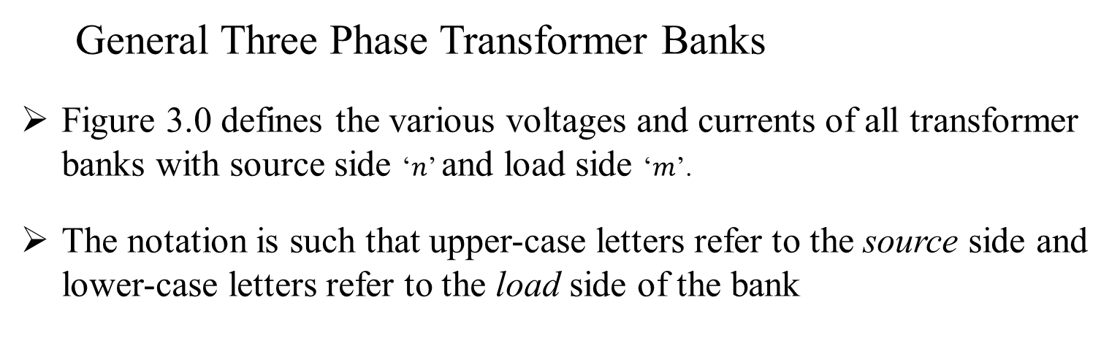
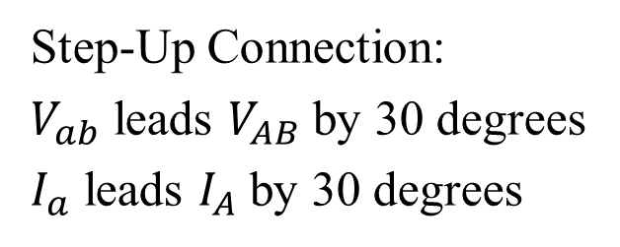
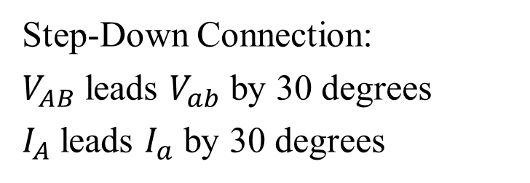
Three Phase Transformer Models
General Three Phase Transformer Banks
Figure 3.0 defines the various voltages and currents of all transformer banks with source side ‘$n$’ and load side ‘$m$’.
The notation is such that upper-case letters refer to the source side and lower-case letters refer to the load side of the bank
Figure 3.0
Step-Down Connection:
$V_{AB}$ leads $V_{ab}$ by 30 degrees
$I_{A}$ leads $I_{a}$ by 30 degrees
Step-Up Connection:
$V_{ab}$ leads $V_{AB}$ by 30 degrees
$I_{a}$ leads $I_{A}$ by 30 degrees

Slide 11
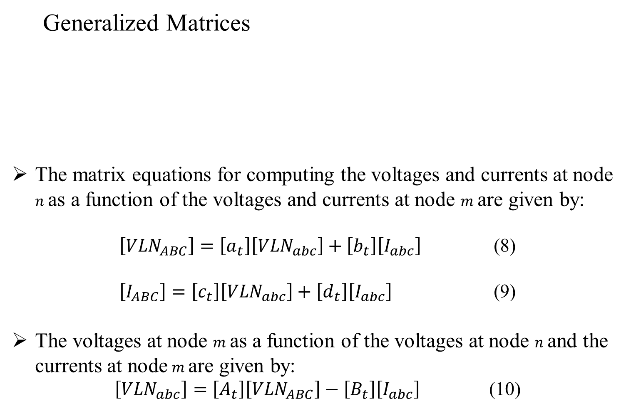
Three Phase Transformer Models
Generalized Matrices
The matrix equations for computing the voltages and currents at node $n$ as a function of the voltages and currents at node $m$ are given by:
$\left[{VLN}_{ABC}\right]=\left[a_{t}\right]\left[{VLN}_{abc}\right]+\left[b_{t}\right]\left[I_{abc}\right]$ (8)
$\left[I_{ABC}\right]=\left[c_{t}\right]\left[{VLN}_{abc}\right]+\left[d_{t}\right]\left[I_{abc}\right]$ (9)
The voltages at node $m$ as a function of the voltages at node $n$and the currents at node $m$ are given by:
$\left[{VLN}_{abc}\right]=\left[A_{t}\right]\left[{VLN}_{ABC}\right]−\left[B_{t}\right]\left[I_{abc}\right]$ (10)

Slide 12
Part 3: Three Phase Transformer Models
Three Phase Transformer Models
General Three Phase Transformer Banks
Generalized Matrices
Symmetrical Components
The Delta-Grounded Wye Step Down Connection
The Ungrounded Wye-Delta Step Down Connection
The Grounded Wye-Grounded Wye Connection
The Delta-Delta Connection
Open Wye-Open Delta
Thevenin Equivalent Circuit

Slide 13
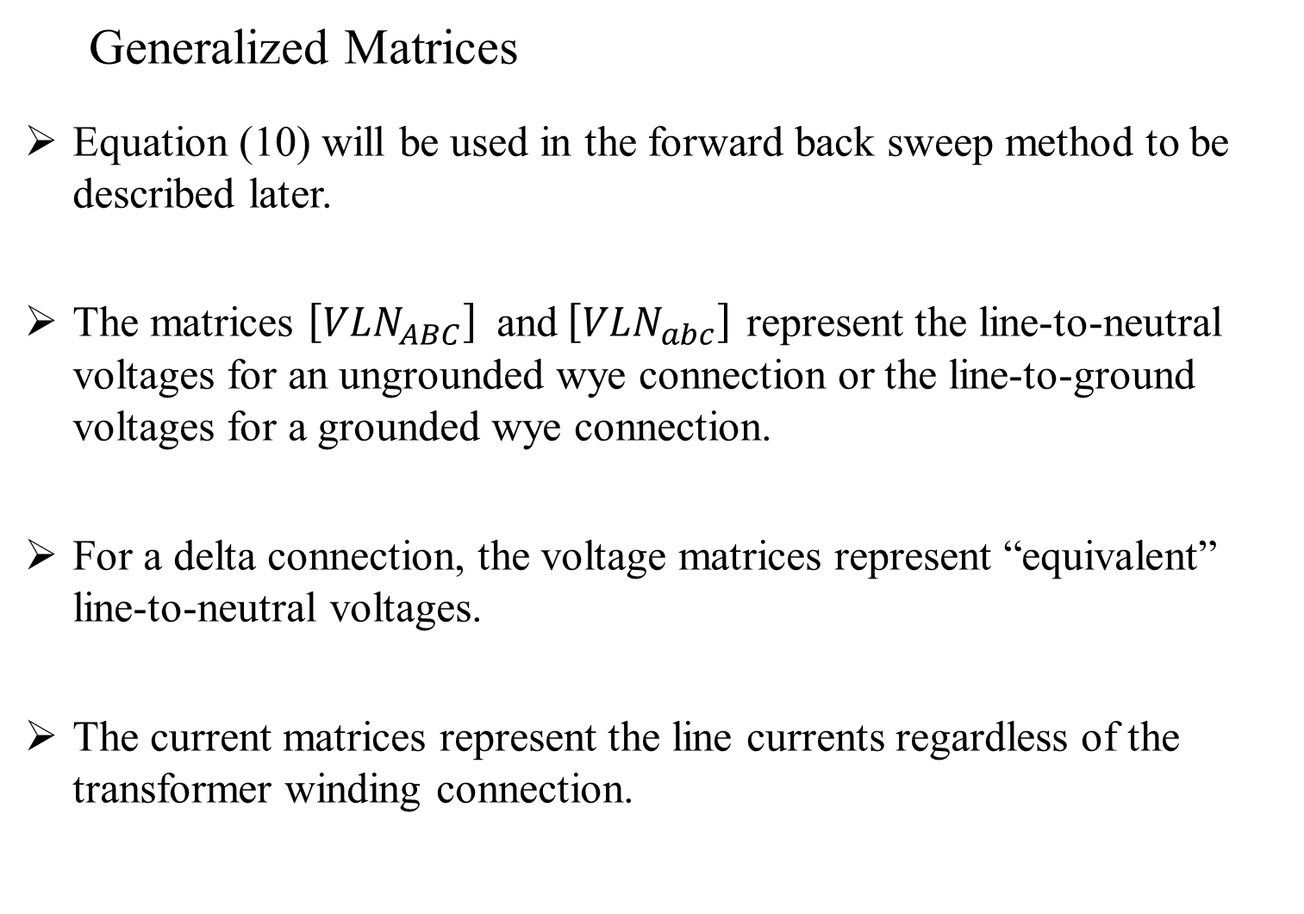
Three Phase Transformer Models
Generalized Matrices
Equation (10) will be used in the forward back sweep method to be described later.
The matrices $\left[{VLN}_{ABC}\right]$ and $\left[{VLN}_{abc}\right]$ represent the line-to-neutral voltages for an ungrounded wye connection or the line-to-ground voltages for a grounded wye connection.
For a delta connection, the voltage matrices represent “equivalent” line-to-neutral voltages.
The current matrices represent the line currents regardless of the transformer winding connection.

Slide 14
Part 3: Three Phase Transformer Models
Three Phase Transformer Models
General Three Phase Transformer Banks
Generalized Matrices
Symmetrical Components
The Delta-Grounded Wye Step Down Connection
The Ungrounded Wye-Delta Step Down Connection
The Grounded Wye-Grounded Wye Connection
The Delta-Delta Connection
Open Wye-Open Delta
Thevenin Equivalent Circuit

Slide 15
Quick Review – Symmetrical Components
Unbalanced systems cannot be studied in terms of balanced three phase voltages and currents
Hence the method of symmetrical components is used for unbalanced systems
If the original phasors are voltages, they may be designated Va, Vb, and Vc. The three sets of symmetrical components are designated by the additional subscript 1 for the positive-sequence components, 2 for the negative-sequence components, and 0 for the zero-sequence components

Slide 16
Quick Review – Symmetrical Components
The positive-sequence components of V_{a}, V_{b}, and V_{c} are V_{a1}, V_{b1}, and V_{c1}, respectively. Similarly, the negative-sequence components are V_{a2}, V_{b2}, and V_{c2}, and the zero-sequence components are V_{a0}, V_{b0}, and V_{c0}, respectively
V_{c1}
V_{b2}
V_{a0} = V_{b0} = V_{c0}
V_{a1}
V_{b1}
V_{c2}
V_{a2}
Positive-sequence
components
Negative-sequence
components
Zero-sequence
components
Fig: Three sets of balanced phasors which are the symmetrical components of three unbalanced phasors

Slide 17
Quick Review – Symmetrical Components
Since each of the original unbalanced phasors is the sum of its
components, the original phasors expressed in terms of their components are
The number of unknown quantities can be reduced by expressing
each component of V_{b} and V_{c} as the product of V_{a} and some function of the operator

Slide 18
Quick Review – Symmetrical Components
Symmetrical component equations for voltages
matrix form
where

Slide 19
Quick Review – Symmetrical Components
Which shows us how to solve three unsymmetrical phasors into their symmetrical components
Similar results apply to line-to-line voltages by replacing V_{ab}, V_{bc}, and V_{ca} in the above equations

Slide 20
Three Phase Transformer Models
Transformers that will be modeled in the coming slides……
1. The Delta-Grounded Wye Step Down Connection
Typically used in a distribution substation serving a four-wire wye feeder system.
Another application is to provide service to a load that is primarily single-phase, since three single-phase circuits are available.
2. The Ungrounded Wye Delta Connection
Typically used to provide service to a combination of single-phase “lighting” load and three-phase “power” load such as an induction motor.

Slide 21
Three Phase Transformer Models
Transformers that will be modeled in the coming slides……
3. The Grounded Wye-Grounded Wye Connection
Primarily used to supply single-phase and three-phase loads on four-wire multigrounded systems.
4. The Delta-Delta Connection
Primarily used on three-wire delta systems to provide service to a three-phase load or a combination of three-phase and single-phase loads.
5. Open Wye-Open Delta
Another connection used to supply a combination of single-phase and three-phase loads. Commonly used when the three-phase load is small compared to the single-phase load.

Slide 22
Part 3: Three Phase Transformer Models
Three Phase Transformer Models
General Three Phase Transformer Banks
Generalized Matrices
Symmetrical Components
The Delta-Grounded Wye Step Down Connection
The Ungrounded Wye-Delta Step Down Connection
The Grounded Wye-Grounded Wye Connection
The Delta-Delta Connection
Open Wye-Open Delta
Thevenin Equivalent Circuit

Slide 23
Three Phase Transformer Models
The Delta-Grounded Wye Step Down Connection
Typically used in a distribution substation serving a four-wire wye feeder system.
Another application is to provide service to a load that is primarily single-phase.
Because of the wye connection, three single-phase circuits are available, making it possible to balance the single phase loading on the transformer bank.

Slide 24
Three Phase Transformer Models
The Delta-Grounded Wye Step Down Connection
Figure 4.0

Slide 25
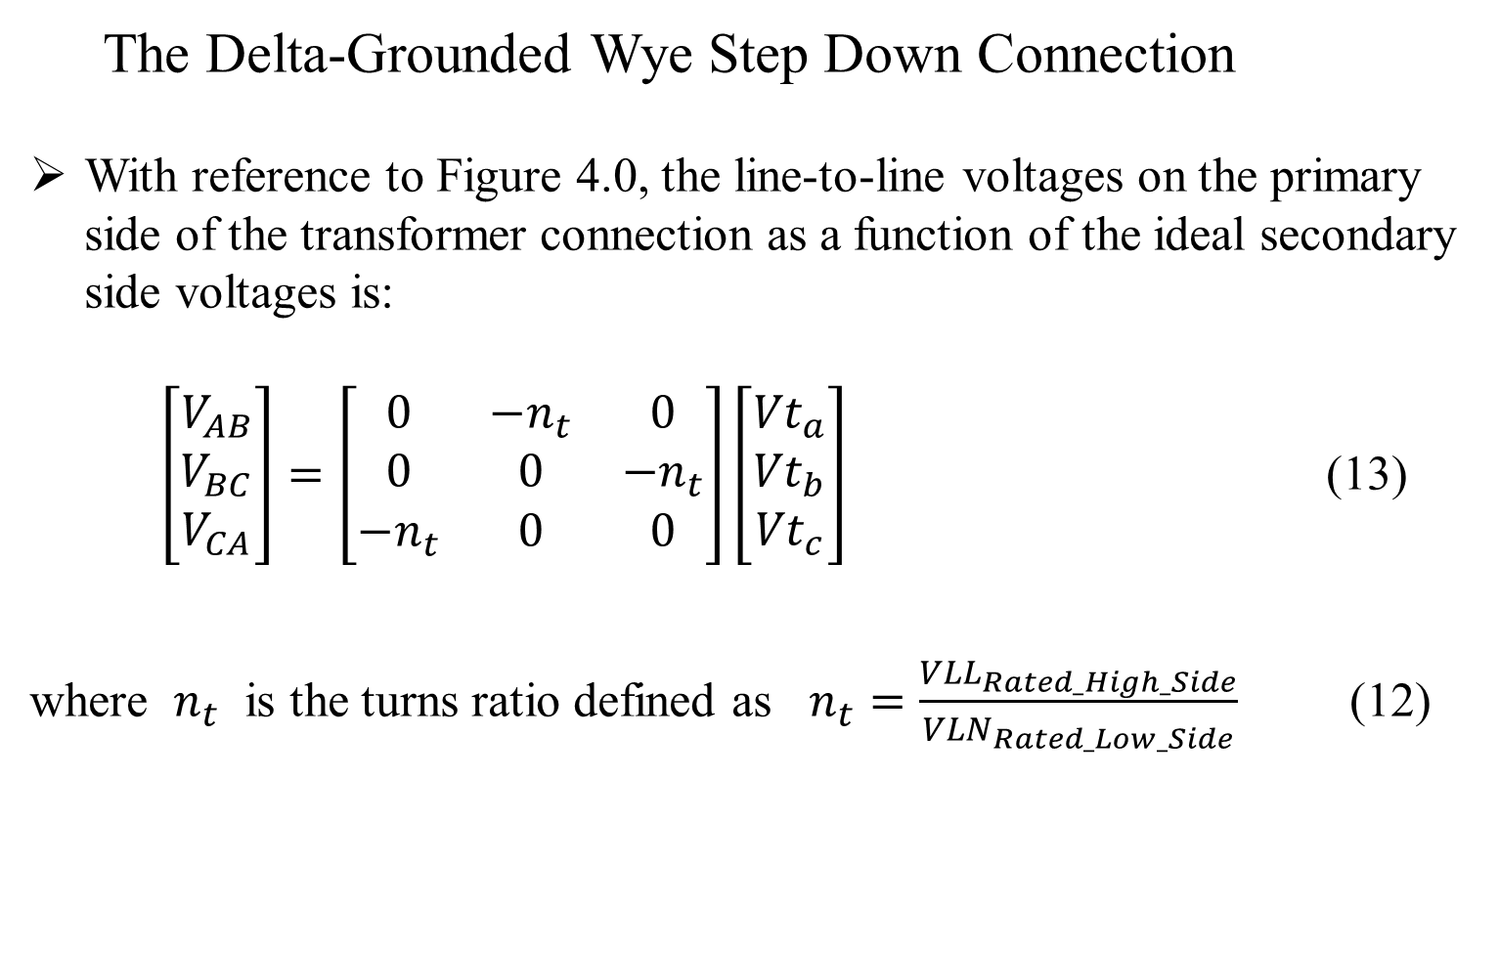
Three Phase Transformer Models
The Delta-Grounded Wye Step Down Connection
With reference to Figure 4.0, the line-to-line voltages on the primary side of the transformer connection as a function of the ideal secondary side voltages is:
$\left[\begin{matrix}V_{AB} \\ V_{BC} \\ V_{CA}\end{matrix}\right]=\left[\begin{matrix}0 & {−n}_{t} & 0 \\ 0 & 0 & {−n}_{t} \\ {−n}_{t} & 0 & 0\end{matrix}\right]\left[\begin{matrix}{Vt}_{a} \\ {Vt}_{b} \\ {Vt}_{c}\end{matrix}\right]$ (13)
where $n_{t}$ is the turns ratio defined as $n_{t}=\frac{{VLL}_{Rated_High_Side}}{{VLN}_{Rated_Low_Side}}$ (12)

Slide 26
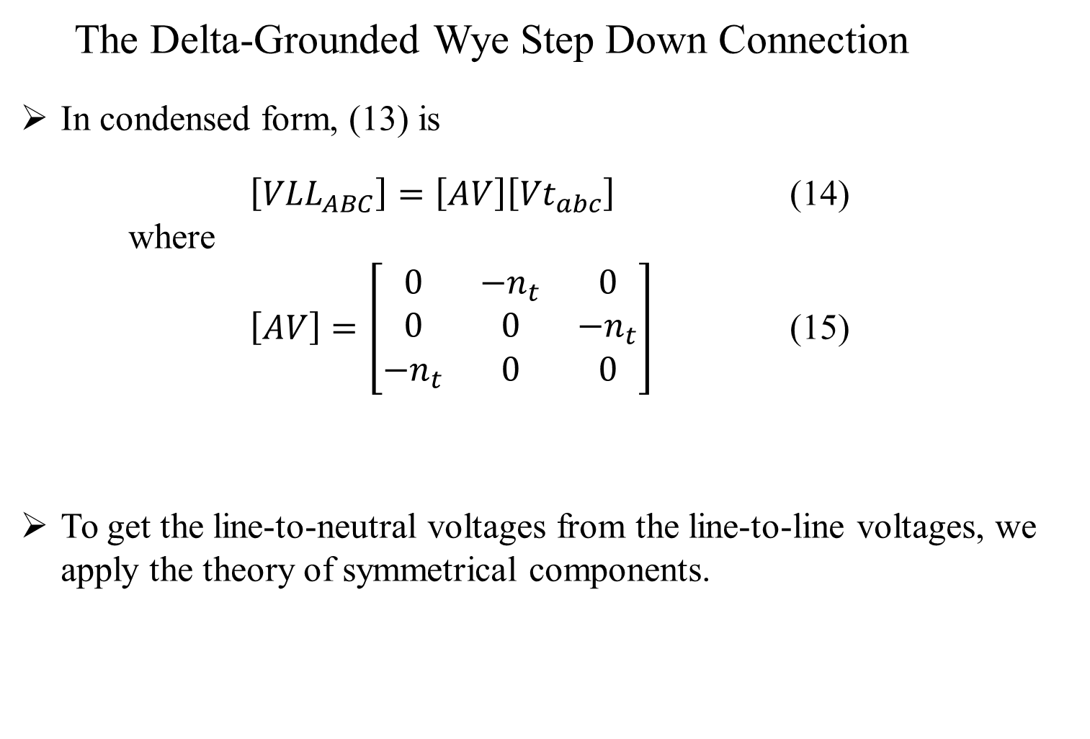
Three Phase Transformer Models
The Delta-Grounded Wye Step Down Connection
In condensed form, (13) is
$\left[{VLL}_{ABC}\right]=\left[AV\right]\left[{Vt}_{abc}\right]$ (14)
where
$\left[AV\right]=\left[\begin{matrix}0 & {−n}_{t} & 0 \\ 0 & 0 & {−n}_{t} \\ {−n}_{t} & 0 & 0\end{matrix}\right]$ (15)
To get the line-to-neutral voltages from the line-to-line voltages, we apply the theory of symmetrical components.

Slide 27
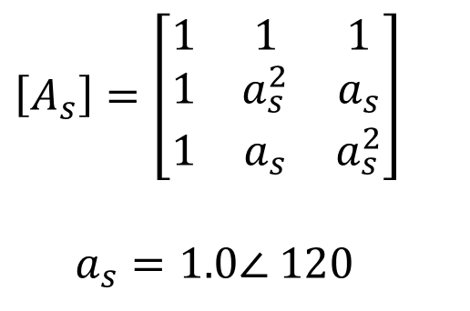
Three Phase Transformer Models
The Delta-Grounded Wye Step Down Connection
The known line-to-line voltages are transformed to their sequence voltages by:
$\left[{VLL}_{012}\right]={\left[A_{s}\right]}^{−1}∙\left[{VLL}_{ABC}\right]$ (16)
$\left[A_{s}\right]=\left[\begin{matrix}1 & 1 & 1 \\ 1 & a_{s}^{2} & a_{s} \\ 1 & a_{s} & a_{s}^{2}\end{matrix}\right]$
$a_{s}=1.0∠ 120$
where
(17)

Slide 28
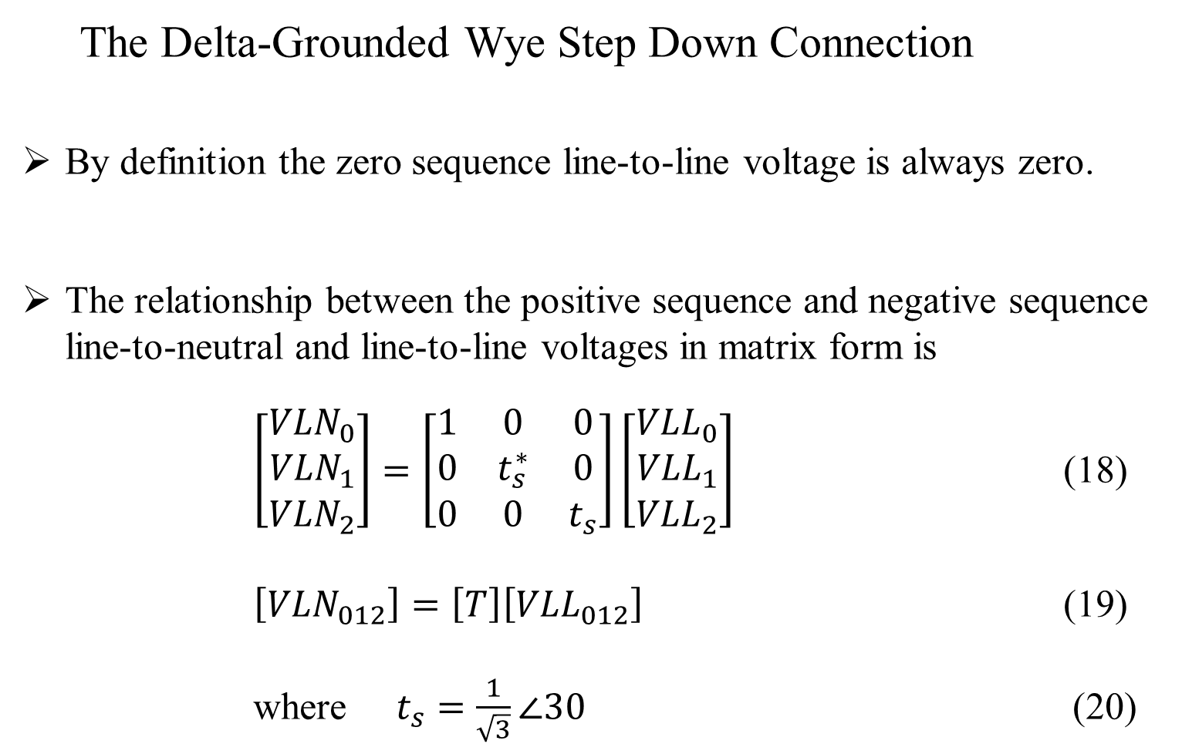
Three Phase Transformer Models
The Delta-Grounded Wye Step Down Connection
By definition the zero sequence line-to-line voltage is always zero.
The relationship between the positive sequence and negative sequence line-to-neutral and line-to-line voltages in matrix form is
$\left[\begin{matrix}{VLN}_{0} \\ {VLN}_{1} \\ {VLN}_{2}\end{matrix}\right]=\left[\begin{matrix}1 & 0 & 0 \\ 0 & t_{s}^{∗} & 0 \\ 0 & 0 & t_{s}\end{matrix}\right]\left[\begin{matrix}{VLL}_{0} \\ {VLL}_{1} \\ {VLL}_{2}\end{matrix}\right]$ (18)
$\left[{VLN}_{012}\right]=\left[T\right]\left[{VLL}_{012}\right]$ (19)
where $t_{s}=\frac{1}{\sqrt{3}}∠30$ (20)

Slide 29
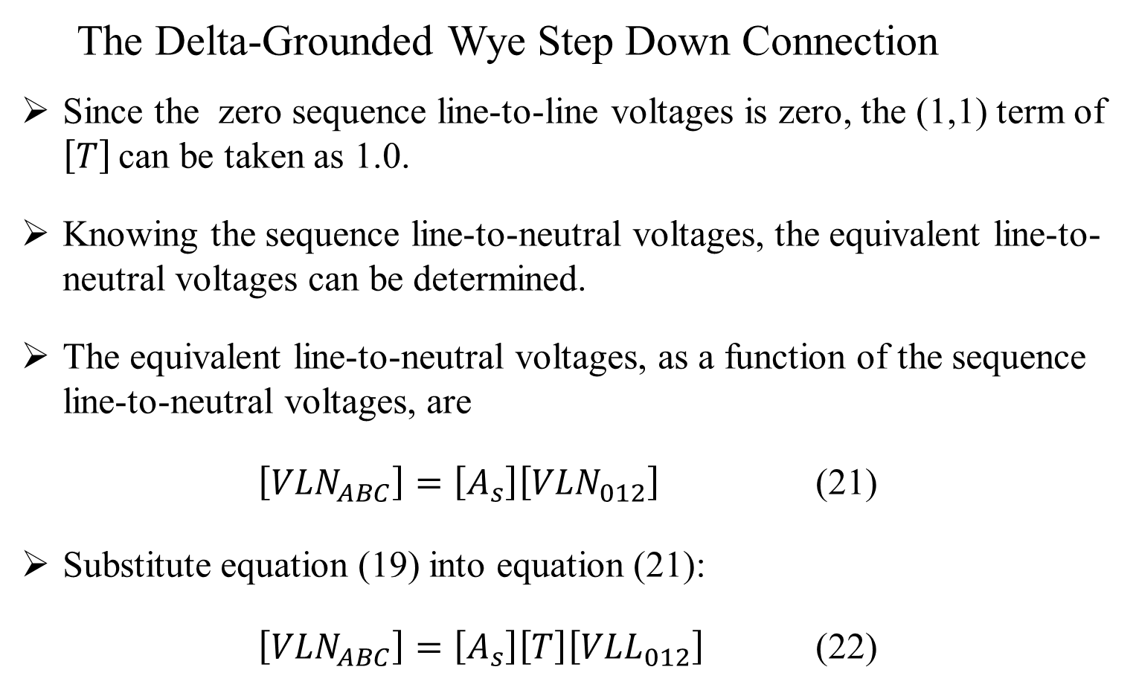
Three Phase Transformer Models
The Delta-Grounded Wye Step Down Connection
Since the zero sequence line-to-line voltages is zero, the (1,1) term of $\left[T\right]$ can be taken as 1.0.
Knowing the sequence line-to-neutral voltages, the equivalent line-to-neutral voltages can be determined.
The equivalent line-to-neutral voltages, as a function of the sequence line-to-neutral voltages, are
$\left[{VLN}_{ABC}\right]=\left[A_{s}\right]\left[{VLN}_{012}\right]$ (21)
Substitute equation (19) into equation (21):
$\left[{VLN}_{ABC}\right]=\left[A_{s}\right]\left[T\right]\left[{VLL}_{012}\right]$ (22)

Slide 30
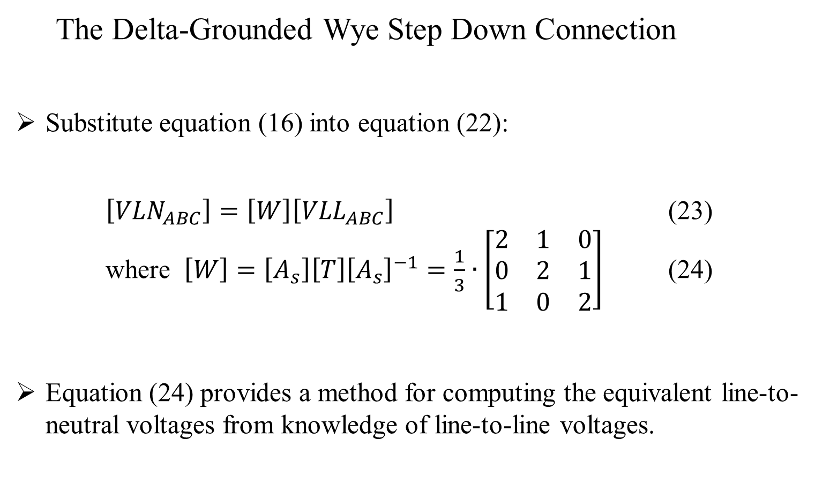
Three Phase Transformer Models
The Delta-Grounded Wye Step Down Connection
Substitute equation (16) into equation (22):
$\left[{VLN}_{ABC}\right]=\left[W\right]\left[{VLL}_{ABC}\right]$ (23)
where $\left[W\right]=\left[A_{s}\right]\left[T\right]{\left[A_{s}\right]}^{−1}=\frac{1}{3}∙\left[\begin{matrix}2 & 1 & 0 \\ 0 & 2 & 1 \\ 1 & 0 & 2\end{matrix}\right]$ (24)
Equation (24) provides a method for computing the equivalent line-to-neutral voltages from knowledge of line-to-line voltages.

Slide 31
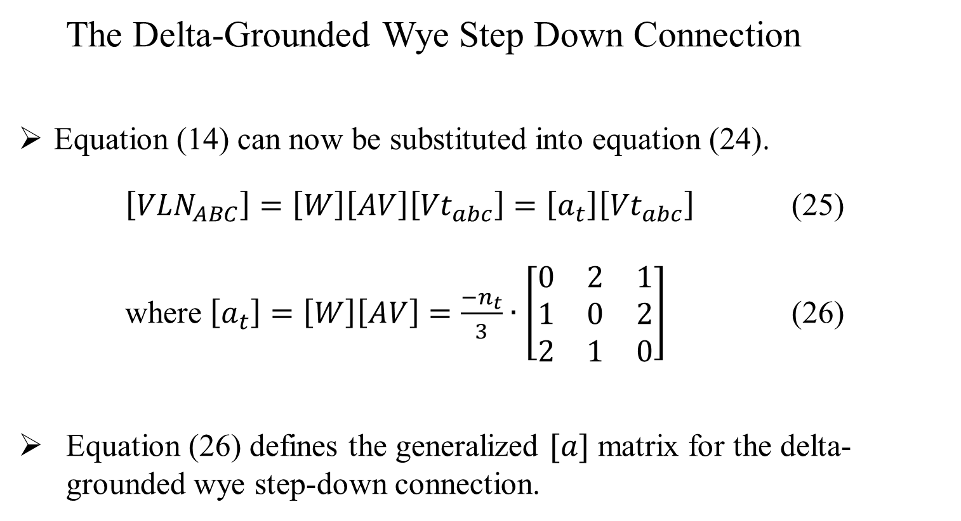
Three Phase Transformer Models
The Delta-Grounded Wye Step Down Connection
Equation (14) can now be substituted into equation (24).
$\left[{VLN}_{ABC}\right]=\left[W\right]\left[AV\right]\left[{Vt}_{abc}\right]=\left[a_{t}\right]\left[{Vt}_{abc}\right]$ (25)
where $\left[a_{t}\right]=\left[W\right]\left[AV\right]=\frac{{−n}_{t}}{3}∙\left[\begin{matrix}0 & 2 & 1 \\ 1 & 0 & 2 \\ 2 & 1 & 0\end{matrix}\right]$ (26)
Equation (26) defines the generalized $[a]$ matrix for the delta-grounded wye step-down connection.

Slide 32
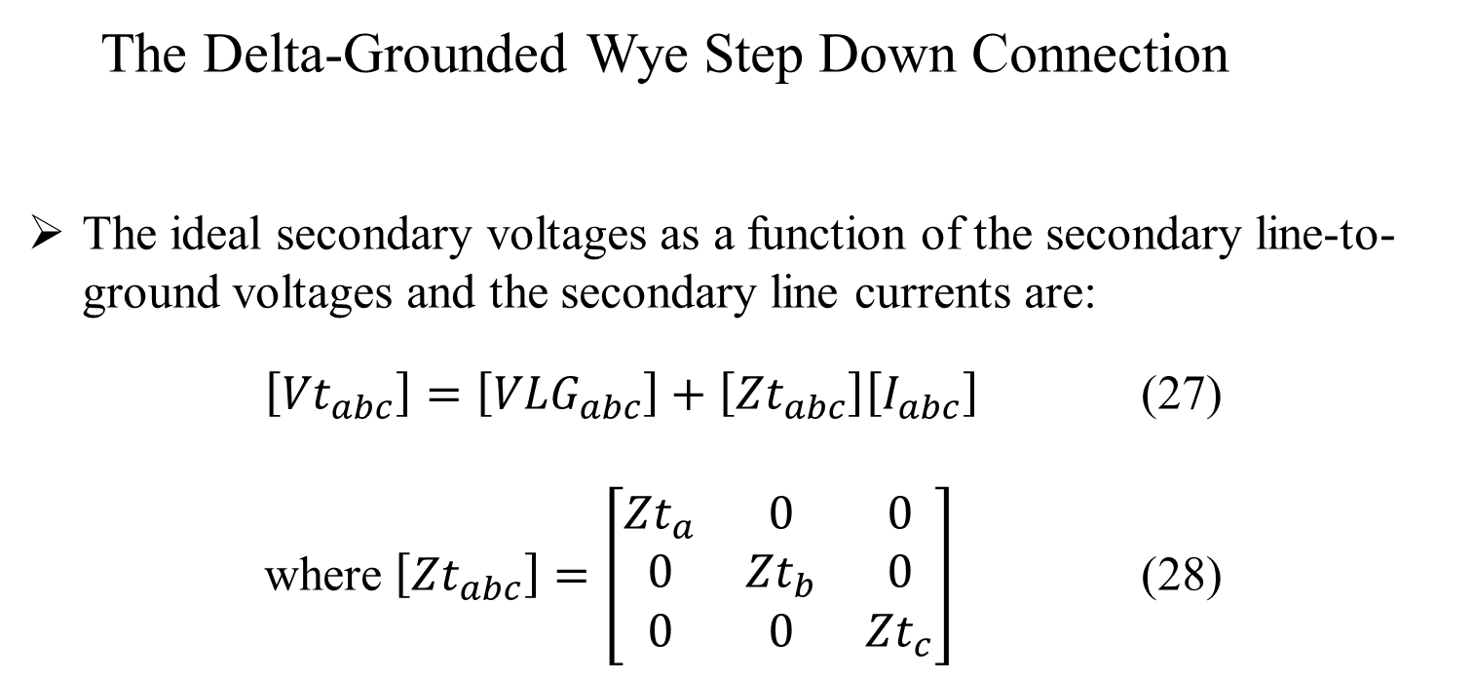
Three Phase Transformer Models
The Delta-Grounded Wye Step Down Connection
The ideal secondary voltages as a function of the secondary line-to-ground voltages and the secondary line currents are:
$\left[{Vt}_{abc}\right]=\left[{VLG}_{abc}\right]+\left[{Zt}_{abc}\right]\left[I_{abc}\right]$ (27)
where $\left[{Zt}_{abc}\right]=\left[\begin{matrix}{Zt}_{a} & 0 & 0 \\ 0 & {Zt}_{b} & 0 \\ 0 & 0 & {Zt}_{c}\end{matrix}\right]$ (28)

Slide 33
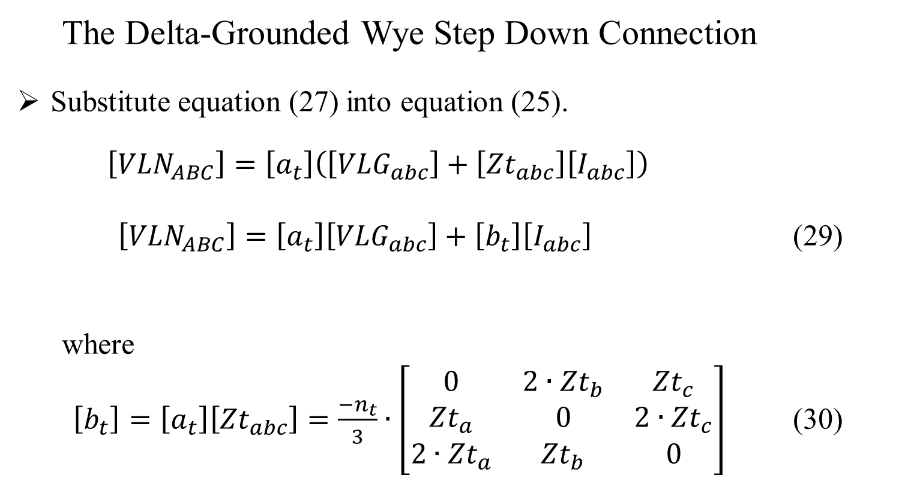
Three Phase Transformer Models
The Delta-Grounded Wye Step Down Connection
Substitute equation (27) into equation (25).
$\left[{VLN}_{ABC}\right]=\left[a_{t}\right]\left(\left[{VLG}_{abc}\right]+\left[{Zt}_{abc}\right]\left[I_{abc}\right]\right)$
$\left[{VLN}_{ABC}\right]=\left[a_{t}\right]\left[{VLG}_{abc}\right]+\left[b_{t}\right]\left[I_{abc}\right]$ (29)
where
$\left[b_{t}\right]=\left[a_{t}\right]\left[{Zt}_{abc}\right]=\frac{{−n}_{t}}{3}∙\left[\begin{matrix}0 & 2∙{Zt}_{b} & {Zt}_{c} \\ {Zt}_{a} & 0 & 2∙{Zt}_{c} \\ 2∙{Zt}_{a} & {Zt}_{b} & 0\end{matrix}\right]$ (30)

Slide 34
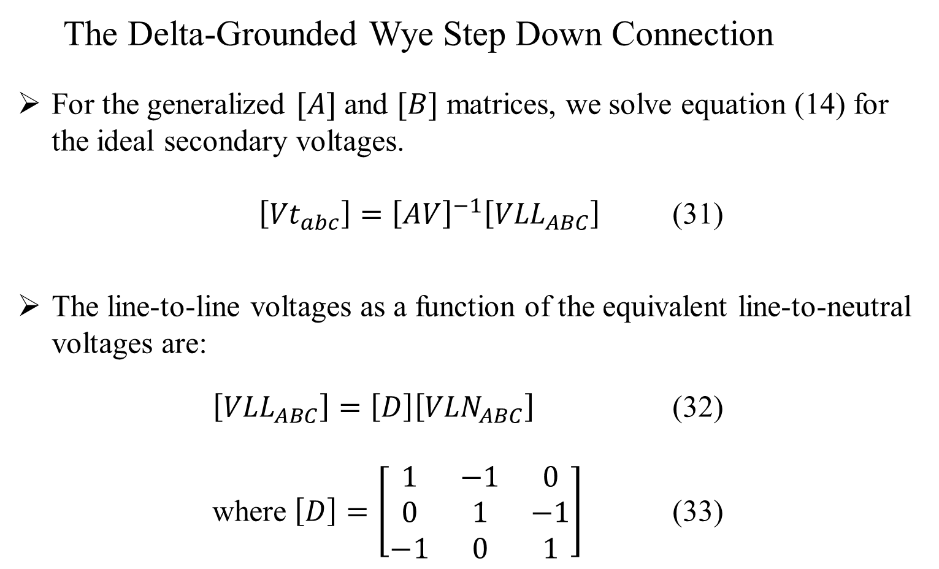
Three Phase Transformer Models
The Delta-Grounded Wye Step Down Connection
For the generalized $[A]$ and $[B]$ matrices, we solve equation (14) for the ideal secondary voltages.
$\left[{Vt}_{abc}\right]={\left[AV\right]}^{−1}\left[{VLL}_{ABC}\right]$ (31)
The line-to-line voltages as a function of the equivalent line-to-neutral voltages are:
$\left[{VLL}_{ABC}\right]=\left[D\right]\left[{VLN}_{ABC}\right]$ (32)
where $\left[D\right]=\left[\begin{matrix}1 & −1 & 0 \\ 0 & 1 & −1 \\ −1 & 0 & 1\end{matrix}\right]$ (33)

Slide 35
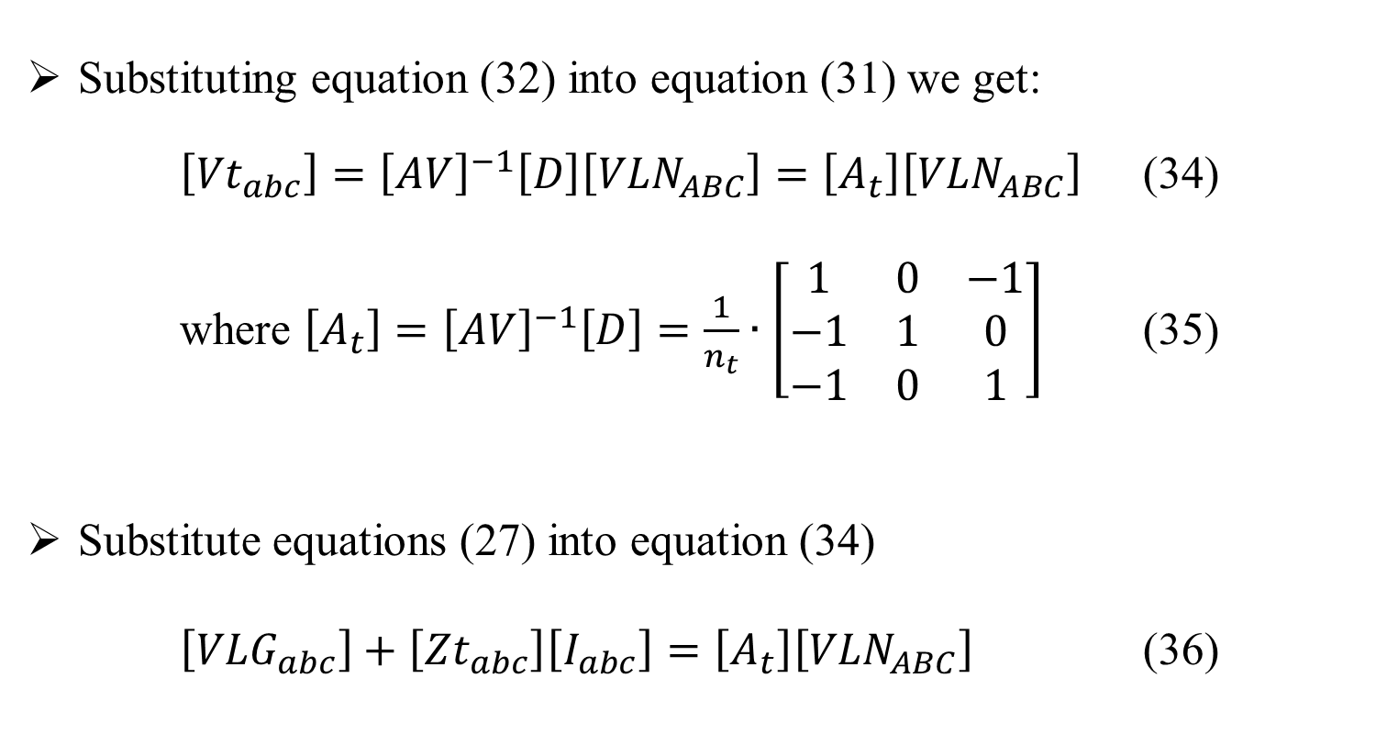
Three Phase Transformer Models
The Delta-Grounded Wye Step Down Connection
Substituting equation (32) into equation (31) we get:
$\left[{Vt}_{abc}\right]={\left[AV\right]}^{−1}\left[D\right]\left[{VLN}_{ABC}\right]=\left[A_{t}\right]\left[{VLN}_{ABC}\right]$ (34)
where $\left[A_{t}\right]={\left[AV\right]}^{−1}\left[D\right]=\frac{1}{n_{t}}∙\left[\begin{matrix}1 & 0 & −1 \\ −1 & 1 & 0 \\ −1 & 0 & 1\end{matrix}\right]$ (35)
Substitute equations (27) into equation (34)
$\left[{VLG}_{abc}\right]+\left[{Zt}_{abc}\right]\left[I_{abc}\right]=\left[A_{t}\right]\left[{VLN}_{ABC}\right]$ (36)

Slide 36
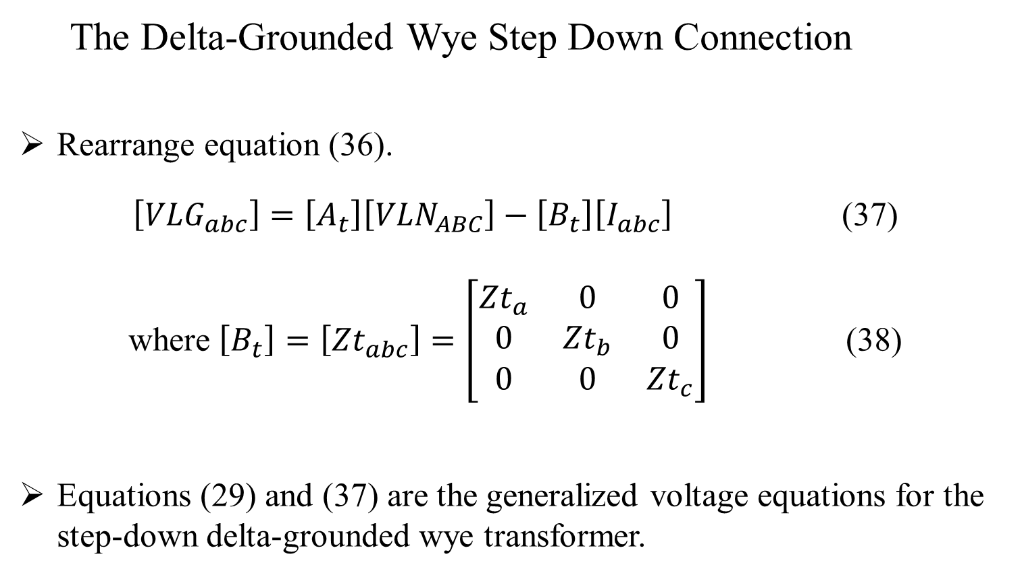
Three Phase Transformer Models
The Delta-Grounded Wye Step Down Connection
Rearrange equation (36).
$\left[{VLG}_{abc}\right]=\left[A_{t}\right]\left[{VLN}_{ABC}\right]−\left[B_{t}\right]\left[I_{abc}\right]$ (37)
where $\left[B_{t}\right]=\left[{Zt}_{abc}\right]=\left[\begin{matrix}{Zt}_{a} & 0 & 0 \\ 0 & {Zt}_{b} & 0 \\ 0 & 0 & {Zt}_{c}\end{matrix}\right]$ (38)
Equations (29) and (37) are the generalized voltage equations for the step-down delta-grounded wye transformer.

Slide 37
Three Phase Transformer Models
The Delta-Grounded Wye Step Down Connection
For currents, the thirty degree connection specifies that the positive sequence current entering H1 terminal will lead the positive sequence currents leaving the X1 terminal by 30 degrees.
Figure 5.0 shows the currents of the delta-grounded wye step down connection
Figure 5.0

Slide 38
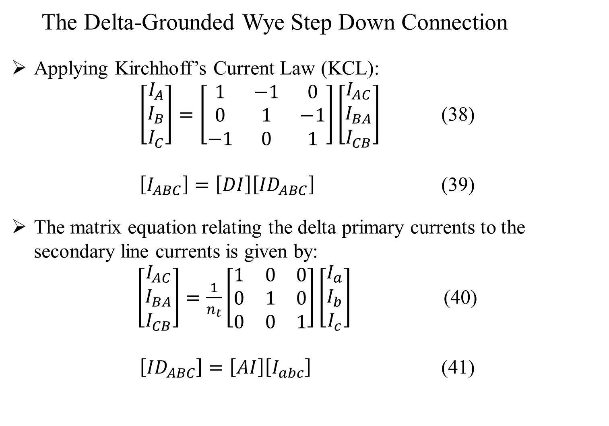
Three Phase Transformer Models
The Delta-Grounded Wye Step Down Connection
Applying Kirchhoff’s Current Law (KCL):
$\left[\begin{matrix}I_{A} \\ I_{B} \\ I_{C}\end{matrix}\right]=\left[\begin{matrix}1 & −1 & 0 \\ 0 & 1 & −1 \\ −1 & 0 & 1\end{matrix}\right]\left[\begin{matrix}I_{AC} \\ I_{BA} \\ I_{CB}\end{matrix}\right]$ (38)
$\left[I_{ABC}\right]=\left[DI\right]\left[{ID}_{ABC}\right]$ (39)
The matrix equation relating the delta primary currents to the secondary line currents is given by:
$\left[\begin{matrix}I_{AC} \\ I_{BA} \\ I_{CB}\end{matrix}\right]=\frac{1}{n_{t}}\left[\begin{matrix}1 & 0 & 0 \\ 0 & 1 & 0 \\ 0 & 0 & 1\end{matrix}\right]\left[\begin{matrix}I_{a} \\ I_{b} \\ I_{c}\end{matrix}\right]$ (40)
$\left[{ID}_{ABC}\right]=\left[AI\right]\left[I_{abc}\right]$ (41)

Slide 39
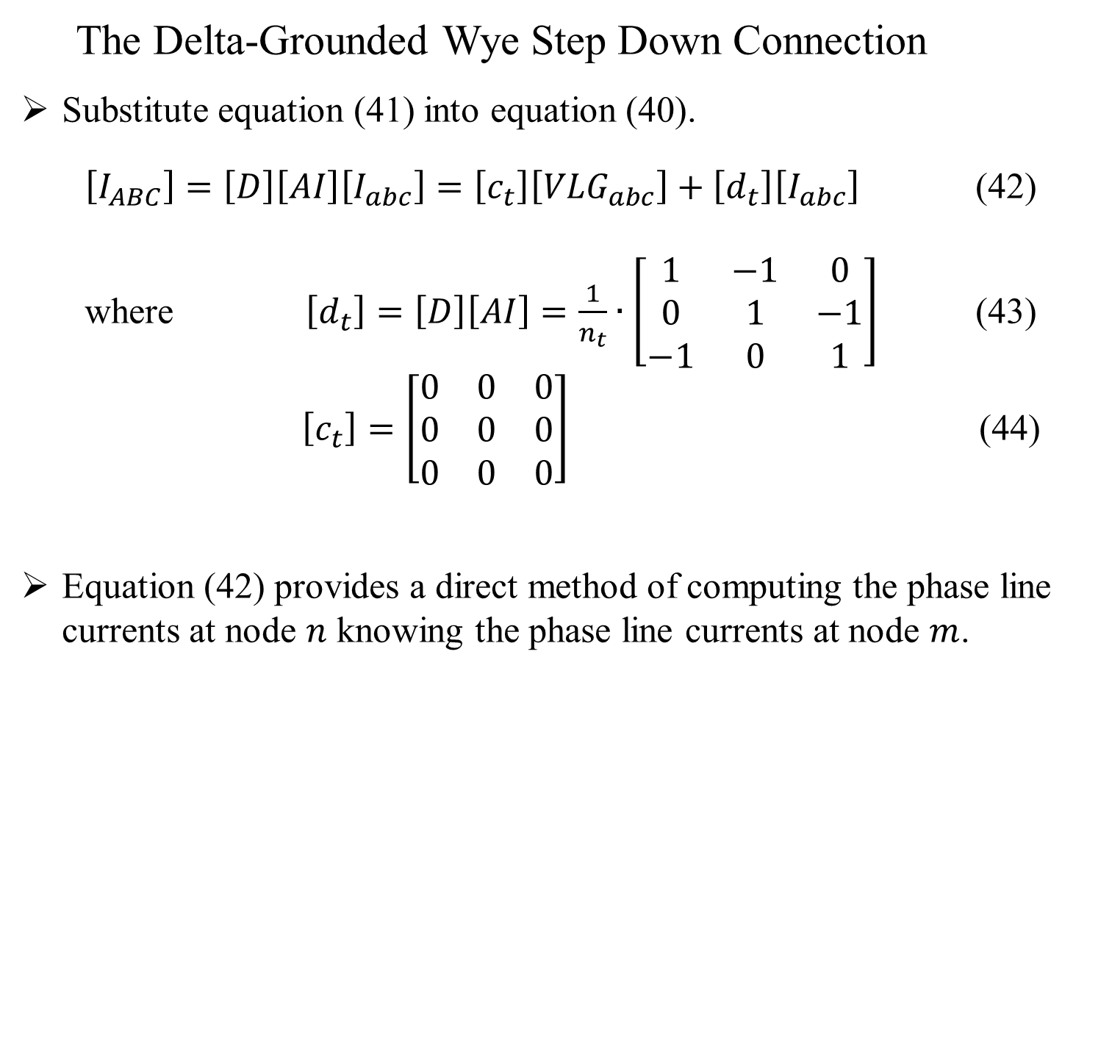
Three Phase Transformer Models
The Delta-Grounded Wye Step Down Connection
Substitute equation (41) into equation (40).
$\left[I_{ABC}\right]=\left[D\right]\left[AI\right]\left[I_{abc}\right]=\left[c_{t}\right]\left[{VLG}_{abc}\right]+\left[d_{t}\right]\left[I_{abc}\right]$ (42)
where $\left[d_{t}\right]=\left[D\right]\left[AI\right]=\frac{1}{n_{t}}∙\left[\begin{matrix}1 & −1 & 0 \\ 0 & 1 & −1 \\ −1 & 0 & 1\end{matrix}\right]$ (43)
$\left[c_{t}\right]=\left[\begin{matrix}0 & 0 & 0 \\ 0 & 0 & 0 \\ 0 & 0 & 0\end{matrix}\right]$ (44)
Equation (42) provides a direct method of computing the phase line currents at node $n$ knowing the phase line currents at node $m$.

Slide 40
Three Phase Transformer Models
The Delta-Grounded Wye Step Down Connection
The equations derived here were for the step down connection.
The procedure for the step up connection will be the same, except the connection between the transformer windings will be different, as will be the definition of the generalized matrices.

Slide 41
Part 3: Three Phase Transformer Models
Three Phase Transformer Models
General Three Phase Transformer Banks
Generalized Matrices
Symmetrical Components
The Delta-Grounded Wye Step Down Connection
The Ungrounded Wye-Delta Step Down Connection
The Grounded Wye-Grounded Wye Connection
The Delta-Delta Connection
Open Wye-Open Delta
Thevenin Equivalent Circuit

Slide 42
Three Phase Transformer Models
The Ungrounded Wye-Delta Step Down Connection
Three single-phase transformers can be connected in a wye-delta connection and the neutral of the wye can be grounded or ungrounded.
The grounded wye is rarely used because:
The grounded wye provides a path for the zero sequence currents for line-to-ground faults upstream from the transformer bank and can cause the transformers to be susceptible to burnouts.
If one phase of the primary circuit is opened, the transformer bank will continue to provide a three phase service, however the remaining two transformers may be subject to overload.
Thus, the ungrounded wye-delta connection is used to provide service to a combination of single-phase “lighting” load and a three-phase “power” load such as an induction motor.

Slide 43
Three Phase Transformer Models
The Ungrounded Wye-Delta Step Down Connection
Figure 6.0

Slide 44

Three Phase Transformer Models
The Ungrounded Wye-Delta Step Down Connection
The basic ideal transformer voltage and current equations as a function of the turns ratio are:
Figure 7.0
$\left[\begin{matrix}V_{AN} \\ V_{BN} \\ V_{CN}\end{matrix}\right]=\left[\begin{matrix}n_{t} & 0 & 0 \\ 0 & n_{t} & 0 \\ 0 & 0 & n_{t}\end{matrix}\right]\left[\begin{matrix}{Vt}_{ab} \\ {Vt}_{bc} \\ {Vt}_{ca}\end{matrix}\right]$
where $n_{t}=\frac{{VLN}_{Rated_High_Side}}{{VLL}_{Rated_Low_Side}}$ (45)

Slide 45
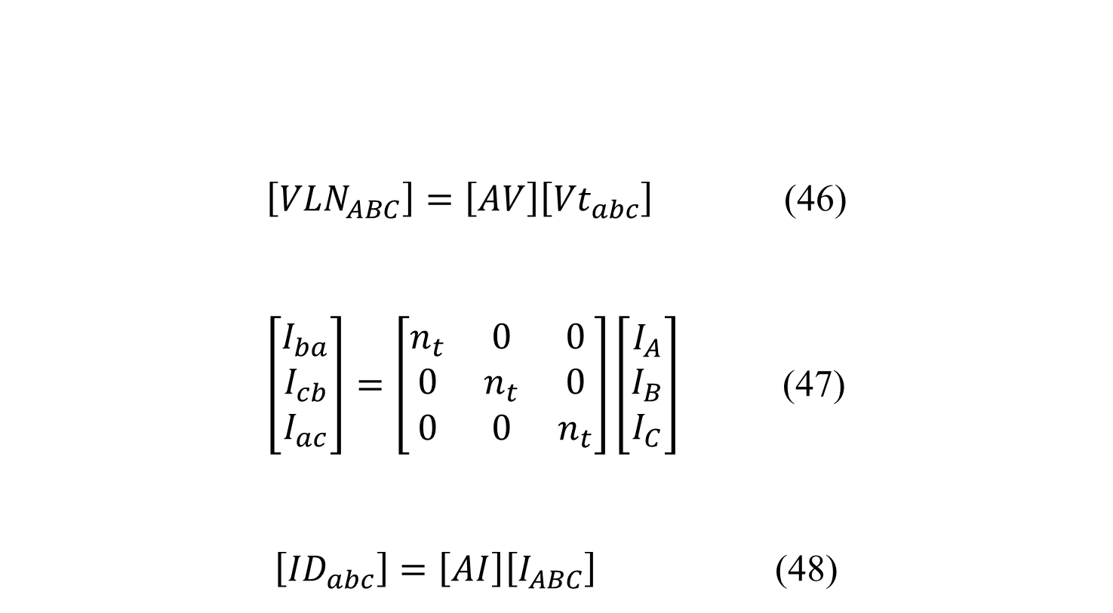
Three Phase Transformer Models
The Ungrounded Wye-Delta Step Down Connection
$\left[{VLN}_{ABC}\right]=\left[AV\right]\left[{Vt}_{abc}\right]$ (46)
$\left[\begin{matrix}I_{ba} \\ I_{cb} \\ I_{ac}\end{matrix}\right]=\left[\begin{matrix}n_{t} & 0 & 0 \\ 0 & n_{t} & 0 \\ 0 & 0 & n_{t}\end{matrix}\right]\left[\begin{matrix}I_{A} \\ I_{B} \\ I_{C}\end{matrix}\right]$ (47)
$\left[{ID}_{abc}\right]=\left[AI\right]\left[I_{ABC}\right]$ (48)
The basic ideal transformer voltage and current equations as a function of the turns ratio (continued):

Slide 46
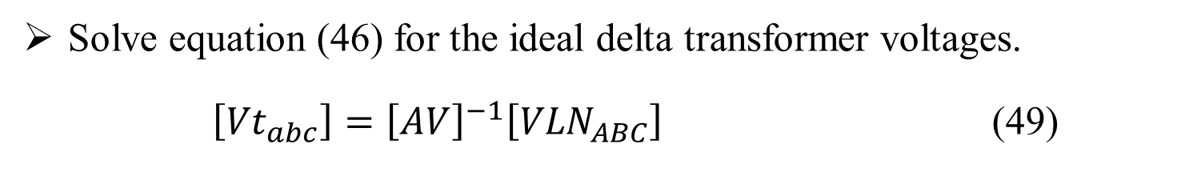
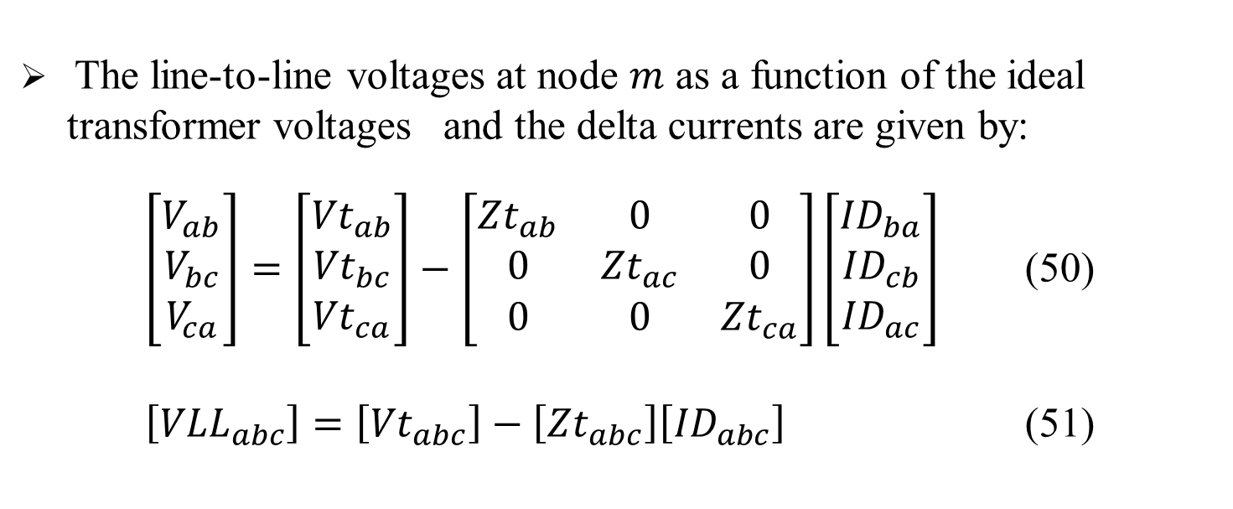
Three Phase Transformer Models
The Ungrounded Wye-Delta Step Down Connection
Solve equation (46) for the ideal delta transformer voltages.
$\left[{Vt}_{abc}\right]={\left[AV\right]}^{−1}\left[{VLN}_{ABC}\right]$ (49)
The line-to-line voltages at node $m$ as a function of the ideal transformer voltages and the delta currents are given by:
$\left[\begin{matrix}V_{ab} \\ V_{bc} \\ V_{ca}\end{matrix}\right]=\left[\begin{matrix}{Vt}_{ab} \\ {Vt}_{bc} \\ {Vt}_{ca}\end{matrix}\right]−\left[\begin{matrix}{Zt}_{ab} & 0 & 0 \\ 0 & {Zt}_{ac} & 0 \\ 0 & 0 & {Zt}_{ca}\end{matrix}\right]\left[\begin{matrix}{ID}_{ba} \\ {ID}_{cb} \\ {ID}_{ac}\end{matrix}\right]$ (50)
$\left[{VLL}_{abc}\right]=\left[{Vt}_{abc}\right]−\left[{Zt}_{abc}\right]\left[{ID}_{abc}\right]$ (51)

Slide 47
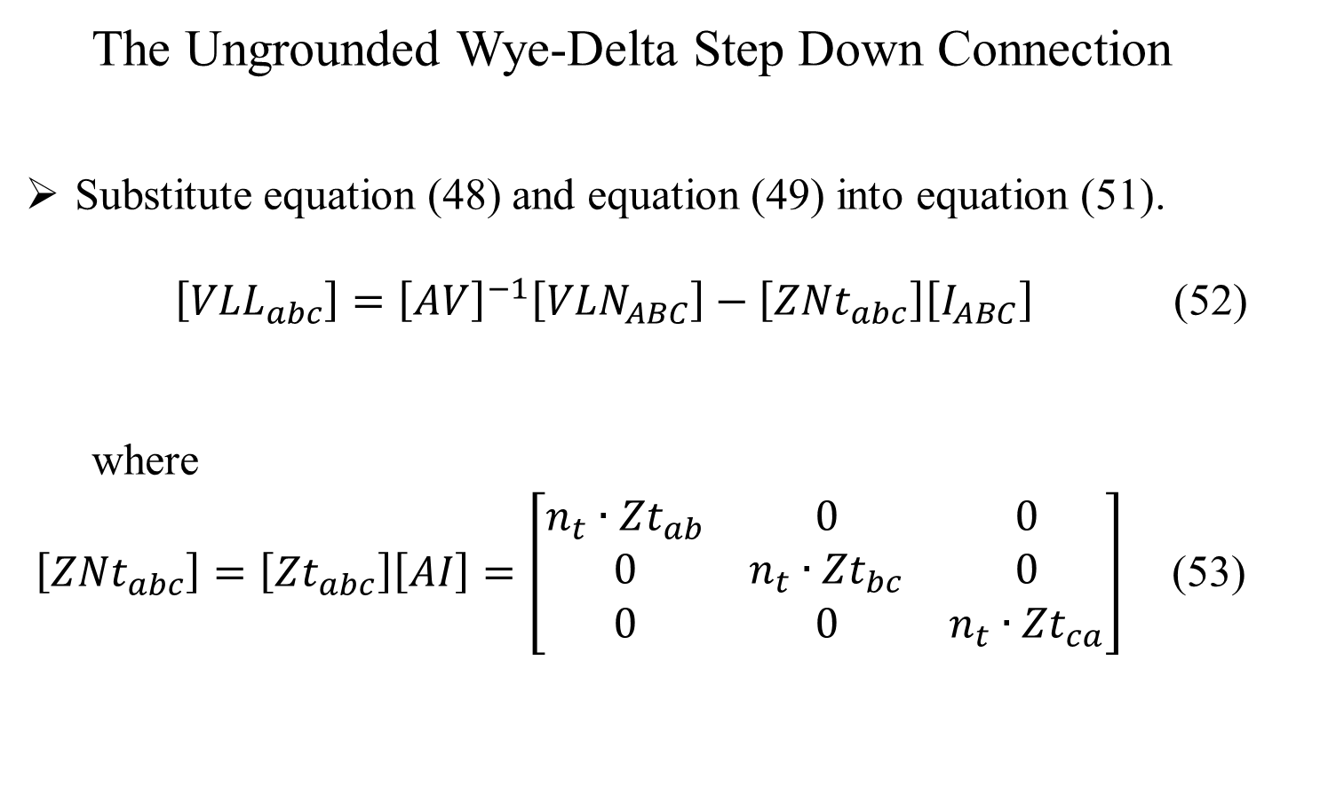
Three Phase Transformer Models
The Ungrounded Wye-Delta Step Down Connection
Substitute equation (48) and equation (49) into equation (51).
$\left[{VLL}_{abc}\right]={\left[AV\right]}^{−1}\left[{VLN}_{ABC}\right]−\left[{ZNt}_{abc}\right]\left[I_{ABC}\right]$ (52)
where
$\left[{ZNt}_{abc}\right]=\left[{Zt}_{abc}\right]\left[AI\right]=\left[\begin{matrix}n_{t}∙{Zt}_{ab} & 0 & 0 \\ 0 & n_{t}∙{Zt}_{bc} & 0 \\ 0 & 0 & n_{t}∙{Zt}_{ca}\end{matrix}\right]$ (53)

Slide 48
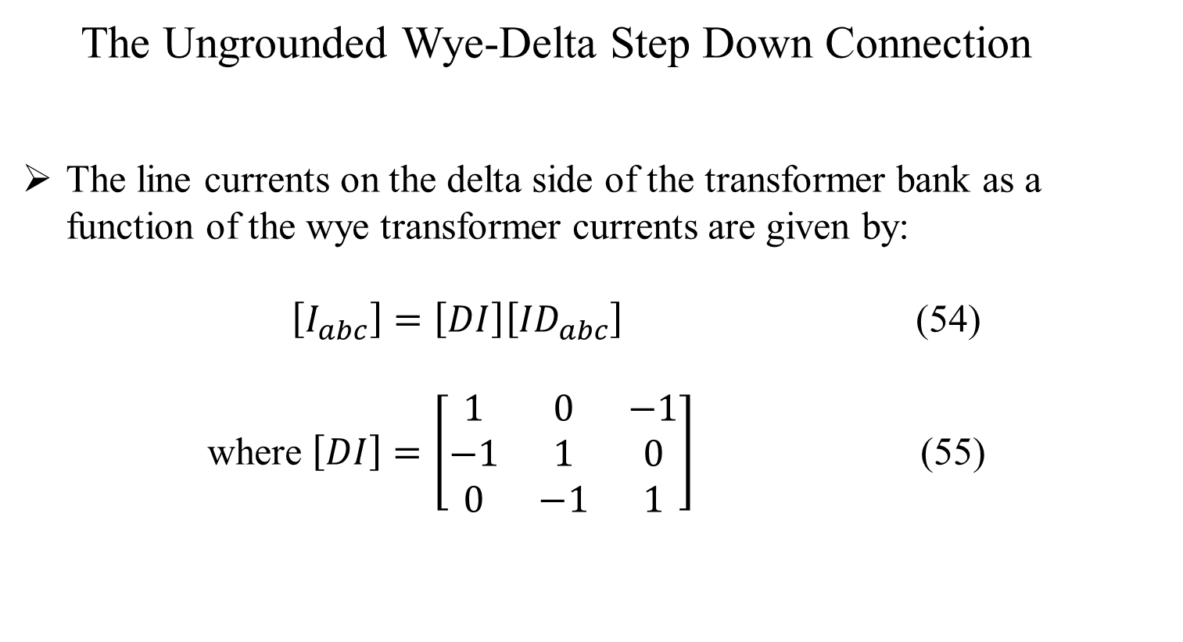
Three Phase Transformer Models
The Ungrounded Wye-Delta Step Down Connection
The line currents on the delta side of the transformer bank as a function of the wye transformer currents are given by:
$\left[I_{abc}\right]=\left[DI\right]\left[{ID}_{abc}\right]$ (54)
where $\left[DI\right]=\left[\begin{matrix}1 & 0 & −1 \\ −1 & 1 & 0 \\ 0 & −1 & 1\end{matrix}\right]$ (55)

Slide 49
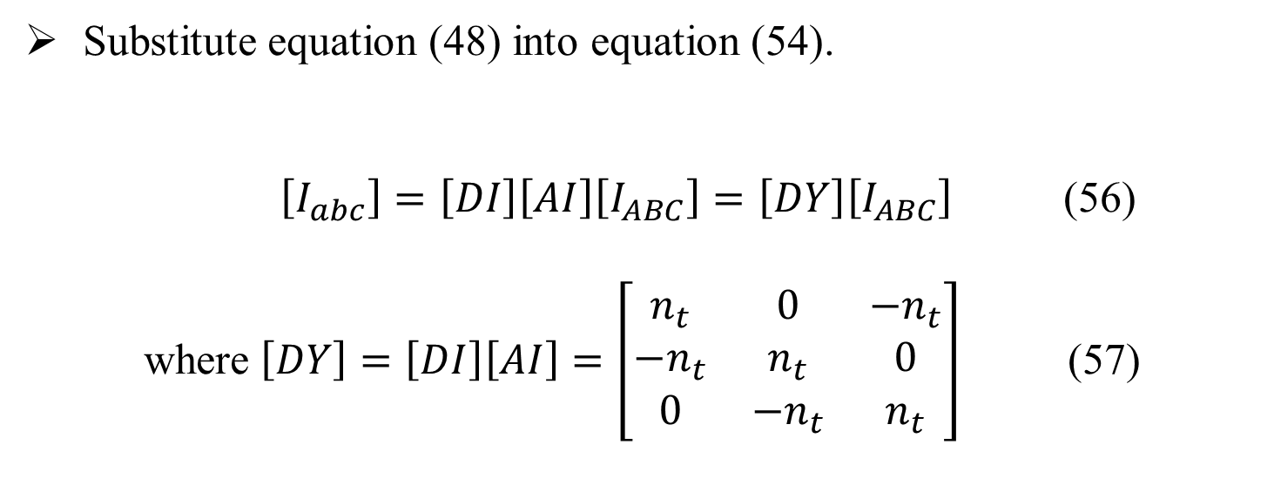
Three Phase Transformer Models
The Ungrounded Wye-Delta Step Down Connection
Substitute equation (48) into equation (54).
$\left[I_{abc}\right]=\left[DI\right]\left[AI\right]\left[I_{ABC}\right]=\left[DY\right]\left[I_{ABC}\right]$ (56)
where $\left[DY\right]=\left[DI\right]\left[AI\right]=\left[\begin{matrix}n_{t} & 0 & {−n}_{t} \\ {−n}_{t} & n_{t} & 0 \\ 0 & {−n}_{t} & n_{t}\end{matrix}\right]$ (57)

Slide 50
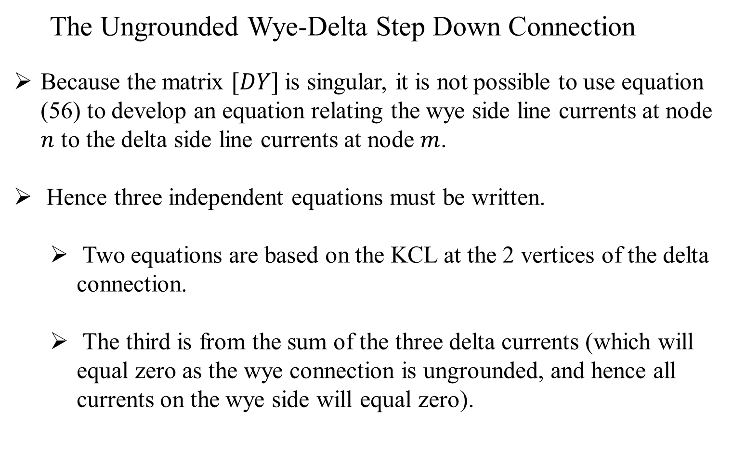
Three Phase Transformer Models
The Ungrounded Wye-Delta Step Down Connection
Because the matrix $[DY]$is singular, it is not possible to use equation (56) to develop an equation relating the wye side line currents at node $n$ to the delta side line currents at node $m$.
Hence three independent equations must be written.
Two equations are based on the KCL at the 2 vertices of the delta connection.
The third is from the sum of the three delta currents (which will equal zero as the wye connection is ungrounded, and hence all currents on the wye side will equal zero).

Slide 51
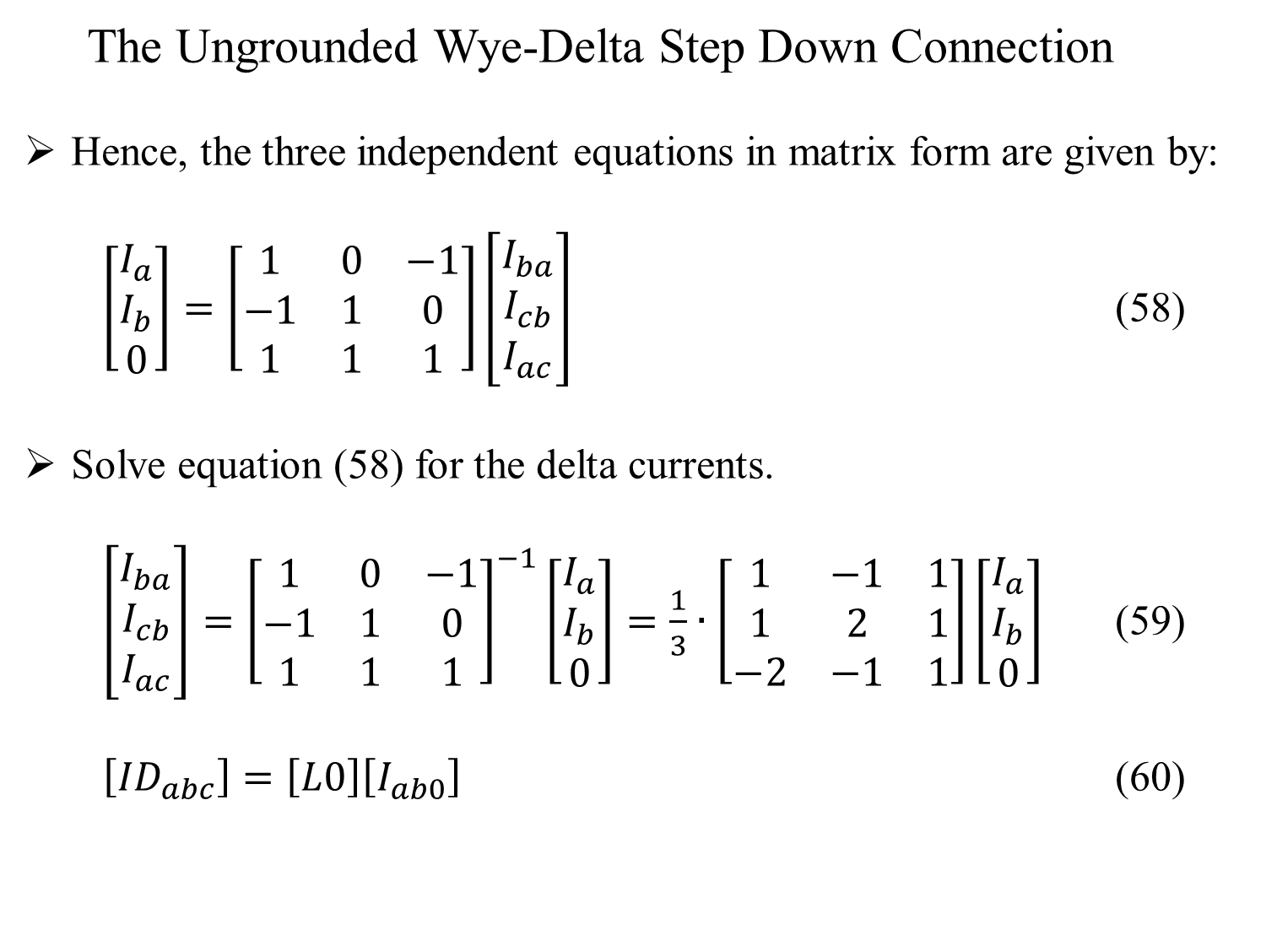
Three Phase Transformer Models
The Ungrounded Wye-Delta Step Down Connection
Hence, the three independent equations in matrix form are given by:
$\left[\begin{matrix}I_{a} \\ I_{b} \\ 0\end{matrix}\right]=\left[\begin{matrix}1 & 0 & −1 \\ −1 & 1 & 0 \\ 1 & 1 & 1\end{matrix}\right]\left[\begin{matrix}I_{ba} \\ I_{cb} \\ I_{ac}\end{matrix}\right]$ (58)
Solve equation (58) for the delta currents.
$\left[\begin{matrix}I_{ba} \\ I_{cb} \\ I_{ac}\end{matrix}\right]={\left[\begin{matrix}1 & 0 & −1 \\ −1 & 1 & 0 \\ 1 & 1 & 1\end{matrix}\right]}^{−1}\left[\begin{matrix}I_{a} \\ I_{b} \\ 0\end{matrix}\right]=\frac{1}{3}∙\left[\begin{matrix}1 & −1 & 1 \\ 1 & 2 & 1 \\ −2 & −1 & 1\end{matrix}\right]\left[\begin{matrix}I_{a} \\ I_{b} \\ 0\end{matrix}\right]$ (59)
$\left[{ID}_{abc}\right]=\left[L0\right]\left[I_{ab0}\right]$ (60)

Slide 52
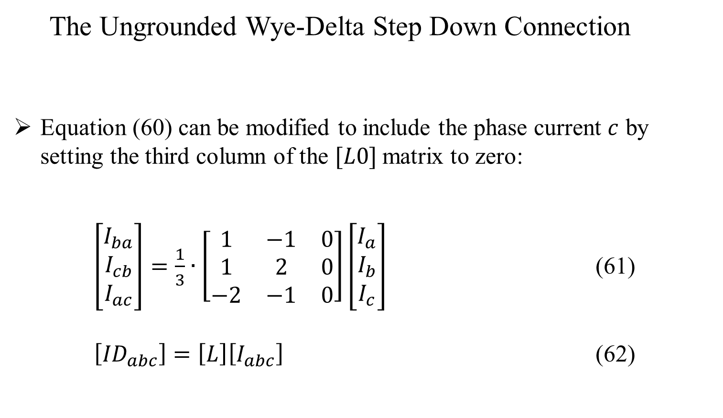
Three Phase Transformer Models
The Ungrounded Wye-Delta Step Down Connection
Equation (60) can be modified to include the phase current $c$ by setting the third column of the $[L0]$matrix to zero:
$\left[\begin{matrix}I_{ba} \\ I_{cb} \\ I_{ac}\end{matrix}\right]=\frac{1}{3}∙\left[\begin{matrix}1 & −1 & 0 \\ 1 & 2 & 0 \\ −2 & −1 & 0\end{matrix}\right]\left[\begin{matrix}I_{a} \\ I_{b} \\ I_{c}\end{matrix}\right]$ (61)
$\left[{ID}_{abc}\right]=\left[L\right]\left[I_{abc}\right]$ (62)

Slide 53
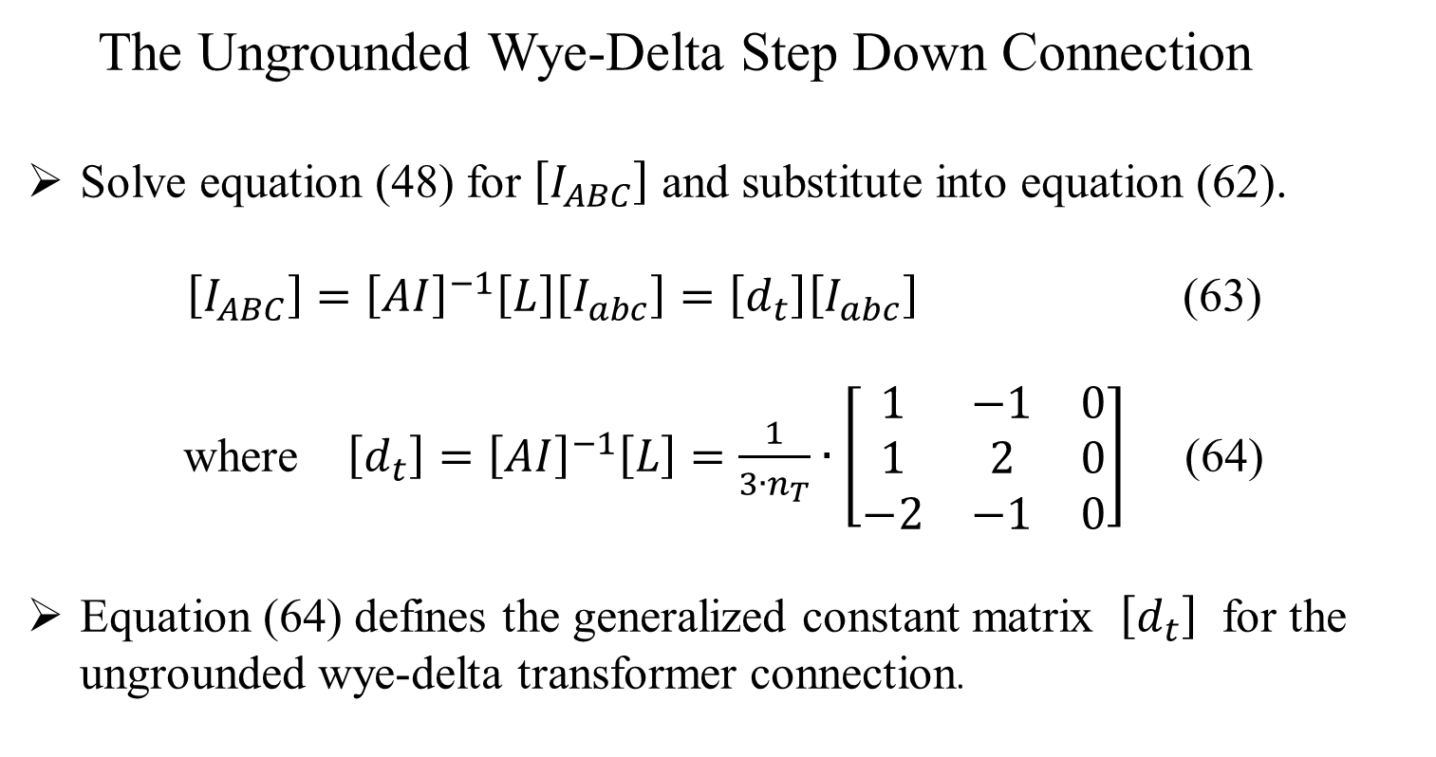
Three Phase Transformer Models
The Ungrounded Wye-Delta Step Down Connection
Solve equation (48) for $\left[I_{ABC}\right]$ and substitute into equation (62).
$\left[I_{ABC}\right]={\left[AI\right]}^{−1}\left[L\right]\left[I_{abc}\right]=\left[d_{t}\right]\left[I_{abc}\right]$ (63)
where $\left[d_{t}\right]={\left[AI\right]}^{−1}\left[L\right]=\frac{1}{3∙n_{T}}∙\left[\begin{matrix}1 & −1 & 0 \\ 1 & 2 & 0 \\ −2 & −1 & 0\end{matrix}\right]$ (64)
Equation (64) defines the generalized constant matrix $\left[d_{t}\right]$ for the ungrounded wye-delta transformer connection.

Slide 54
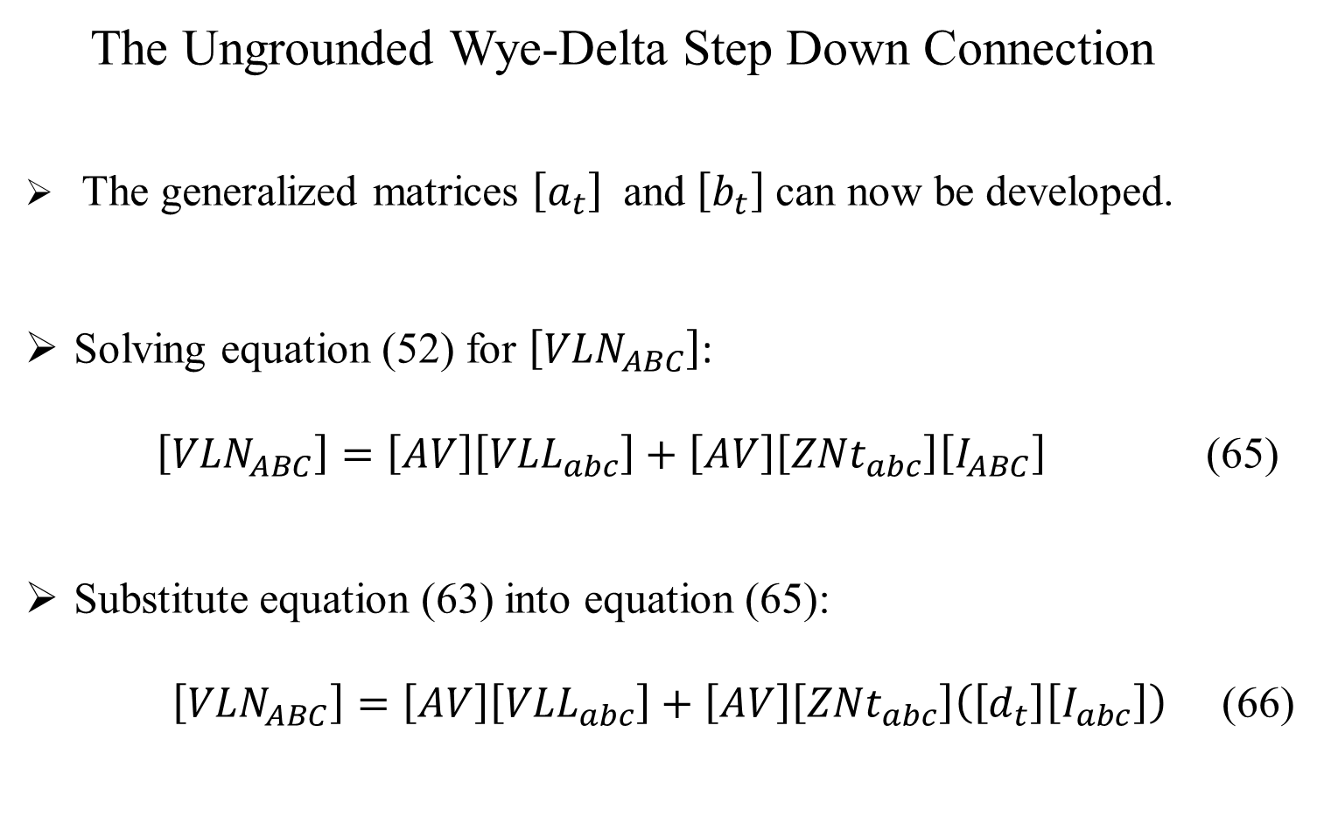
Three Phase Transformer Models
The Ungrounded Wye-Delta Step Down Connection
The generalized matrices $\left[a_{t}\right]$ and $\left[b_{t}\right]$ can now be developed.
Solving equation (52) for $\left[{VLN}_{ABC}\right]$:
$\left[{VLN}_{ABC}\right]=\left[AV\right]\left[{VLL}_{abc}\right]+\left[AV\right]\left[{ZNt}_{abc}\right]\left[I_{ABC}\right]$ (65)
Substitute equation (63) into equation (65):
$\left[{VLN}_{ABC}\right]=\left[AV\right]\left[{VLL}_{abc}\right]+\left[AV\right]\left[{ZNt}_{abc}\right]\left(\left[d_{t}\right]\left[I_{abc}\right]\right)$ (66)

Slide 55
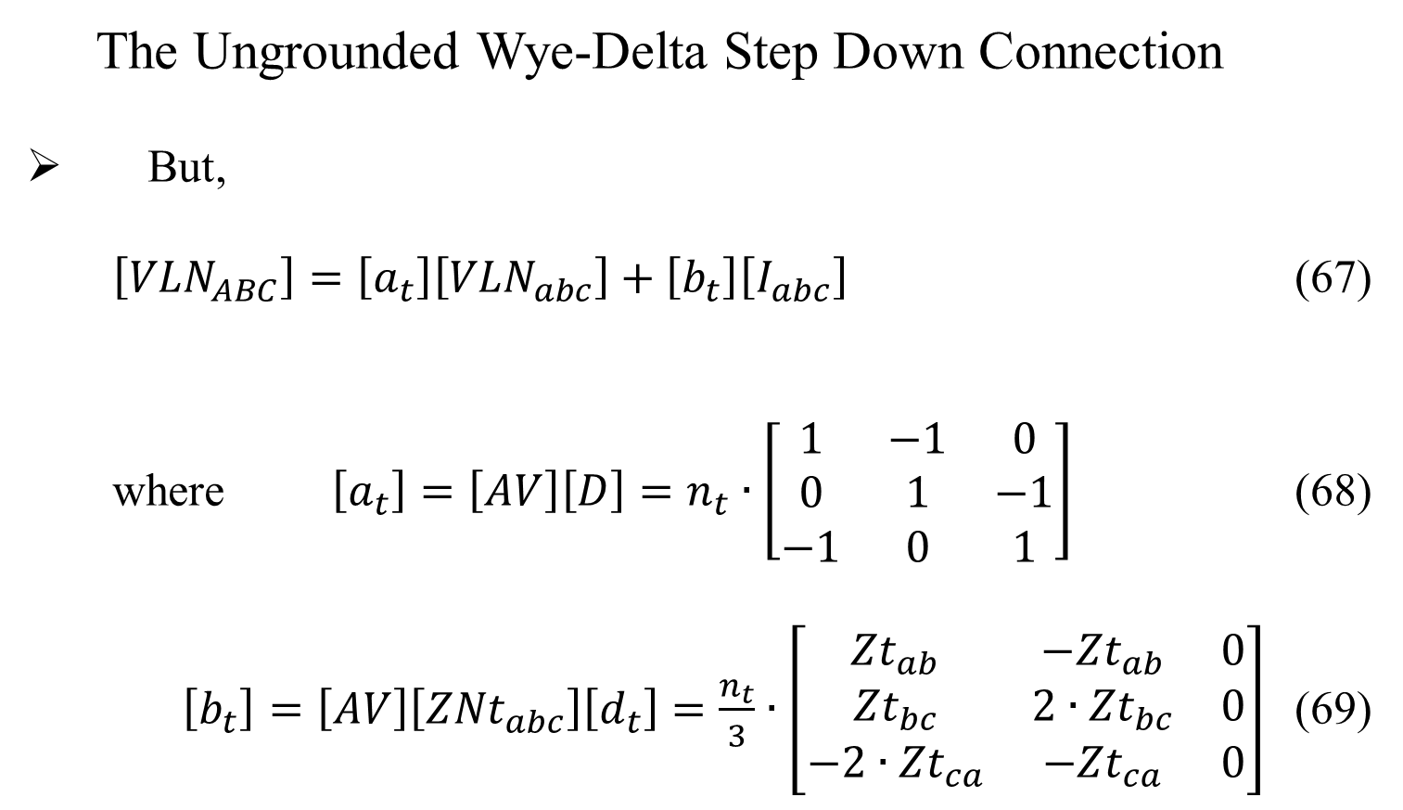
Three Phase Transformer Models
The Ungrounded Wye-Delta Step Down Connection
But,
$\left[{VLN}_{ABC}\right]=\left[a_{t}\right]\left[{VLN}_{abc}\right]+\left[b_{t}\right]\left[I_{abc}\right]$ (67)
where $\left[a_{t}\right]=\left[AV\right]\left[D\right]=n_{t}∙\left[\begin{matrix}1 & −1 & 0 \\ 0 & 1 & −1 \\ −1 & 0 & 1\end{matrix}\right]$ (68)
$\left[b_{t}\right]=\left[AV\right]\left[{ZNt}_{abc}\right]\left[d_{t}\right]=\frac{n_{t}}{3}∙\left[\begin{matrix}{Zt}_{ab} & −{Zt}_{ab} & 0 \\ {Zt}_{bc} & 2∙{Zt}_{bc} & 0 \\ −2∙{Zt}_{ca} & −{Zt}_{ca} & 0\end{matrix}\right]$ (69)

Slide 56
Three Phase Transformer Models
The Ungrounded Wye-Delta Step Down Connection
The generalized constant matrices have been developed for computing the voltages from the load to the source.
The reverse generalized matrices can be developed by substituting equation (52) into equation (23):
$\left[{VLN}_{abc}\right]=\left[A_{t}\right]\left[{VLN}_{ABC}\right]−\left[B_{t}\right]\left[I_{abc}\right]$ (70)

Slide 57
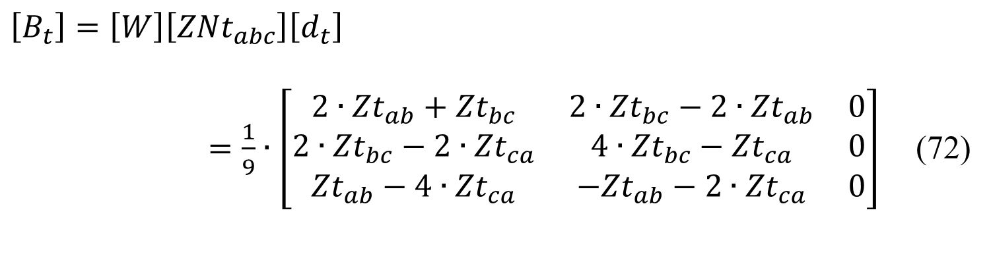

Three Phase Transformer Models
The Ungrounded Wye-Delta Step Down Connection
where $\left[A_{t}\right]=\left[W\right]{\left[AV\right]}^{−1}=\frac{1}{3∙n_{t}}∙\left[\begin{matrix}2 & 1 & 0 \\ 0 & 2 & 1 \\ 1 & 0 & 2\end{matrix}\right]$ (71)
$$\left[B_{t}\right]=\left[W\right]\left[{ZNt}_{abc}\right]\left[d_{t}\right]$$
$=\frac{1}{9}∙\left[\begin{matrix}{2∙Zt}_{ab}+{Zt}_{bc} & 2∙{Zt}_{bc}−{2∙Zt}_{ab} & 0 \\ {2∙Zt}_{bc}−2∙{Zt}_{ca} & 4∙{Zt}_{bc}−{Zt}_{ca} & 0 \\ {Zt}_{ab}−4∙{Zt}_{ca} & −{Zt}_{ab}−{2∙Zt}_{ca} & 0\end{matrix}\right]$ (72)

Slide 58
Part 3: Three Phase Transformer Models
Three Phase Transformer Models
General Three Phase Transformer Banks
Generalized Matrices
Symmetrical Components
The Delta-Grounded Wye Step Down Connection
The Ungrounded Wye-Delta Step Down Connection
The Grounded Wye-Grounded Wye Connection
The Delta-Delta Connection
Open Wye-Open Delta
Thevenin Equivalent Circuit

Slide 59
Three Phase Transformer Models
The Grounded Wye-Grounded Wye Connection
The grounded wye-grounded wye connection is primarily used to supply single-phase and three-phase loads on four-wire multi-grounded systems.
Unlike the delta-wye and wye-delta connections, there is no phase shift between the voltages and currents on the two sides of the bank.

Slide 60
Three Phase Transformer Models
The Grounded Wye-Grounded Wye Connection
Figure 8.0

Slide 61
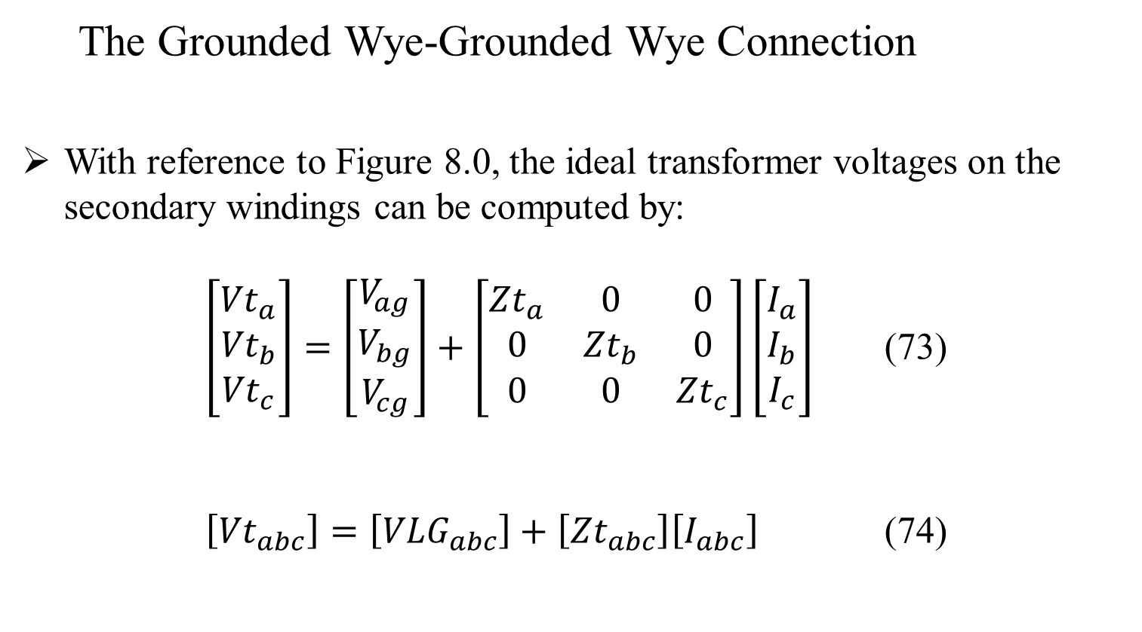
Three Phase Transformer Models
The Grounded Wye-Grounded Wye Connection
With reference to Figure 8.0, the ideal transformer voltages on the secondary windings can be computed by:
$\left[\begin{matrix}{Vt}_{a} \\ {Vt}_{b} \\ {Vt}_{c}\end{matrix}\right]=\left[\begin{matrix}V_{ag} \\ V_{bg} \\ V_{cg}\end{matrix}\right]+\left[\begin{matrix}{Zt}_{a} & 0 & 0 \\ 0 & {Zt}_{b} & 0 \\ 0 & 0 & {Zt}_{c}\end{matrix}\right]\left[\begin{matrix}I_{a} \\ I_{b} \\ I_{c}\end{matrix}\right]$ (73)
$\left[{Vt}_{abc}\right]=\left[{VLG}_{abc}\right]+\left[{Zt}_{abc}\right]\left[I_{abc}\right]$ (74)

Slide 62
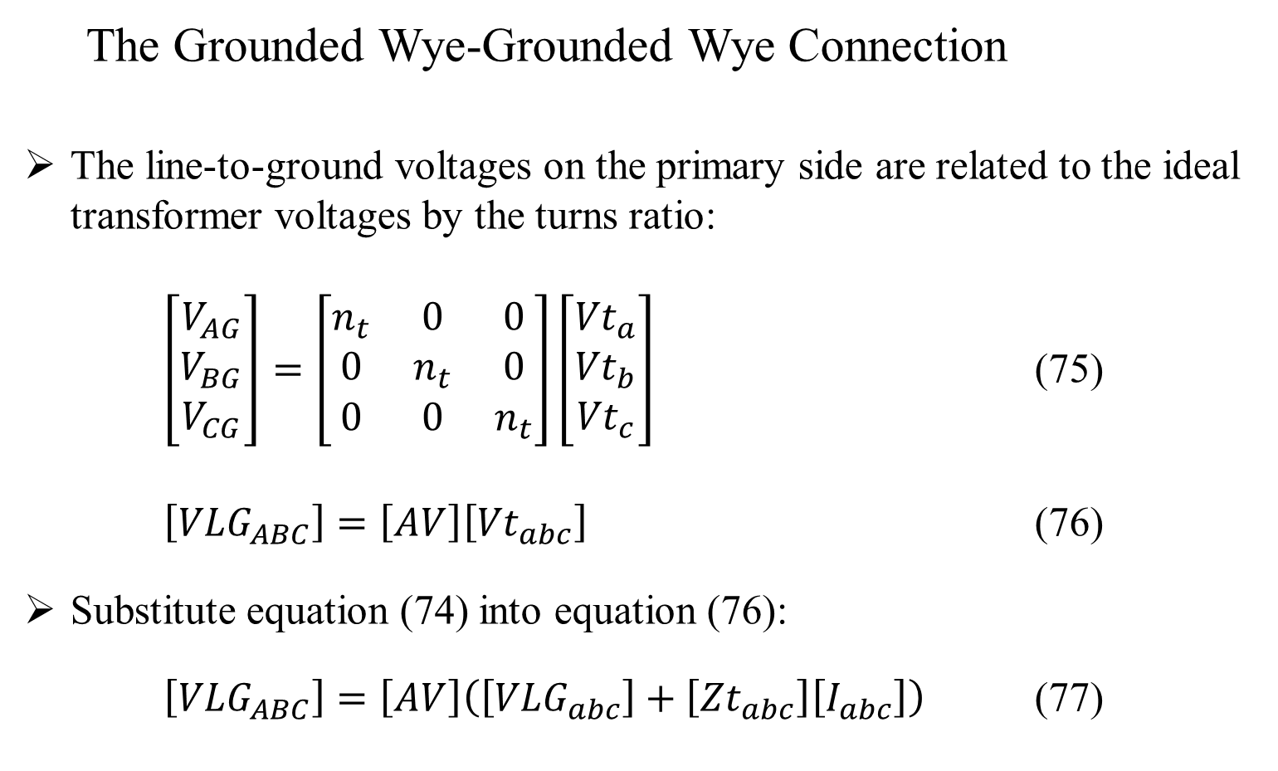
Three Phase Transformer Models
The Grounded Wye-Grounded Wye Connection
The line-to-ground voltages on the primary side are related to the ideal transformer voltages by the turns ratio:
$\left[\begin{matrix}V_{AG} \\ V_{BG} \\ V_{CG}\end{matrix}\right]=\left[\begin{matrix}n_{t} & 0 & 0 \\ 0 & n_{t} & 0 \\ 0 & 0 & n_{t}\end{matrix}\right]\left[\begin{matrix}{Vt}_{a} \\ {Vt}_{b} \\ {Vt}_{c}\end{matrix}\right]$ (75)
$\left[{VLG}_{ABC}\right]=\left[AV\right]\left[{Vt}_{abc}\right]$ (76)
Substitute equation (74) into equation (76):
$\left[{VLG}_{ABC}\right]=\left[AV\right]\left(\left[{VLG}_{abc}\right]+\left[{Zt}_{abc}\right]\left[I_{abc}\right]\right)$ (77)

Slide 63
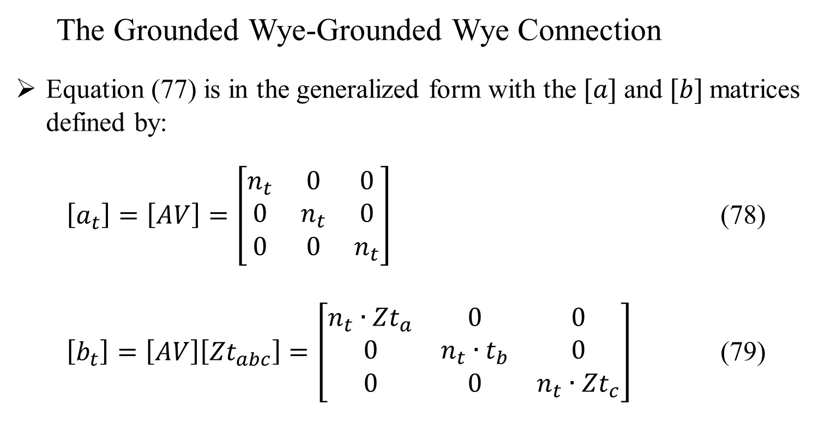
Three Phase Transformer Models
The Grounded Wye-Grounded Wye Connection
Equation (77) is in the generalized form with the $[a]$ and $[b]$ matrices defined by:
$\left[a_{t}\right]=\left[AV\right]=\left[\begin{matrix}n_{t} & 0 & 0 \\ 0 & n_{t} & 0 \\ 0 & 0 & n_{t}\end{matrix}\right]$ (78)
$\left[b_{t}\right]=\left[AV\right]\left[{Zt}_{abc}\right]=\left[\begin{matrix}{n_{t}∙Zt}_{a} & 0 & 0 \\ 0 & {n_{t}∙t}_{b} & 0 \\ 0 & 0 & {n_{t}∙Zt}_{c}\end{matrix}\right]$ (79)

Slide 64
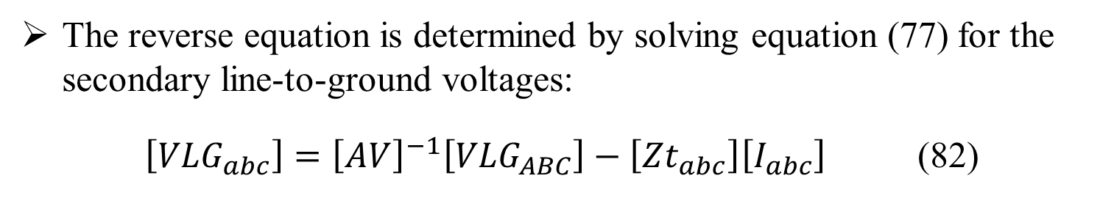

Three Phase Transformer Models
The Grounded Wye-Grounded Wye Connection
The primary line currents as a function of the secondary line currents is given by:
$\left[I_{ABC}\right]=\left[d_{t}\right]\left[I_{abc}\right]$ (80)
where $\left[d_{t}\right]=\left[\begin{matrix}\frac{1}{n_{t}} & 0 & 0 \\ 0 & \frac{1}{n_{t}} & 0 \\ 0 & 0 & \frac{1}{n_{t}}\end{matrix}\right]$ (81)
The reverse equation is determined by solving equation (77) for the secondary line-to-ground voltages:
$\left[{VLG}_{abc}\right]={\left[AV\right]}^{−1}\left[{VLG}_{ABC}\right]−\left[{Zt}_{abc}\right]\left[I_{abc}\right]$ (82)

Slide 65
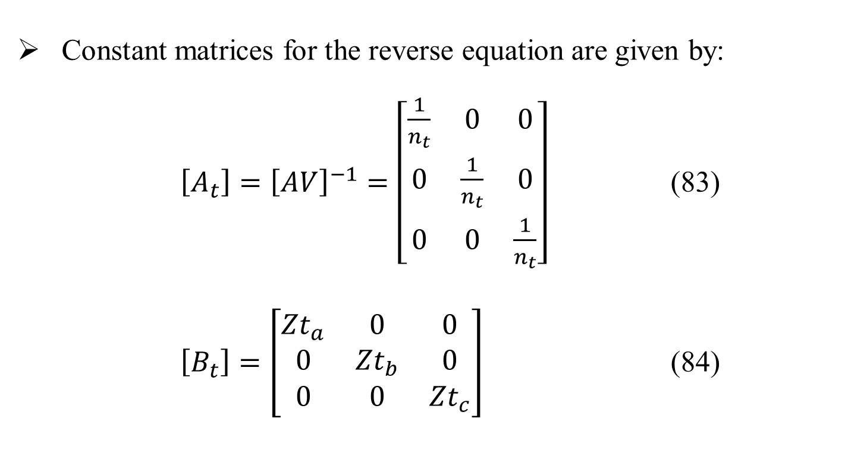
Three Phase Transformer Models
The Grounded Wye-Grounded Wye Connection
Constant matrices for the reverse equation are given by:
$\left[A_{t}\right]={\left[AV\right]}^{−1}=\left[\begin{matrix}\frac{1}{n_{t}} & 0 & 0 \\ 0 & \frac{1}{n_{t}} & 0 \\ 0 & 0 & \frac{1}{n_{t}}\end{matrix}\right]$ (83)
$\left[B_{t}\right]=\left[\begin{matrix}{Zt}_{a} & 0 & 0 \\ 0 & {Zt}_{b} & 0 \\ 0 & 0 & {Zt}_{c}\end{matrix}\right]$ (84)

Slide 66
Part 3: Three Phase Transformer Models
Three Phase Transformer Models
General Three Phase Transformer Banks
Generalized Matrices
Symmetrical Components
The Delta-Grounded Wye Step Down Connection
The Ungrounded Wye-Delta Step Down Connection
The Grounded Wye-Grounded Wye Connection
The Delta-Delta Connection
Open Wye-Open Delta
Thevenin Equivalent Circuit

Slide 67
Three Phase Transformer Models
The Delta-Delta Connection
The delta-delta connection is primarily used on three wire systems to provide service to a three-phase load or a combination of three-phase and single-phase loads.
Figure 9.0

Slide 68
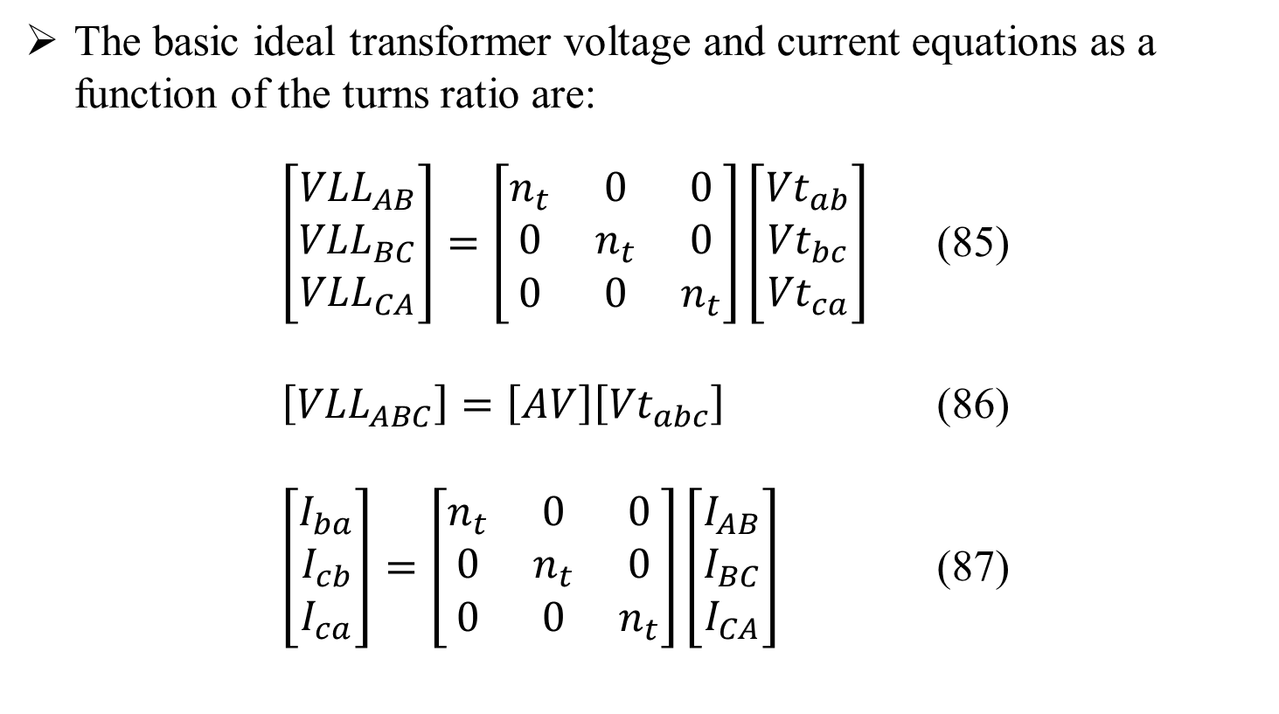
Three Phase Transformer Models
The Delta-Delta Connection
The basic ideal transformer voltage and current equations as a function of the turns ratio are:
$\left[\begin{matrix}{VLL}_{AB} \\ {VLL}_{BC} \\ {VLL}_{CA}\end{matrix}\right]=\left[\begin{matrix}n_{t} & 0 & 0 \\ 0 & n_{t} & 0 \\ 0 & 0 & n_{t}\end{matrix}\right]\left[\begin{matrix}{Vt}_{ab} \\ {Vt}_{bc} \\ {Vt}_{ca}\end{matrix}\right]$ (85)
$\left[{VLL}_{ABC}\right]=\left[AV\right]\left[{Vt}_{abc}\right]$ (86)
$\left[\begin{matrix}I_{ba} \\ I_{cb} \\ I_{ca}\end{matrix}\right]=\left[\begin{matrix}n_{t} & 0 & 0 \\ 0 & n_{t} & 0 \\ 0 & 0 & n_{t}\end{matrix}\right]\left[\begin{matrix}I_{AB} \\ I_{BC} \\ I_{CA}\end{matrix}\right]$ (87)

Slide 69

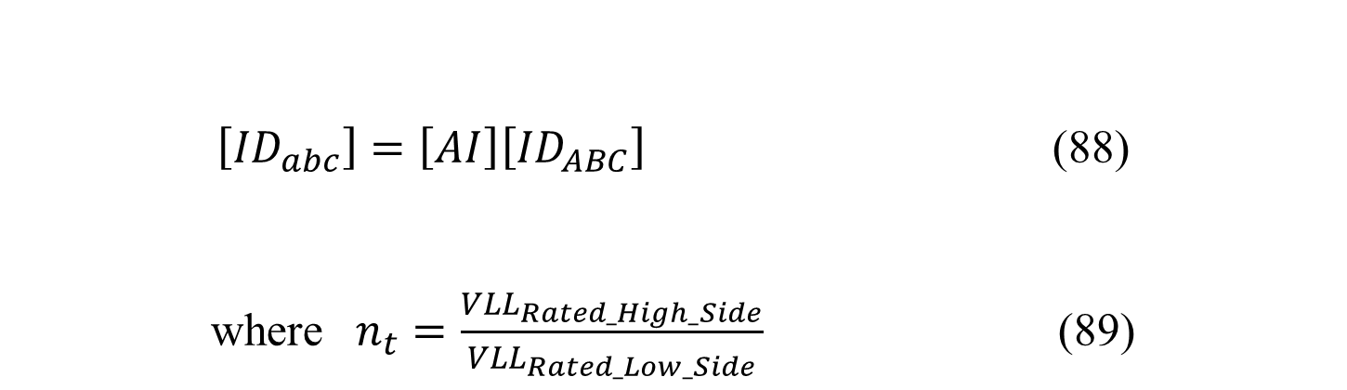
Three Phase Transformer Models
The Delta-Delta Connection
The basic ideal transformer voltage and current equations as a function of the turns ratio (continued):
$\left[{ID}_{abc}\right]=\left[AI\right]\left[{ID}_{ABC}\right]$ (88)
where $n_{t}=\frac{{VLL}_{Rated_High_Side}}{{VLL}_{Rated_Low_Side}}$ (89)
Solve equation (88) for the source side delta currents.
$\left[{ID}_{ABC}\right]={\left[AI\right]}^{−1}\left[{ID}_{abc}\right]$ (90)

Slide 70
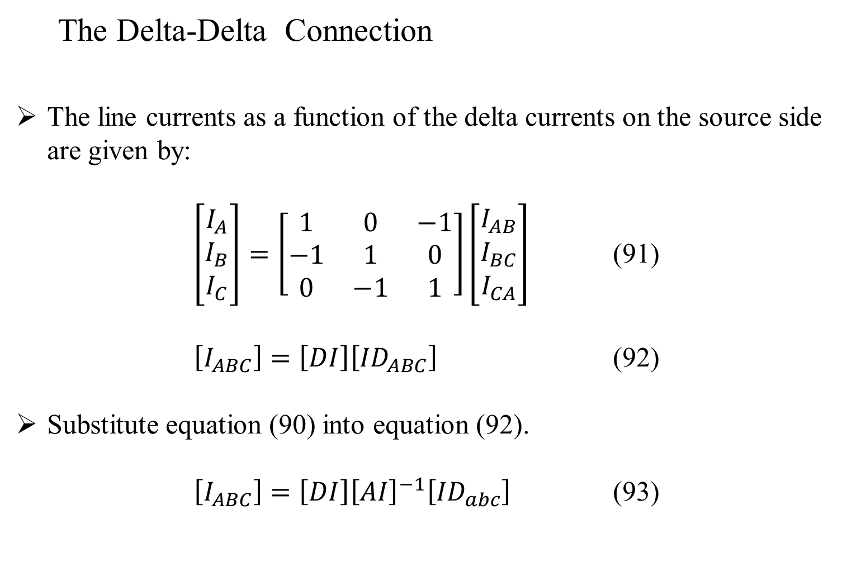
Three Phase Transformer Models
The Delta-Delta Connection
The line currents as a function of the delta currents on the source side are given by:
$\left[\begin{matrix}I_{A} \\ I_{B} \\ I_{C}\end{matrix}\right]=\left[\begin{matrix}1 & 0 & −1 \\ −1 & 1 & 0 \\ 0 & −1 & 1\end{matrix}\right]\left[\begin{matrix}I_{AB} \\ I_{BC} \\ I_{CA}\end{matrix}\right]$ (91)
$\left[I_{ABC}\right]=\left[DI\right]\left[{ID}_{ABC}\right]$ (92)
Substitute equation (90) into equation (92).
$\left[I_{ABC}\right]=\left[DI\right]{\left[AI\right]}^{−1}\left[{ID}_{abc}\right]$ (93)

Slide 71
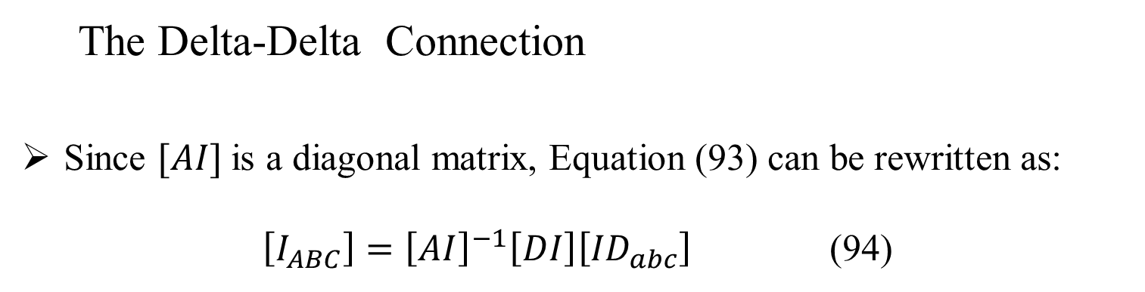
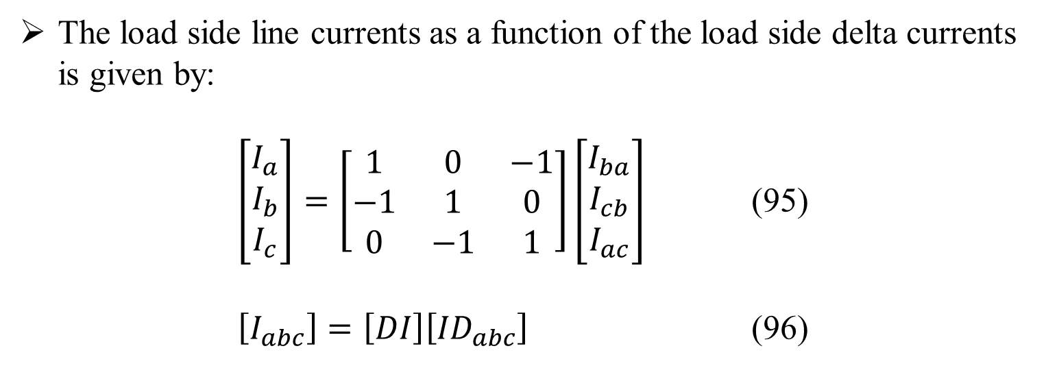
Three Phase Transformer Models
The Delta-Delta Connection
Since $[AI]$is a diagonal matrix, Equation (93) can be rewritten as:
$\left[I_{ABC}\right]={\left[AI\right]}^{−1}\left[DI\right]\left[{ID}_{abc}\right]$ (94)
The load side line currents as a function of the load side delta currents is given by:
$\left[\begin{matrix}I_{a} \\ I_{b} \\ I_{c}\end{matrix}\right]=\left[\begin{matrix}1 & 0 & −1 \\ −1 & 1 & 0 \\ 0 & −1 & 1\end{matrix}\right]\left[\begin{matrix}I_{ba} \\ I_{cb} \\ I_{ac}\end{matrix}\right]$ (95)
$\left[I_{abc}\right]=\left[DI\right]\left[{ID}_{abc}\right]$ (96)

Slide 72
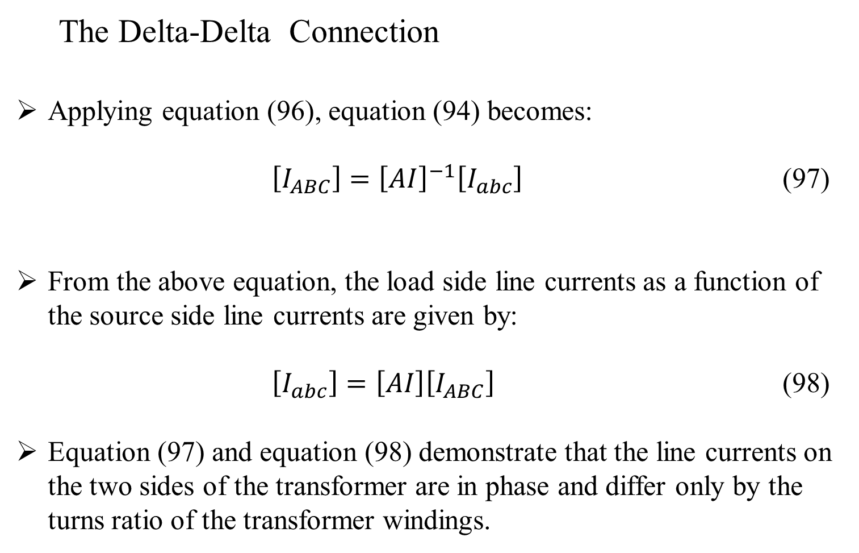
Three Phase Transformer Models
The Delta-Delta Connection
Applying equation (96), equation (94) becomes:
$\left[I_{ABC}\right]={\left[AI\right]}^{−1}\left[I_{abc}\right]$ (97)
From the above equation, the load side line currents as a function of the source side line currents are given by:
$\left[I_{abc}\right]=\left[AI\right]\left[I_{ABC}\right]$ (98)
Equation (97) and equation (98) demonstrate that the line currents on the two sides of the transformer are in phase and differ only by the turns ratio of the transformer windings.

Slide 73
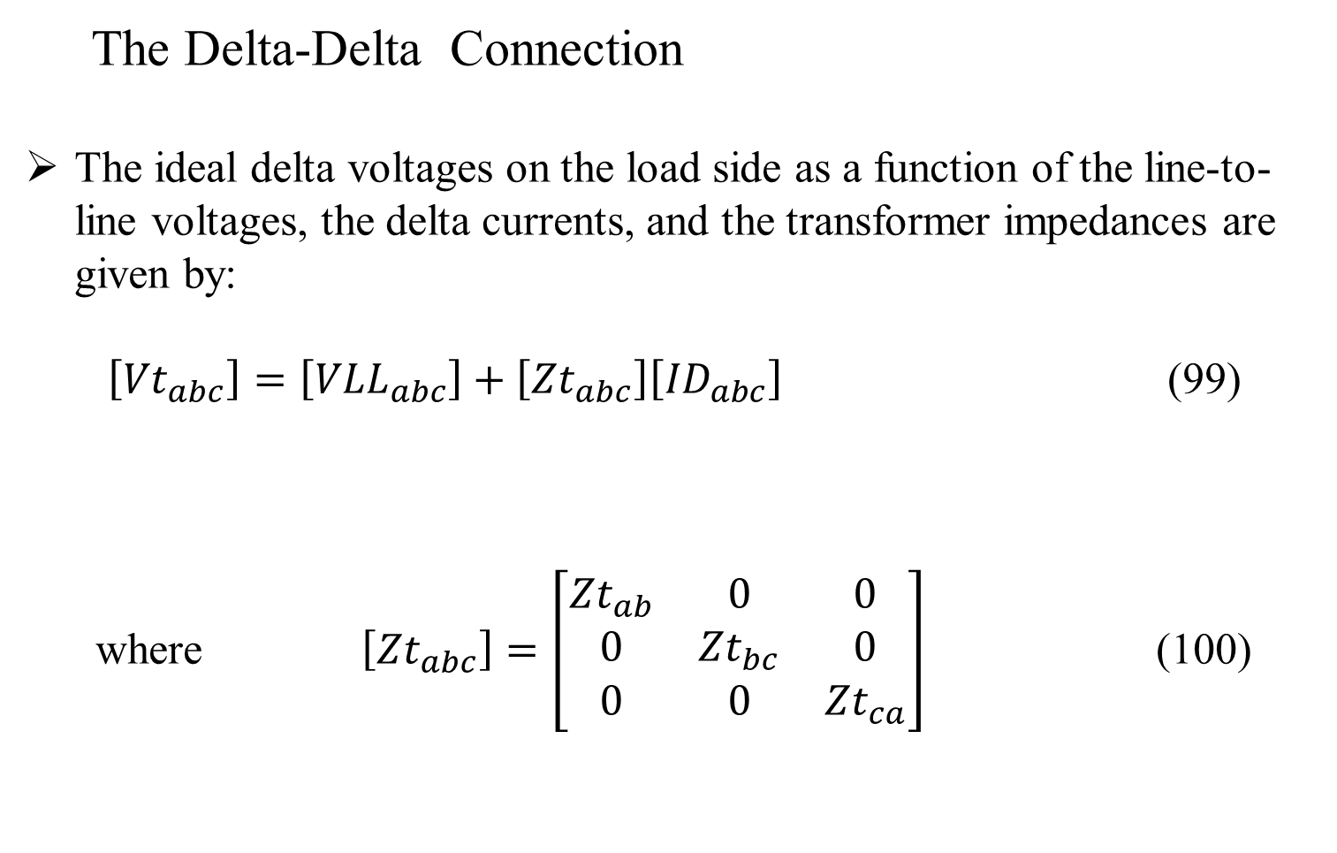
Three Phase Transformer Models
The Delta-Delta Connection
The ideal delta voltages on the load side as a function of the line-to-line voltages, the delta currents, and the transformer impedances are given by:
$\left[{Vt}_{abc}\right]=\left[{VLL}_{abc}\right]+\left[{Zt}_{abc}\right]\left[{ID}_{abc}\right]$ (99)
where $\left[{Zt}_{abc}\right]=\left[\begin{matrix}{Zt}_{ab} & 0 & 0 \\ 0 & {Zt}_{bc} & 0 \\ 0 & 0 & {Zt}_{ca}\end{matrix}\right]$ (100)

Slide 74
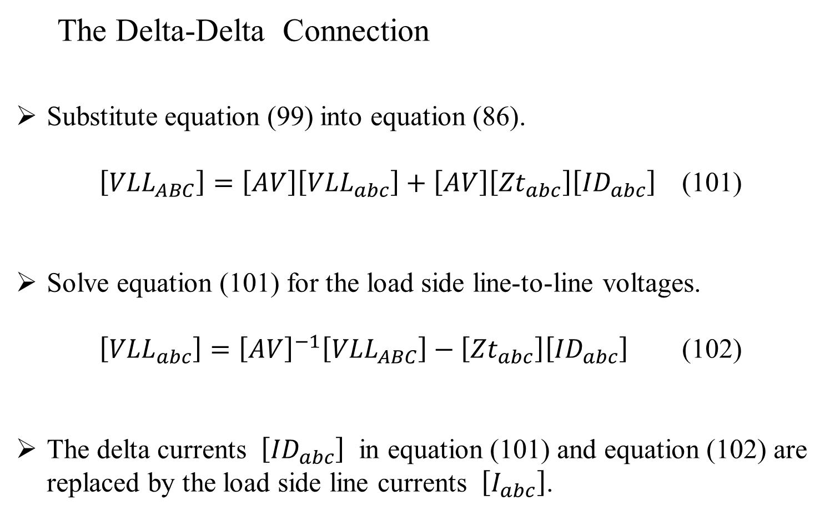
Three Phase Transformer Models
The Delta-Delta Connection
Substitute equation (99) into equation (86).
$\left[{VLL}_{ABC}\right]=\left[AV\right]\left[{VLL}_{abc}\right]+\left[AV\right]\left[{Zt}_{abc}\right]\left[{ID}_{abc}\right]$ (101)
Solve equation (101) for the load side line-to-line voltages.
$\left[{VLL}_{abc}\right]={\left[AV\right]}^{−1}\left[{VLL}_{ABC}\right]−\left[{Zt}_{abc}\right]\left[{ID}_{abc}\right]$ (102)
The delta currents $\left[{ID}_{abc}\right]$ in equation (101) and equation (102) are replaced by the load side line currents $\left[I_{abc}\right]$.

Slide 75
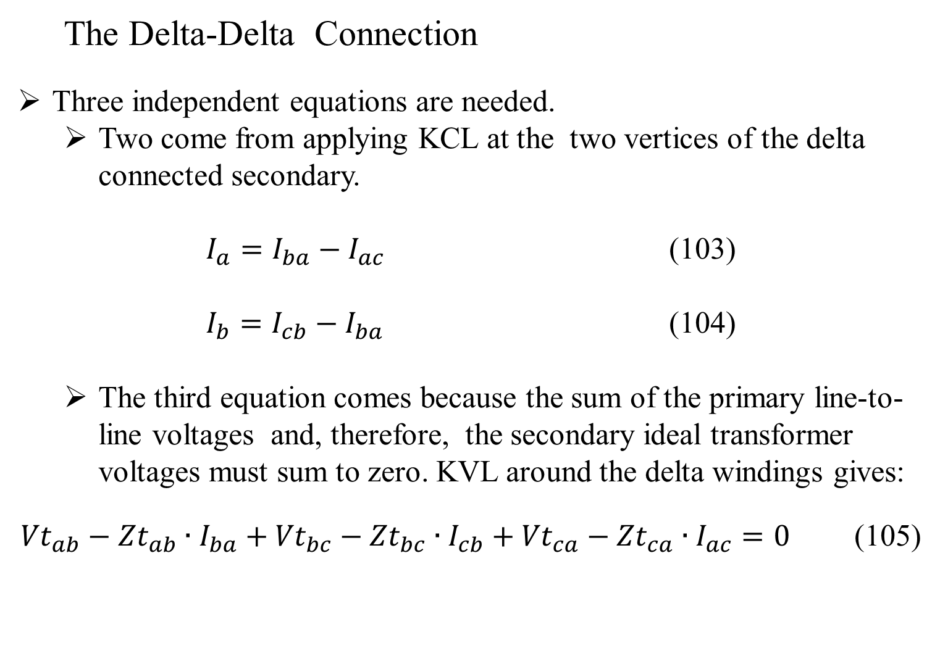
Three Phase Transformer Models
The Delta-Delta Connection
Three independent equations are needed.
Two come from applying KCL at the two vertices of the delta connected secondary.
$I_{a}=I_{ba}−I_{ac}$ (103)
$I_{b}=I_{cb}−I_{ba}$ (104)
The third equation comes because the sum of the primary line-to-line voltages and, therefore, the secondary ideal transformer voltages must sum to zero. KVL around the delta windings gives:
${Vt}_{ab}−{Zt}_{ab}∙I_{ba}+{Vt}_{bc}−{Zt}_{bc}∙I_{cb}+{Vt}_{ca}−{Zt}_{ca}∙I_{ac}=0$ (105)

Slide 76
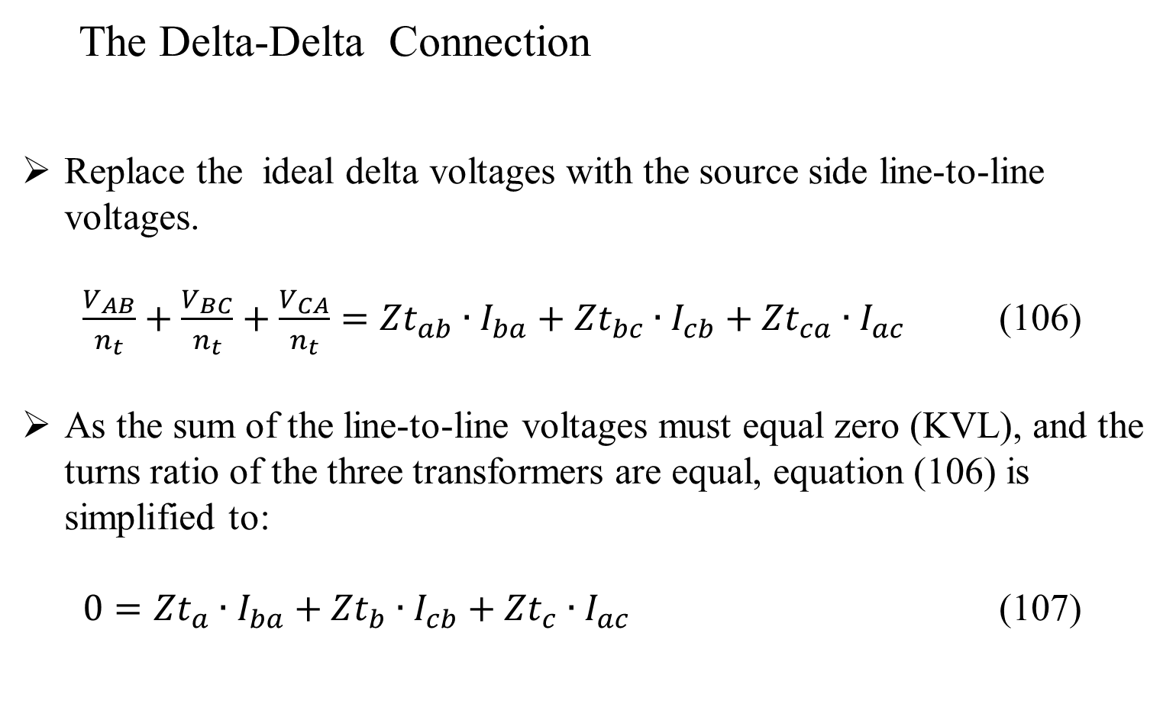
Three Phase Transformer Models
The Delta-Delta Connection
Replace the ideal delta voltages with the source side line-to-line voltages.
$\frac{V_{AB}}{n_{t}}+\frac{V_{BC}}{n_{t}}+\frac{V_{CA}}{n_{t}}={Zt}_{ab}∙I_{ba}+{Zt}_{bc}∙I_{cb}+{Zt}_{ca}∙I_{ac}$ (106)
As the sum of the line-to-line voltages must equal zero (KVL), and the turns ratio of the three transformers are equal, equation (106) is simplified to:
$0={Zt}_{a}∙I_{ba}+{Zt}_{b}∙I_{cb}+{Zt}_{c}∙I_{ac}$ (107)

Slide 77
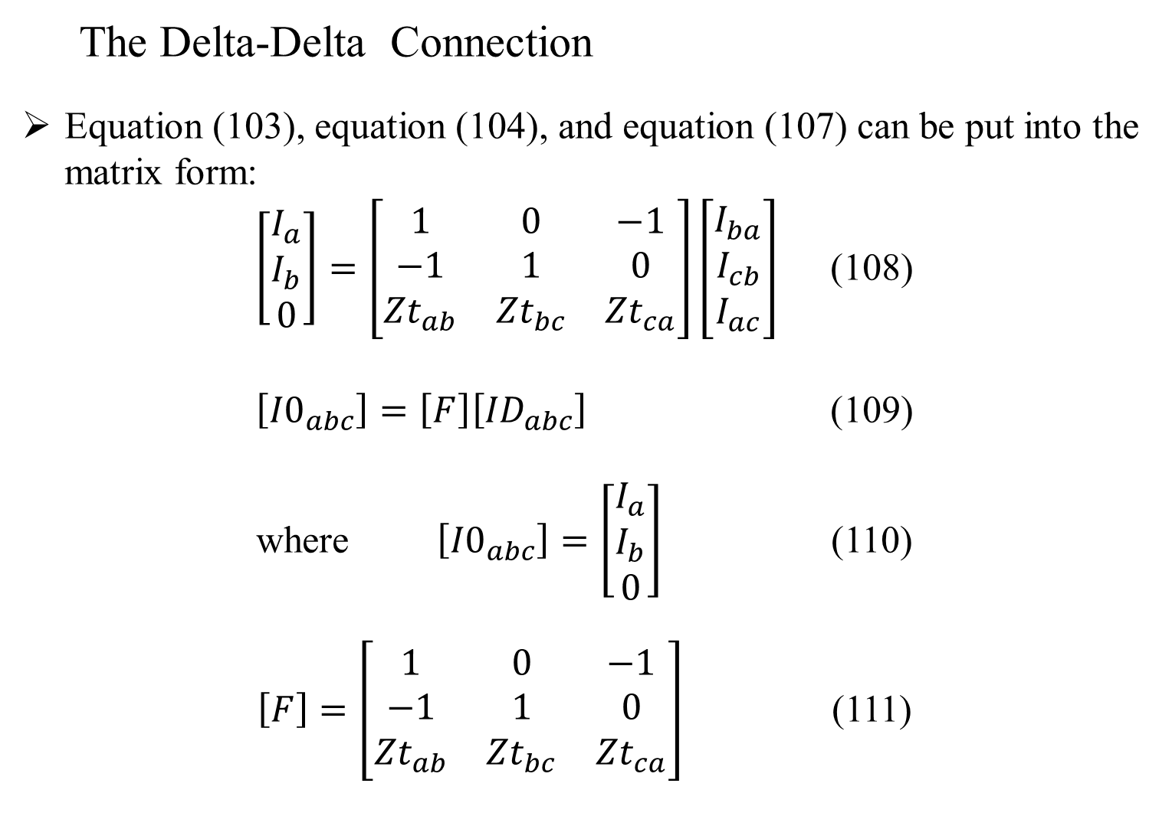
Three Phase Transformer Models
The Delta-Delta Connection
Equation (103), equation (104), and equation (107) can be put into the matrix form:
$\left[\begin{matrix}I_{a} \\ I_{b} \\ 0\end{matrix}\right]=\left[\begin{matrix}1 & 0 & −1 \\ −1 & 1 & 0 \\ {Zt}_{ab} & {Zt}_{bc} & {Zt}_{ca}\end{matrix}\right]\left[\begin{matrix}I_{ba} \\ I_{cb} \\ I_{ac}\end{matrix}\right]$ (108)
$\left[{I0}_{abc}\right]=\left[F\right]\left[{ID}_{abc}\right]$ (109)
where $\left[{I0}_{abc}\right]=\left[\begin{matrix}I_{a} \\ I_{b} \\ 0\end{matrix}\right]$ (110)
$\left[F\right]=\left[\begin{matrix}1 & 0 & −1 \\ −1 & 1 & 0 \\ {Zt}_{ab} & {Zt}_{bc} & {Zt}_{ca}\end{matrix}\right]$ (111)

Slide 78

Three Phase Transformer Models
The Delta-Delta Connection
Solve (109) for the load side delta currents.
$\left[{ID}_{abc}\right]={\left[F\right]}^{−1}\left[{I0}_{abc}\right]=\left[G\right]\left[{I0}_{abc}\right]$ (112)
where
$\left[G\right]={\left[F\right]}^{−1}=\frac{1}{{Zt}_{ab}+{Zt}_{bc}+{Zt}_{ca}}∙\left[\begin{matrix}{Zt}_{ca} & {−Zt}_{bc} & 1 \\ {Zt}_{ca} & {Zt}_{ab}+{Zt}_{ca} & 1 \\ {−Zt}_{ab}−{Zt}_{bc} & {−Zt}_{bc} & 1\end{matrix}\right]$ (113)

Slide 79


Three Phase Transformer Models
The Delta-Delta Connection
Writing equation (112) in the matrix form gives:
$\left[\begin{matrix}I_{ba} \\ I_{cb} \\ I_{ac}\end{matrix}\right]=\left[\begin{matrix}G_{11} & G_{12} & G_{13} \\ G_{21} & G_{22} & G_{23} \\ G_{31} & G_{32} & G_{33}\end{matrix}\right]\left[\begin{matrix}I_{a} \\ I_{b} \\ 0\end{matrix}\right]$ (114)
From equation (113) and equation (114), it can be seen that the delta currents are a function of the transformer impedances and the line currents in phases $a$ and $b$.

Slide 80

Three Phase Transformer Models
The Delta-Delta Connection
Equation (114) can be modified to include the line current in phase $c$ by setting the last column of the $[G]$ matrix to zeros.
$\left[\begin{matrix}I_{ba} \\ I_{cb} \\ I_{ac}\end{matrix}\right]=\left[\begin{matrix}G_{11} & G_{12} & 0 \\ G_{21} & G_{22} & 0 \\ G_{31} & G_{32} & 0\end{matrix}\right]\left[\begin{matrix}I_{a} \\ I_{b} \\ I_{c}\end{matrix}\right]$ (115)
The final form of equation (115) can be written as:
$\left[{ID}_{abc}\right]=\left[G1\right]\left[I_{abc}\right]$ (116)
where $\left[G1\right]=\frac{1}{{Zt}_{ab}+{Zt}_{bc}+{Zt}_{ca}}∙\left[\begin{matrix}{Zt}_{ca} & {−Zt}_{bc} & 0 \\ {Zt}_{ca} & {Zt}_{ab}+{Zt}_{ca} & 0 \\ {−Zt}_{ab}−{Zt}_{bc} & {−Zt}_{bc} & 0\end{matrix}\right]$ (117)

Slide 81

Three Phase Transformer Models
The Delta-Delta Connection
The general form of the equation (117) will be used to define the generalized constant matrices for the delta-delta connection.
Substitute equation (117) into equation (111).
$\left[{VLL}_{ABC}\right]=\left[AV\right]\left[{VLL}_{abc}\right]+\left[AV\right]\left[{Zt}_{abc}\right]\left[G1\right]\left[I_{abc}\right]$ (118)
The generalized matrices are defined in terms of the line-to-neutral voltages on the two sides of the transformer bank.
Equation (118) is modified to be in terms of equivalent line-to-neutral voltages
$$\left[{VLN}_{ABC}\right]=\left[W\right]\left[{VLL}_{ABC}\right]$$
$\left[{VLN}_{ABC}\right]=\left[W\right]\left[AV\right]\left[D\right]\left[{VLN}_{abc}\right]+\left[W\right]\left[{Zt}_{abc}\right]\left[G1\right]\left[I_{abc}\right]$ (119)

Slide 82

Three Phase Transformer Models
The Delta-Delta Connection
Equation (119) is in the general form:
$\left[{VLN}_{ABC}\right]=\left[a_{t}\right]\left[{VLN}_{abc}\right]+\left[b_{t}\right]\left[I_{abc}\right]$ (120)
where $\left[a_{t}\right]=\left[W\right]\left[AV\right]\left[D\right]=\frac{n_{t}}{3}∙\left[\begin{matrix}2 & −1 & −1 \\ −1 & 2 & −1 \\ −1 & −1 & 2\end{matrix}\right]$ (121)
$\left[b_{t}\right]=\left[AV\right]\left[W\right]\left[{Zt}_{abc}\right]\left[G1\right]$ (122)

Slide 83

Three Phase Transformer Models
The Delta-Delta Connection
Equation (97) gives the generalized equation for currents.
$\left[I_{ABC}\right]={\left[AI\right]}^{−1}\left[I_{abc}\right]=\left[d_{t}\right]\left[I_{abc}\right]$ (123)
where $\left[d_{t}\right]=\left[\begin{matrix}\frac{1}{n_{t}} & 0 & 0 \\ 0 & \frac{1}{n_{t}} & 0 \\ 0 & 0 & \frac{1}{n_{t}}\end{matrix}\right]$ (124)

Slide 84

Three Phase Transformer Models
The Delta-Delta Connection
The reverse generalized equation can be derived by modifying Equation (102) in terms of equivalent line-to-neutral voltages.
$$\left[{VLN}_{abc}\right]=\left[W\right]\left[{VLL}_{abc}\right]$$
$\left[{VLN}_{abc}\right]=\left[W\right]{\left[AV\right]}^{−1}\left[D\right]\left[{VLN}_{ABC}\right]−\left[W\right]\left[{Zt}_{abc}\right]\left[G1\right]\left[I_{abc}\right]$ (125)
$\left[{VLN}_{abc}\right]=\left[A_{t}\right]\left[{VLN}_{ABC}\right]−\left[B_{t}\right]\left[I_{abc}\right]$ (126)
where $\left[A_{t}\right]=\left[W\right]{\left[AV\right]}^{−1}\left[D\right]=\frac{1}{3∙n_{t}}∙\left[\begin{matrix}2 & −1 & −1 \\ −1 & 2 & −1 \\ −1 & 2 & −1\end{matrix}\right]$ (127)
$\left[B_{t}\right]=\left[W\right]\left[{Zt}_{abc}\right]\left[G1\right]$ (128)

Slide 85
Part 3: Three Phase Transformer Models
Three Phase Transformer Models
General Three Phase Transformer Banks
Generalized Matrices
Symmetrical Components
The Delta-Grounded Wye Step Down Connection
The Ungrounded Wye-Delta Step Down Connection
The Grounded Wye-Grounded Wye Connection
The Delta-Delta Connection
Open Wye-Open Delta
Thevenin Equivalent Circuit

Slide 86
Three Phase Transformer Models
Open Wye-Open Delta
A distribution feeder commonly serves a combination of both single phase and three phase loads.
This combination can be served with an ungrounded wye-delta connection as previously described.
When the three phase load is small compared to the single phase load, the “open wye-open delta” combination is commonly used.
The advantage of the open wye-open delta connection is that it requires only two transformers, but can provide three-phase line-to-line voltages to the combination load.

Slide 87
Three Phase Transformer Models
Open Wye-Open Delta
Figure 10.0 shows the open wye-open delta connection and the primary and secondary positive sequence voltage phasors.
Figure 10.0

Slide 88

Three Phase Transformer Models
Open Wye-Open Delta
With reference to Figure 10.0, the basic ideal transformer voltages as a function of the “turns ratio” are:
$\left[\begin{matrix}V_{AN} \\ V_{BN} \\ V_{CN}\end{matrix}\right]=\left[\begin{matrix}n_{t} & 0 & 0 \\ 0 & n_{t} & 0 \\ 0 & 0 & 0\end{matrix}\right]\left[\begin{matrix}{Vt}_{ab} \\ {Vt}_{bc} \\ {Vt}_{ca}\end{matrix}\right]$ (129)
$\left[{VLN}_{ABC}\right]=\left[AV\right]\left[{Vt}_{abc}\right]$ (130)

Slide 89


Three Phase Transformer Models
Open Wye-Open Delta
The currents as a function of the turns ratio are given by:
$I_{ba}=n_{T}∙I_{A}=I_{a}$
$I_{cb}=n_{T}∙I_{B}={−I}_{c}$
$I_{b}=−(I_{a}+I_{c})$
(131)
Equation (131) can be expressed in matrix form by:
$\left[\begin{matrix}I_{a} \\ I_{b} \\ I_{c}\end{matrix}\right]=\left[\begin{matrix}n_{t} & 0 & 0 \\ −n_{t} & n_{t} & 0 \\ 0 & −n_{t} & 0\end{matrix}\right]\left[\begin{matrix}I_{A} \\ I_{B} \\ I_{C}\end{matrix}\right]$ (132)
$\left[I_{abc}\right]=\left[AI\right]\left[I_{ABC}\right]$ (133)

Slide 90

Three Phase Transformer Models
Open Wye-Open Delta
The ideal voltages on the delta windings can be determined by:
$${Vt}_{ab}=V_{ab}+{Zt}_{ab}∙I_{a}$$
$${Vt}_{bc}=V_{bc}−{Zt}_{bc}∙I_{c}$$
Apply equation (129) to equation (134).
$$V_{AG}=n_{t}∙{Vt}_{ab}=n_{t}∙V_{ab}+n_{t}∙{Zt}_{ab}∙I_{a}$$
$$V_{BG}=n_{t}∙{Vt}_{bc}=n_{t}∙V_{bc}−n_{t}∙{Zt}_{bc}∙I_{c}$$
(134)
(135)

Slide 91

Three Phase Transformer Models
Open Wye-Open Delta
Equation (135) can be put into three-phase matrix form as:
$\left[\begin{matrix}V_{AG} \\ V_{BG} \\ V_{CG}\end{matrix}\right]=\left[\begin{matrix}n_{t} & 0 & 0 \\ 0 & n_{t} & 0 \\ 0 & 0 & 0\end{matrix}\right]\left[\begin{matrix}V_{ab} \\ V_{bc} \\ V_{ca}\end{matrix}\right]+\left[\begin{matrix}n_{t}∙{Zt}_{ab} & 0 & 0 \\ 0 & 0 & {−n}_{t}∙{Zt}_{bc} \\ 0 & 0 & 0\end{matrix}\right]\left[\begin{matrix}I_{a} \\ I_{b} \\ I_{c}\end{matrix}\right]$ (136)
$\left[{VLG}_{ABC}\right]=\left[AV\right]\left[{VLL}_{abc}\right]+\left[b_{t}\right]\left[I_{abc}\right]$ (137)
The secondary line-to-line voltages in equation (137) can be replaced by the equivalent line-to-neutral secondary voltages.
$\left[{VLG}_{ABC}\right]=\left[AV\right]\left[D\right]\left[{VLN}_{abc}\right]+\left[b_{t}\right]\left[I_{abc}\right]$ (138)

Slide 92

Three Phase Transformer Models
Open Wye-Open Delta
The generalized matrix equation becomes:
$\left[{VLG}_{ABC}\right]=\left[a_{t}\right]\left[{VLN}_{abc}\right]+\left[b_{t}\right]\left[I_{abc}\right]$ (139)
where $\left[a_{t}\right]=\left[\begin{matrix}n_{t} & −n_{t} & 0 \\ 0 & n_{t} & −n_{t} \\ 0 & 0 & 0\end{matrix}\right]$ (140)
$\left[b_{t}\right]=\left[\begin{matrix}n_{t}∙{Zt}_{ab} & 0 & 0 \\ 0 & 0 & {−n}_{t}∙{Zt}_{bc} \\ 0 & 0 & 0\end{matrix}\right]$ (142)

Slide 93

Three Phase Transformer Models
Open Wye-Open Delta
The source side line currents as a function of the load side line currents are given by:
$\left[\begin{matrix}I_{A} \\ I_{B} \\ I_{C}\end{matrix}\right]=\left[\begin{matrix}\frac{1}{n_{t}} & 0 & 0 \\ 0 & 0 & −\frac{1}{n_{t}} \\ 0 & 0 & 0\end{matrix}\right]\left[\begin{matrix}I_{a} \\ I_{b} \\ I_{c}\end{matrix}\right]$ (143)
$\left[I_{ABC}\right]=\left[d_{t}\right]\left[I_{abc}\right]$ (144)
where $\left[d_{t}\right]=\left[\begin{matrix}\frac{1}{n_{t}} & 0 & 0 \\ 0 & 0 & −\frac{1}{n_{t}} \\ 0 & 0 & 0\end{matrix}\right]$ (145)

Slide 94

Three Phase Transformer Models
Open Wye-Open Delta
For deriving the reverse equation, relating the secondary equivalent line-to-neutral voltages as a function of the source side line-to-ground voltages and line currents, we first obtain the two line-to-line secondary voltages.
$$V_{ab}=\frac{1}{n_{t}}∙V_{AG}−{Zt}_{ab}∙I_{a}$$
$$V_{bc}=\frac{1}{n_{t}}∙V_{BG}−{Zt}_{bc}∙I_{c}$$
(146)

Slide 95

Three Phase Transformer Models
Open Wye-Open Delta
The third line-to-line voltage ($Vca$) must be equal to the negative sum of the other two line-to-line voltages(KVL). In the matrix form, the desired equation is:
$\left[\begin{matrix}V_{ab} \\ V_{bc} \\ V_{ca}\end{matrix}\right]=\left[\begin{matrix}\frac{1}{n_{t}} & 0 & 0 \\ 0 & \frac{1}{n_{t}} & 0 \\ −\frac{1}{n_{t}} & −\frac{1}{n_{t}} & 0\end{matrix}\right]\left[\begin{matrix}V_{AG} \\ V_{BG} \\ V_{CG}\end{matrix}\right]−\left[\begin{matrix}{Zt}_{ab} & 0 & 0 \\ 0 & 0 & −{Zt}_{bc} \\ {−Zt}_{ab} & 0 & {Zt}_{bc}\end{matrix}\right]\left[\begin{matrix}I_{a} \\ I_{b} \\ I_{c}\end{matrix}\right]$ (147)
$\left[{VLL}_{abc}\right]=\left[BV\right]\left[{VLG}_{ABC}\right]−\left[{Zt}_{abc}\right]\left[I_{abc}\right]$ (148)

Slide 96


Three Phase Transformer Models
Open Wye-Open Delta
The equivalent secondary line-to-neutral voltages are given by:
$$\left[{VLN}_{abc}\right]=\left[W\right]\left[{VLL}_{ABC}\right]$$
and
$\left[W\right]\left[{VLL}_{ABC}\right]=\left[W\right]\left[BV\right]\left[{VLG}_{ABC}\right]−\left[W\right]\left[{Zt}_{abc}\right]\left[I_{abc}\right]$ (149)
The generalized reverse equation is given by:
$\left[{VLN}_{abc}\right]=\left[A_{t}\right]\left[{VLG}_{ABC}\right]−\left[B_{t}\right]\left[I_{abc}\right]$ (150)

Slide 97

Three Phase Transformer Models
Open Wye-Open Delta
where
$\left[A_{t}\right]=\left[W\right]\left[BV\right]=\frac{1}{3∙n_{t}}∙\left[\begin{matrix}2 & 1 & 0 \\ −1 & 1 & 0 \\ −1 & −2 & 0\end{matrix}\right]$ (151)
$\left[B_{t}\right]=\left[W\right]\left[{Zt}_{abc}\right]=\frac{1}{3}∙\left[\begin{matrix}2∙{Zt}_{ab} & 0 & −{Zt}_{bc} \\ −{Zt}_{ab} & 0 & −{Zt}_{bc} \\ −{Zt}_{ab} & 0 & 2∙{Zt}_{bc}\end{matrix}\right]$ (152)

Slide 98
Three Phase Transformer Models
Open Wye-Open Delta
The equations derived on the previous slide are for an open-wye-open delta connection on phases A and B on the primary.
The same methodology can be adopted to derive the equations when the transformers are on phases B and C or A and C on the primary.
The terms “leading” and “lagging” connection are also associated with the open wye-open delta connection.

Slide 99
Three Phase Transformer Models
Open Wye-Open Delta
When the “lighting” transformer is connected across the leading of the two phases, it is known as “leading” connection.
For example when connected from phase A to ground, the connection would be known as a leading connection.
When the “lighting” transformer is connected across the lagging of the two phases, it is known as a “lagging” connection.
For example, when the connection is from the ground to phase A, it is known as a lagging connection

Slide 100
Part 3: Three Phase Transformer Models
Three Phase Transformer Models
General Three Phase Transformer Banks
Generalized Matrices
Symmetrical Components
The Delta-Grounded Wye Step Down Connection
The Ungrounded Wye-Delta Step Down Connection
The Grounded Wye-Grounded Wye Connection
The Delta-Delta Connection
Open Wye-Open Delta
Thevenin Equivalent Circuit

Slide 101
Three Phase Transformer Models
Thevenin Equivalent Circuit
The Thevenin equivalent circuit referenced to the secondary terminals of the transformer must take into account the equivalent impedance between the primary terminals of the transformer and the feeder source.
Figure 11.0 is a general circuit showing the feeder source down to the secondary bus.
Figure 11.0

Slide 102
Three Phase Transformer Models
Thevenin Equivalent Circuit
The Thevenin equivalent is obtained by “referring” the source voltage and the source impedance to the secondary side of the transformer.
The desired Thevenin equivalent circuit at the transformer secondary node is shown in Figure 12.0.
Figure 12.0

Slide 103

Three Phase Transformer Models
Thevenin Equivalent Circuit
In Figure 11.0, the primary transformer equivalent line-to-neutral voltages as a function of the source voltage and the equivalent high side impedance is given by:
$\left[{VLN}_{ABC}\right]=\left[{ELN}_{ABC}\right]−\left[{Zsys}_{ABC}\right]\left[I_{ABC}\right]$ (153)
But $\left[I_{ABC}\right]=\left[d_{t}\right]\left[I_{abc}\right]$
Therefore,
$\left[{VLN}_{ABC}\right]=\left[{ELN}_{ABC}\right]−\left[{Zsys}_{ABC}\right]\left[d_{t}\right]\left[I_{abc}\right]$ (154)

Slide 104

Three Phase Transformer Models
Thevenin Equivalent Circuit
The general reverse equation gives the secondary line-to-neutral voltages as a function of the primary line-to-neutral voltages:
$\left[{VLN}_{abc}\right]=\left[A_{t}\right]\left[{VLN}_{ABC}\right]−\left[B_{t}\right]\left[I_{abc}\right]$ (155)
Substitute equation (154) into equation (155).
$\left[{VLN}_{abc}\right]=\left[A_{t}\right]\left\{\left[{ELN}_{ABC}\right]−\left[{Zsys}_{ABC}\right]\left[d_{t}\right]\left[I_{abc}\right]\right\}−\left[B_{t}\right]\left[I_{abc}\right]$ (156)

Slide 105

Three Phase Transformer Models
Thevenin Equivalent Circuit
With reference to equation (156), the Thevenin equivalent voltages and impedances can be defined as:
$\left[{Eth}_{abc}\right]=\left[A_{t}\right]\left[{ELN}_{ABC}\right]$ (157)
$\left[{Zth}_{abc}\right]=\left[A_{t}\right]\left[{Zsys}_{ABC}\right]\left[d_{t}\right]+\left[B_{t}\right]$ (158)
The definition of the Thevenin equivalent voltages and impedances as given in equation (157) and equation (158) are general and can be used for all transformer connections.

Slide 106
Part 4: Center –Tapped Transformers and Secondaries
Center –Tapped Transformers and Secondaries
Center-Tapped Single-Phase Transformer
Matrix Equations
Center-Tapped Transformer Serving Loads through a Triplex Secondary
Underground Wye-Delta Transformer Bank with a Center Tapped Transformer
Leading Open Wye-Open Delta Transformer Connection
Lagging Open Wye-Open Delta Connection
Four Wire Secondary

Slide 107
Center-Tapped Single-Phase Transformer
The standard method of providing three-wire service is from a center-tapped single-phase transformer.
In this type of connection there are two 120 volt circuits and one 240-volt circuit.
There are two types of center tapped transformers.

Slide 108
Center-Tapped Single-Phase Transformer
The first is as shown in Figure 13.0.
Figure 13.0
Here the secondary consists of one winding that is center tapped. The secondary voltage of this transformer will be specified as 240/120 volts.
The 240/120 volts secondary rating specifies that the full winding voltage is 240 volts with the center tap providing two 120 volt circuits.

Slide 109
Center-Tapped Single-Phase Transformer
A second type is as shown in Figure 14.0.
Figure 14.0
Here the transformer consists of a three winding transformer with the two secondary windings connected in series.
The secondary of this transformer is specified in 120/240 volts.

Slide 110
Center-Tapped Single-Phase Transformer
The model of the center-tapped transformer of Figure 13.0 and 14.0 is shown in Figure 15.0.
Figure 15.0
It can either represent the model of the center tapped transformer of Figure 13.0 or the two secondary windings connected in series of Figure 14.0.

Slide 111

Center-Tapped Single-Phase Transformer
The first step to developing the model is to determine the impedances $Z_{0}$, $Z_{1}$, $Z_{2}$.
The values of $R_{A}$ and $X_{A}$ in per-unit based upon transformer ratings are given in Turan Gonen’s Electric Power Distribution System Engineering.
Empirical equations are commonly used to convert the transformer impedance to the winding impendences.

Slide 112

Center-Tapped Single-Phase Transformer
For an interlaced designed, these equations are given by:
$Z_{0}=0.5∙R_{A}+j0.8∙X_{A}$
$Z_{1}=R_{A}+j0.4∙X_{A}$ (159)
$Z_{2}=R_{A}+j0.4∙X_{A}$
For a non-interlaced designed, these equations are given by:
$Z_{0}=0.25∙R_{A}−j0.6∙X_{A}$
$Z_{1}=1.5∙R_{A}+j3.3∙X_{A}$ (160)
$Z_{2}={1.5∙R}_{A}+j3.1∙X_{A}$

Slide 113
Part 4: Center –Tapped Transformers and Secondaries
Center –Tapped Transformers and Secondaries
Center-Tapped Single-Phase Transformer
Matrix Equations
Center-Tapped Transformer Serving Loads through a Triplex Secondary
Underground Wye-Delta Transformer Bank with a Center Tapped Transformer
Leading Open Wye-Open Delta Transformer Connection
Lagging Open Wye-Open Delta Connection
Four Wire Secondary

Slide 114

Center-Tapped Single-Phase Transformer
Matrix Equations
Referring to Figure 13.0, the ideal secondary voltages of the transformer are:
$\left[\begin{matrix}{Vt}_{1} \\ {Vt}_{2}\end{matrix}\right]=\left[\begin{matrix}V_{1} \\ V_{2}\end{matrix}\right]+\left[\begin{matrix}Z_{1} & 0 \\ 0 & {−Z}_{2}\end{matrix}\right]\left[\begin{matrix}I_{1} \\ I_{2}\end{matrix}\right]$
$\left[{Vt}_{12}\right]=\left[V_{12}\right]+\left[Z_{12}\right]\left[I_{12}\right]$
(161)
(162)

Slide 115

Center-Tapped Single-Phase Transformer
Matrix Equations
The ideal primary voltage as a function of the secondary ideal voltages is:
$\left[\begin{matrix}E_{0} \\ E_{0}\end{matrix}\right]=n_{t}∙\left[\begin{matrix}1 & 0 \\ 0 & 1\end{matrix}\right]\left[\begin{matrix}{Vt}_{1} \\ {Vt}_{2}\end{matrix}\right]$
$\left[E_{00}\right]=\left[av\right]\left[{Vt}_{12}\right]$
where $n_{t}=\frac{\text{High} \text{Side} \text{Rated} \text{Voltage}}{\text{Low} \text{Side} \text{Half} \text{Winding} \text{Rated} \text{Voltage}}$ (163)
(162)

Slide 116

Center-Tapped Single-Phase Transformer
Matrix Equations
The primary transformer current as a function of the secondary winding currents is given in equation (164).
The negative sign is due to the selected direction of the current $I_{2}$
$I_{0}=\frac{1}{n_{t}}∙\left(I_{1}−I_{2}\right)$
$\left[\begin{matrix}I_{0} \\ I_{0}\end{matrix}\right]=\frac{1}{n_{t}}∙\left[\begin{matrix}1 & −1 \\ 1 & −1\end{matrix}\right]\left[\begin{matrix}I_{1} \\ I_{2}\end{matrix}\right]$
$\left[I_{00}\right]=\left[ai\right]\left[I_{12}\right]$
(164)

Slide 117


Center-Tapped Single-Phase Transformer
Matrix Equations
Substitute equations (161) into equations (162).
$\left[E_{00}\right]=\left[av\right]\left(\left[V_{12}\right]+\left[Z_{12}\right]\left[I_{12}\right]\right)$
$\left[E_{00}\right]=\left[av\right]\left[V_{12}\right]+\left[av\right]\left[Z_{12}\right]\left[I_{12}\right]$
(165)
The source voltage as a function of the ideal primary voltage is:
$\left[\begin{matrix}V_{s} \\ V_{s}\end{matrix}\right]=\left[\begin{matrix}E_{0} \\ E_{0}\end{matrix}\right]+\left[\begin{matrix}Z_{0} & 0 \\ 0 & Z_{0}\end{matrix}\right]\left[\begin{matrix}I_{0} \\ I_{0}\end{matrix}\right]$
$\left[V_{ss}\right]=\left[E_{00}\right]+\left[Z_{00}\right]\left[I_{00}\right]$
(166)

Slide 118

Center-Tapped Single-Phase Transformer
Matrix Equations
Substitute equations (165) into equations (166):
$\left[V_{ss}\right]=\left[av\right]\left[V_{12}\right]+\left[av\right]\left[Z_{12}\right]\left[I_{12}\right]+\left[Z_{00}\right]\left[I_{00}\right]$ (167)
Substitute equations (164) into equations (167):
$\left[V_{ss}\right]=\left[av\right]\left[V_{12}\right]+\left[av\right]\left[Z_{12}\right]\left[I_{12}\right]+\left[Z_{00}\right]\left[ai\right]\left[I_{12}\right]$
$\left[V_{ss}\right]=\left[av\right]\left[V_{12}\right]+\left(\left[av\right]\left[Z_{12}\right]+\left[Z_{00}\right]\left[ai\right]\right)\left[I_{12}\right]$
(168)

Slide 119

Center-Tapped Single-Phase Transformer
Matrix Equations
Equation (168) is of the form:
$\left[V_{ss}\right]=\left[a_{1}\right]\left[V_{12}\right]+\left[b_{1}\right]\left[I_{12}\right]$ (169)
where
$\left[a_{1}\right]=\left[av\right]=n_{t}∙\left[\begin{matrix}1 & 0 \\ 0 & 1\end{matrix}\right]$ (170)
$\left[b_{1}\right]=\left[av\right]\left[Z_{12}\right]+\left[Z_{00}\right]\left[ai\right]$
$\left[b_{1}\right]=\left[\begin{matrix}n_{t}∙Z_{1}+\frac{1}{n_{t}}∙Z_{0} & −\frac{1}{n_{t}}∙Z_{0} \\ \frac{1}{n_{t}}∙Z_{0} & −\left(n_{t}∙Z_{2}+\frac{1}{n_{t}}∙Z_{0}\right)\end{matrix}\right]$
(171)

Slide 120

Center-Tapped Single-Phase Transformer
Matrix Equations
Equation (164) is of the form:
$\left[I_{00}\right]=\left[c_{1}\right]\left[V_{12}\right]+\left[d_{1}\right]\left[I_{12}\right]$
where $\left[c_{1}\right]=\left[\begin{matrix}0 & 0 \\ 0 & 0\end{matrix}\right]$ (172)
$\left[d_{1}\right]=\frac{1}{n_{t}}∙\left[\begin{matrix}1 & −1 \\ 1 & −1\end{matrix}\right]$
Equation (169) is used to compute the primary source voltage when the secondary terminal voltages and the secondary currents are known.

Slide 121

Center-Tapped Single-Phase Transformer
Matrix Equations
The reverse equations for determining the secondary terminal voltage when the primary source voltage and secondary currents are known are obtained by solving equation (169) for the secondary terminal voltages.
$\left[V_{12}\right]={\left[a_{1}\right]}^{−1}\left(\left[V_{ss}\right]−\left[b_{1}\right]\left[I_{12}\right]\right)$
$\left[V_{12}\right]={\left[a_{1}\right]}^{−1}\left[V_{ss}\right]−{\left[a_{1}\right]}^{−1}\left[b_{1}\right]\left[I_{12}\right]$
$\left[V_{12}\right]=\left[A_{1}\right]\left[V_{ss}\right]−\left[B_{1}\right]\left[I_{12}\right]$ (173)

Slide 122

Center-Tapped Single-Phase Transformer
Matrix Equations
where
$$\left[A_{1}\right]={\left[a_{1}\right]}^{−1}=\frac{1}{n_{t}}∙\left[\begin{matrix}1 & 0 \\ 0 & 1\end{matrix}\right]$$
$\left[B_{1}\right]={\left[a_{1}\right]}^{−1}\left[b_{1}\right]=\left[\begin{matrix}Z_{1}+\frac{1}{n_{t}^{2}}∙Z_{0} & −\frac{1}{n_{t}^{2}}∙Z_{0} \\ \frac{1}{n_{t}^{2}}∙Z_{0} & −\left(Z_{2}+\frac{1}{n_{t}^{2}}∙Z_{0}\right)\end{matrix}\right]$
(174)

Slide 123
Part 4: Center –Tapped Transformers and Secondaries
Center –Tapped Transformers and Secondaries
Center-Tapped Single-Phase Transformer
Matrix Equations
Center-Tapped Transformer Serving Loads through a Triplex Secondary
Underground Wye-Delta Transformer Bank with a Center Tapped Transformer
Leading Open Wye-Open Delta Transformer Connection
Lagging Open Wye-Open Delta Connection
Four Wire Secondary

Slide 124
Center-Tapped Single-Phase Transformer
Center-Tapped Transformer Serving Loads through a Triplex Secondary
Figure 16.0 shows a center-tapped transformer serving a load through a triplex secondary.
Figure 16.0

Slide 125

Center-Tapped Single-Phase Transformer
Center-Tapped Transformer Serving Loads through a Triplex Secondary
A triplex secondary consisting of two insulated conductors and one un-insulated neutral conductor is as shown in Figure 17.0.
Figure 17.0
The impedance matrix of the triplex secondary is determined using Carson’s equation.
Apply Carson’s equations:
$${zp}_{ii}=r_{i}+0.09530+j0.12134\left(\ln{\frac{1}{{GMR}_{i}}+7.93402}\right)$$
${zp}_{ij}=0.09530+j0.12134\left(\ln{\frac{1}{D_{ij}}+7.93402}\right)$
(175)

Slide 126

Center-Tapped Single-Phase Transformer
Center-Tapped Transformer Serving Loads through a Triplex Secondary
The secondary voltage equation in the matrix form is:
$\left[\begin{matrix}v_{1} \\ v_{2} \\ v_{n}\end{matrix}\right]=\left[\begin{matrix}V_{1g} \\ V_{2g} \\ V_{ng}\end{matrix}\right]−\left[\begin{matrix}{VL}_{1g} \\ {VL}_{2g} \\ {VL}_{ng}\end{matrix}\right]=\left[\begin{matrix}{zp}_{11} & {zp}_{12} & {zp}_{13} \\ {zp}_{21} & {zp}_{22} & {zp}_{23} \\ {zp}_{31} & {zp}_{32} & {zp}_{33}\end{matrix}\right]\left[\begin{matrix}I_{1} \\ I_{2} \\ I_{n}\end{matrix}\right]$ (176)
When the neutral is grounded at the transformer and the load then:
$v_{n}=V_{ng}−{VL}_{ng}=0$ (177)
This leads to the Kron reduction equation in partitioned form:
$\left[\begin{matrix}\left[v_{12}\right] \\ \left[0\right]\end{matrix}\right]=\left[\begin{matrix}\left[{zp}_{ij}\right] & \left[{zp}_{in}\right] \\ \left[{zp}_{nj}\right] & \left[{zp}_{nn}\right]\end{matrix}\right]\left[\begin{matrix}\left[I_{12}\right] \\ \left[I_{n}\right]\end{matrix}\right]$ (178)

Slide 127

Center-Tapped Single-Phase Transformer
Center-Tapped Transformer Serving Loads through a Triplex Secondary
Solving equation (178) for the neutral current:
$\left[I_{n}\right]=−{\left[{zp}_{nn}\right]}^{−1}\left[{zp}_{ni}\right]\left[I_{12}\right]$
$\left[I_{n}\right]=\left[t_{n}\right]\left[I_{12}\right]$
define $\left[t_{n}\right]=−{\left[{zp}_{nn}\right]}^{−1}\left[{zp}_{ni}\right]$ (180)
(179)

Slide 128

Center-Tapped Single-Phase Transformer
Center-Tapped Transformer Serving Loads through a Triplex Secondary
Substituting equation (178) into equation (180) and solving for the voltage drops we get:
$\left[v_{12}\right]=\left(\left[{zp}_{ij}\right]−\left[{zp}_{ni}\right]{\left[{zp}_{nn}\right]}^{−1}\left[{zp}_{ni}\right]\right)\left[I_{12}\right]$
$\left[v_{12}\right]=\left[zs\right]\left[I_{12}\right]$ (181)
define $\left[zs\right]=\left[{zp}_{ij}\right]−\left[{zp}_{ni}\right]{\left[{zp}_{nn}\right]}^{−1}\left[{zp}_{ni}\right]$
$\left[zs\right]=\left[\begin{matrix}{zs}_{11} & {zs}_{12} \\ {zs}_{21} & {zs}_{22}\end{matrix}\right]$ (182)

Slide 129

Center-Tapped Single-Phase Transformer
Center-Tapped Transformer Serving Loads through a Triplex Secondary
For a secondary of length $L$:
$\left[Z \text{sec}\right]=\left[zs\right]∙L=\left[\begin{matrix}{Z \text{sec}}_{11} & {Z \text{sec}}_{12} \\ {Z \text{sec}}_{21} & {Z \text{sec}}_{22}\end{matrix}\right]$ (183)
Referring to Figure 16.0, the secondary output voltages of the transformer are given by:
$\left[\begin{matrix}V_{1} \\ V_{2}\end{matrix}\right]=\left[\begin{matrix}{VL}_{1} \\ {VL}_{2}\end{matrix}\right]+\left[\begin{matrix}{Z \text{sec}}_{11} & {Z \text{sec}}_{12} \\ {−Z \text{sec}}_{21} & {−Z \text{sec}}_{22}\end{matrix}\right]\left[\begin{matrix}I_{1} \\ I_{2}\end{matrix}\right]$ (184)
$\left[V_{12}\right]=\left[{VL}_{12}\right]+\left[Zs\right]\left[I_{12}\right]$
The transformer primary voltage is given by equation (172).

Slide 130

Center-Tapped Single-Phase Transformer
Center-Tapped Transformer Serving Loads through a Triplex Secondary
Substituting equation (184) into equation (172):
$\left[V_{SS}\right]=\left[a_{1}\right]\left(\left[{VL}_{12}\right]+\left[Zs\right]\left[I_{12}\right]\right)+\left[b_{1}\right]\left[I_{12}\right]$
$\left[V_{SS}\right]=\left[a_{1}\right]\left[{VL}_{12}\right]+\left(\left[a_{1}\right]\left[Zs\right]+\left[b_{1}\right]\right)\left[I_{12}\right]$
$\left[V_{SS}\right]=\left[a_{eq}\right]\left[{VL}_{12}\right]+\left[b_{eq}\right]\left[I_{12}\right]$
(185)
where $\left[a_{eq}\right]=\left[a_{1}\right]$
$\left[b_{eq}\right]=\left[a_{1}\right]\left[Zs\right]+\left[b_{1}\right]$

Slide 131

Center-Tapped Single-Phase Transformer
Center-Tapped Transformer Serving Loads through a Triplex Secondary
Since there are no shunt elements in the secondary, the primary current as a function of the secondary currents is still given by equation (164).
Equation (185) can be used to solve for the load voltages when the primary source voltages and the secondary currents are known.
$\left[{VL}_{12}\right]={\left[a_{eq}\right]}^{−1}\left(\left[V_{SS}\right]−\left[b_{eq}\right]\left[I_{12}\right]\right)$
$\left[{VL}_{12}\right]=\left[A_{eq}\right]\left[V_{SS}\right]−\left[B_{eq}\right]\left[I_{12}\right]$
where $\left[A_{eq}\right]={\left[a_{eq}\right]}^{−1}$ (186)
$\left[B_{eq}\right]={\left[a_{eq}\right]}^{−1}\left[b_{1}\right]$

Slide 132

Center-Tapped Single-Phase Transformer
Center-Tapped Transformer Serving Loads through a Triplex Secondary
In the matrix form, equation (186) can be given by:
$\left[{VL}_{12}\right]=\left[A_{eq}\right]\left[V_{SS}\right]−\left[B_{eq}\right]\left[I_{12}\right]$ (187)

Slide 133
Part 4: Center –Tapped Transformers and Secondaries
Center –Tapped Transformers and Secondaries
Center-Tapped Single-Phase Transformer
Matrix Equations
Center-Tapped Transformer Serving Loads through a Triplex Secondary
Underground Wye-Delta Transformer Bank with a Center Tapped Transformer
Leading Open Wye-Open Delta Transformer Connection
Lagging Open Wye-Open Delta Connection
Four Wire Secondary

Slide 134
Center-Tapped Single-Phase Transformer
Underground Wye-Delta Transformer Bank with a Center Tapped Transformer
Ungrounded wye-delta transformer connection is used for providing service to a combination of three-phase and single-phase loads.
In order to provide three-wire service for single-phase loads, one of the transformers is a center tap transformer.
This transformer is called the “lighting” transformer and the other two transformers are called the “power” transformers.

Slide 135
Center-Tapped Single-Phase Transformer
Underground Wye-Delta Transformer Bank with a Center Tapped Transformer
Figure 18.0 : Ungrounded wye-delta with center-tapped transformer

Slide 136

Center-Tapped Single-Phase Transformer
Underground Wye-Delta Transformer Bank with a Center Tapped Transformer
Backward Sweep Equations
In order to compute the source side voltages and currents from the secondary side voltages and currents, from Figure 18.0, define the secondary terminal voltages as:
$\left[V_{anbc}\right]=\left[\begin{matrix}V_{an} \\ V_{nb} \\ \begin{matrix}V_{bc} \\ V_{ca}\end{matrix}\end{matrix}\right]$ (188)

Slide 137

Center-Tapped Single-Phase Transformer
Underground Wye-Delta Transformer Bank with a Center Tapped Transformer
The secondary line currents and the currents flowing inside the delta are defined as:
$\left[I_{abc}\right]=\left[\begin{matrix}I_{a} \\ I_{b} \\ I_{c}\end{matrix}\right]$ (189) $\left[{ID}_{anbc}\right]=\left[\begin{matrix}I_{na} \\ I_{bn} \\ \begin{matrix}I_{cb} \\ I_{ac}\end{matrix}\end{matrix}\right]$ (190)
The transformer ratio is defined as:
$n_{t}=\frac{\text{Rated} \text{Primary} \text{Line}\text{−}\text{to}\text{−}\text{Neutral} \text{Voltage}}{0.5 \text{Rated} \text{Secondary} \text{Line}\text{−}\text{to}\text{−}\text{Line} \text{Voltage}}$ (191)

Slide 138

Center-Tapped Single-Phase Transformer
Underground Wye-Delta Transformer Bank with a Center Tapped Transformer
The matrix equation relating the primary ideal transformer voltages to the secondary ideal voltages is:
$\left[\begin{matrix}{VT}_{AN} \\ {VT}_{BN} \\ {VT}_{CN}\end{matrix}\right]=n_{t}\left[\begin{matrix}1 & 0 & 0 \\ 0 & 0 & 0.5 \\ 0 & 0 & 0\end{matrix} \begin{matrix}0 \\ 0 \\ 0.5\end{matrix}\right]\left[\begin{matrix}{Vt}_{an} \\ {Vt}_{nb} \\ \begin{matrix}{Vt}_{bc} \\ {Vt}_{ca}\end{matrix}\end{matrix}\right]$ (192)
The primary terminal voltages are given by:
$\left[\begin{matrix}V_{AN} \\ V_{BN} \\ V_{CN}\end{matrix}\right]=\left[\begin{matrix}{VT}_{AN} \\ {VT}_{BN} \\ {VT}_{CN}\end{matrix}\right]+\left[\begin{matrix}Z_{0} & 0 & 0 \\ 0 & 0 & 0 \\ 0 & 0 & 0\end{matrix}\right]\left[\begin{matrix}I_{A} \\ I_{B} \\ I_{C}\end{matrix}\right]$
$\left[{VLN}_{ABC}\right]=\left[{VT}_{ABC}\right]+\left[{ZT}_{0}\right]\left[I_{ABC}\right]$ (193)

Slide 139

Center-Tapped Single-Phase Transformer
Underground Wye-Delta Transformer Bank with a Center Tapped Transformer
Substitute equation (192) into equation (193).
$\left[{VLN}_{ABC}\right]=\left[DT\right]\left[{Vt}_{anbc}\right]+\left[{ZT}_{0}\right]\left[I_{ABC}\right]$ (194)
The primary line currents as a function of the secondary delta currents are given by:
$\left[\begin{matrix}I_{A} \\ I_{B} \\ I_{C}\end{matrix}\right]=\frac{1}{n_{t}}∙\left[\begin{matrix}1 & 1 & 0 \\ 0 & 0 & 2 \\ 0 & 0 & 0\end{matrix} \begin{matrix}0 \\ 0 \\ 2\end{matrix}\right]\left[\begin{matrix}I_{na} \\ I_{bn} \\ \begin{matrix}I_{cb} \\ I_{ac}\end{matrix}\end{matrix}\right]$
$\left[I_{ABC}\right]=\left[N\right]\left[{ID}_{anbc}\right]$ (195)

Slide 140

Center-Tapped Single-Phase Transformer
Underground Wye-Delta Transformer Bank with a Center Tapped Transformer
Substitute equation (195) into equation (194):
$\left[{VLN}_{ABC}\right]=\left[DT\right]\left[{Vt}_{anbc}\right]+\left[{ZT}_{0}\right]\left[N\right]\left[{ID}_{anbc}\right]$ (196)
The secondary ideal transformer voltages are given by:
$\left[\begin{matrix}{Vt}_{an} \\ {Vt}_{nb} \\ \begin{matrix}{Vt}_{bc} \\ {Vt}_{ca}\end{matrix}\end{matrix}\right]=\left[\begin{matrix}V_{an} \\ V_{nb} \\ \begin{matrix}V_{bc} \\ V_{ca}\end{matrix}\end{matrix}\right]+\left[\begin{matrix}Z_{1} \\ \begin{matrix}0 \\ \begin{matrix}0 \\ 0\end{matrix}\end{matrix}\end{matrix} \begin{matrix}0 \\ \begin{matrix}Z_{2} \\ \begin{matrix}0 \\ 0\end{matrix}\end{matrix}\end{matrix} \begin{matrix}0 \\ \begin{matrix}0 \\ \begin{matrix}Z_{b} \\ 0\end{matrix}\end{matrix}\end{matrix} \begin{matrix}0 \\ \begin{matrix}0 \\ \begin{matrix}0 \\ Z_{c}\end{matrix}\end{matrix}\end{matrix}\right]\left[\begin{matrix}I_{na} \\ I_{bn} \\ \begin{matrix}I_{cb} \\ I_{ac}\end{matrix}\end{matrix}\right]$
$\left[{Vt}_{anbc}\right]=\left[V_{anbc}\right]+\left[{Zt}_{12bc}\right]\left[{ID}_{anbc}\right]$ (197)

Slide 141

Center-Tapped Single-Phase Transformer
Underground Wye-Delta Transformer Bank with a Center Tapped Transformer
Substitute equation (190) into equation (196):
$$\left[{VLN}_{ABC}\right]=\left[DT\right]\left(\left[V_{anbc}\right]+\left[{Zt}_{12bc}\right]\left[{ID}_{anbc}\right]\right)+\left[{ZT}_{0}\right]\left[N\right]\left[{ID}_{anbc}\right]$$
$\left[{VLN}_{ABC}\right]=\left[DT\right]\left[V_{anbc}\right]+\left(\left[DT\right]\left[{Zt}_{12bc}\right]+\left[{ZT}_{0}\right]\left[N\right]\right)\left[{ID}_{anbc}\right]$ (198)

Slide 142
Part 4: Center –Tapped Transformers and Secondaries
Center –Tapped Transformers and Secondaries
Center-Tapped Single-Phase Transformer
Matrix Equations
Center-Tapped Transformer Serving Loads through a Triplex Secondary
Underground Wye-Delta Transformer Bank with a Center Tapped Transformer
Leading Open Wye-Open Delta Transformer Connection
Lagging Open Wye-Open Delta Connection
Four Wire Secondary

Slide 143
Center-Tapped Single-Phase Transformer
Leading Open Wye-Open Delta Transformer Connection
The leading open wye-open delta connection consists of one lighting and one power transformer used to serve a combination of single-phase and three-phase loads.
The leading open wye-open delta connection and the no-load voltage phasors for this connection are as shown in Figure 19.0 and Figure 20.0.

Slide 144
Center-Tapped Single-Phase Transformer
Leading Open Wye-Open Delta Transformer Connection
Figure 19.0

Slide 145

Center-Tapped Single-Phase Transformer
Leading Open Wye-Open Delta Transformer Connection
Unlike the closed delta, there is a direct relationship between the secondary transformer currents and the line currents.
Hence, applying KCL in Figure 19.0, the currents flowing in the open delta as a function of the line currents are given by:
Figure 20.0
$$\left[\begin{matrix}I_{an} \\ I_{nb} \\ \begin{matrix}I_{cb} \\ I_{ac}\end{matrix}\end{matrix}\right]=\left[\begin{matrix}1 \\ 0 \\ \begin{matrix}0 \\ 0\end{matrix}\end{matrix} \begin{matrix}0 \\ −1 \\ \begin{matrix}0 \\ 0\end{matrix}\end{matrix} \begin{matrix}0 \\ −1 \\ \begin{matrix}−1 \\ 0\end{matrix}\end{matrix}\right]\left[\begin{matrix}I_{a} \\ I_{b} \\ I_{c}\end{matrix}\right]$$
$\left[DI\right]=\left[\begin{matrix}1 \\ 0 \\ \begin{matrix}0 \\ 0\end{matrix}\end{matrix} \begin{matrix}0 \\ −1 \\ \begin{matrix}0 \\ 0\end{matrix}\end{matrix} \begin{matrix}0 \\ −1 \\ \begin{matrix}−1 \\ 0\end{matrix}\end{matrix}\right]$ (200)

Slide 146

Center-Tapped Single-Phase Transformer
Leading Open Wye-Open Delta Transformer Connection
The primary and secondary ideal transformer voltages going from the secondary to the primary are related by:
$$\left[\begin{matrix}I_{a} \\ I_{b} \\ I_{c}\end{matrix}\right]=n_{t}∙\left[\begin{matrix}1 & 0 & 0 \\ 0 & 0 & 0.5 \\ 0 & 0 & 0\end{matrix} \begin{matrix}0 \\ 0 \\ 0\end{matrix}\right]\left[\begin{matrix}I_{an} \\ I_{nb} \\ \begin{matrix}I_{cb} \\ I_{ac}\end{matrix}\end{matrix}\right]$$
$\left[DT\right]=n_{t}∙\left[\begin{matrix}1 & 0 & 0 \\ 0 & 0 & 0.5 \\ 0 & 0 & 0\end{matrix} \begin{matrix}0 \\ 0 \\ 0\end{matrix}\right]$ (201)

Slide 147

Center-Tapped Single-Phase Transformer
Leading Open Wye-Open Delta Transformer Connection
The primary and transformer secondary currents are related by:
$$\left[\begin{matrix}I_{A} \\ I_{B} \\ I_{C}\end{matrix}\right]=\frac{1}{n_{t}}∙\left[\begin{matrix}1 & 1 & 0 \\ 0 & 0 & 2 \\ 0 & 0 & 0\end{matrix} \begin{matrix}0 \\ 0 \\ 0\end{matrix}\right]\left[\begin{matrix}I_{an} \\ I_{nb} \\ \begin{matrix}I_{cb} \\ I_{ac}\end{matrix}\end{matrix}\right]$$
$\left[N\right]=\frac{1}{n_{t}}∙\left[\begin{matrix}1 & 1 & 0 \\ 0 & 0 & 2 \\ 0 & 0 & 0\end{matrix} \begin{matrix}0 \\ 0 \\ 0\end{matrix}\right]$ (202)

Slide 148

Center-Tapped Single-Phase Transformer
Leading Open Wye-Open Delta Transformer Connection
Going from the primary ideal transformer voltages to the secondary ideal voltages (forward sweep), the voltages are related by:
$\left[\begin{matrix}{Vt}_{an} \\ {Vt}_{nb} \\ \begin{matrix}{Vt}_{cb} \\ {Vt}_{ac}\end{matrix}\end{matrix}\right]=\frac{1}{n_{t}}∙\left[\begin{matrix}1 \\ 1 \\ \begin{matrix}0 \\ 0\end{matrix}\end{matrix} \begin{matrix}0 \\ 0 \\ \begin{matrix}2 \\ 0\end{matrix}\end{matrix} \begin{matrix}0 \\ 0 \\ \begin{matrix}0 \\ 0\end{matrix}\end{matrix}\right]\left[\begin{matrix}{VT}_{AN} \\ {VT}_{BN} \\ {VT}_{CN}\end{matrix}\right]$
$\left[Dt\right]=\frac{1}{n_{t}}∙\left[\begin{matrix}1 \\ 1 \\ \begin{matrix}0 \\ 0\end{matrix}\end{matrix} \begin{matrix}0 \\ 0 \\ \begin{matrix}2 \\ 0\end{matrix}\end{matrix} \begin{matrix}0 \\ 0 \\ \begin{matrix}0 \\ 0\end{matrix}\end{matrix}\right]$ (203)

Slide 149

Center-Tapped Single-Phase Transformer
Leading Open Wye-Open Delta Transformer Connection
For this open wye-open delta connection, the transformer impedance matrices are defined as:
$$\left[{ZT}_{0}\right]=\left[\begin{matrix}Z_{0} & 0 & 0 \\ 0 & 0 & 0 \\ 0 & 0 & 0\end{matrix}\right]$$
$\left[{Zt}_{12bc}\right]=\left[\begin{matrix}Z_{1} & 0 \\ 0 & Z_{2} \\ \begin{matrix}0 \\ 0\end{matrix} & \begin{matrix}0 \\ 0\end{matrix}\end{matrix} \begin{matrix}0 & 0 \\ 0 & 0 \\ \begin{matrix}Z_{b} \\ 0\end{matrix} & \begin{matrix}0 \\ 0\end{matrix}\end{matrix}\right]$ (204)

Slide 150

Center-Tapped Single-Phase Transformer
Leading Open Wye-Open Delta Transformer Connection
Equation (199):
$$\left[a_{t}\right]=\left[DT\right]$$
$$\left[b_{t}\right]=\left(\left[DT\right]\left[{Zt}_{12bc}\right]+\left[{ZT}_{0}\right]\left[N\right]\right)\left[DI\right]$$
$$\left[d_{t}\right]=\left[N\right]\left[DI\right]$$
$$\left[A_{t}\right]=\left[Dt\right]$$
$\left[B_{t}\right]=\left[DT\right]\left[{ZT}_{0}\right]\left[d_{t}\right]+\left[{Zt}_{12bc}\right]\left[DI\right]$ (199)
Equation (199) is now used to determine the forward and backward matrices.

Slide 151
Part 4: Center –Tapped Transformers and Secondaries
Center –Tapped Transformers and Secondaries
Center-Tapped Single-Phase Transformer
Matrix Equations
Center-Tapped Transformer Serving Loads through a Triplex Secondary
Underground Wye-Delta Transformer Bank with a Center Tapped Transformer
Leading Open Wye-Open Delta Transformer Connection
Lagging Open Wye-Open Delta Connection
Four Wire Secondary

Slide 152
Center-Tapped Single-Phase Transformer
Lagging Open Wye-Open Delta Connection
In the lagging open wye-open delta connection, the transformer serving the single phase load is connected across the voltage that lags the power transformer by 120 degrees.
A number of connections can be used to achieve the lagging open wye-open delta connection, Figure 21.0 shows the connection that will be used here.

Slide 153
Center-Tapped Single-Phase Transformer
Lagging Open Wye-Open Delta Connection
Figure 21.0

Slide 154
Center-Tapped Single-Phase Transformer
Lagging Open Wye-Open Delta Connection
In Figure 21.0, the lighting transformer is connected to phase C and the power transformer is connected to phase A.
The no-load phasor voltage phasor diagrams for this connection are shown in Figure 22.0.
Figure 22.0

Slide 155

Center-Tapped Single-Phase Transformer
Lagging Open Wye-Open Delta Connection
With this connection, the phasing of the secondary will remain the same as the leading connection. Hence the definition of the $[DI]$matrix will remain the same as equation (200).
The primary and the secondary ideal transformer voltages going from the secondary to the primary are related by:
$\left[\begin{matrix}{VT}_{AN} \\ {VT}_{BN} \\ {VT}_{CN}\end{matrix}\right]=n_{t}\left[\begin{matrix}0 & 0 & 0.5 \\ 0 & 0 & 0 \\ 1 & 0 & 0\end{matrix} \begin{matrix}0 \\ 0 \\ 0\end{matrix}\right]\left[\begin{matrix}{Vt}_{an} \\ {Vt}_{nb} \\ \begin{matrix}{Vt}_{bc} \\ {Vt}_{ca}\end{matrix}\end{matrix}\right]$
$\left[DT\right]=n_{t}\left[\begin{matrix}0 & 0 & 0.5 \\ 0 & 0 & 0 \\ 1 & 0 & 0\end{matrix} \begin{matrix}0 \\ 0 \\ 0\end{matrix}\right]$ (205)

Slide 156

Center-Tapped Single-Phase Transformer
Lagging Open Wye-Open Delta Connection
The primary and transformer secondary currents are related by:
$\left[\begin{matrix}I_{A} \\ I_{B} \\ I_{C}\end{matrix}\right]=\frac{1}{n_{t}}∙\left[\begin{matrix}0 & 0 & 2 \\ 0 & 0 & 0 \\ 1 & 1 & 0\end{matrix} \begin{matrix}0 \\ 0 \\ 0\end{matrix}\right]\left[\begin{matrix}I_{an} \\ I_{nb} \\ \begin{matrix}I_{cb} \\ I_{ac}\end{matrix}\end{matrix}\right]$
$\left[N\right]=\frac{1}{n_{t}}∙\left[\begin{matrix}0 & 0 & 2 \\ 0 & 0 & 0 \\ 1 & 1 & 0\end{matrix} \begin{matrix}0 \\ 0 \\ 0\end{matrix}\right]$ (206)

Slide 157

Center-Tapped Single-Phase Transformer
Lagging Open Wye-Open Delta Connection
Going from the primary ideal transformer voltages to the secondary ideal voltages (forward sweep) the voltages are related by:
$$\left[\begin{matrix}{Vt}_{an} \\ {Vt}_{nb} \\ \begin{matrix}{Vt}_{bc} \\ {Vt}_{ca}\end{matrix}\end{matrix}\right]=\frac{1}{n_{t}}∙\left[\begin{matrix}0 \\ 0 \\ \begin{matrix}2 \\ 0\end{matrix}\end{matrix} \begin{matrix}0 \\ 0 \\ \begin{matrix}0 \\ 0\end{matrix}\end{matrix} \begin{matrix}1 \\ 1 \\ \begin{matrix}0 \\ 0\end{matrix}\end{matrix}\right]\left[\begin{matrix}{VT}_{AN} \\ {VT}_{BN} \\ {VT}_{CN}\end{matrix}\right]$$
$\left[Dt\right]=\frac{1}{n_{t}}∙\left[\begin{matrix}0 \\ 0 \\ \begin{matrix}2 \\ 0\end{matrix}\end{matrix} \begin{matrix}0 \\ 0 \\ \begin{matrix}0 \\ 0\end{matrix}\end{matrix} \begin{matrix}1 \\ 1 \\ \begin{matrix}0 \\ 0\end{matrix}\end{matrix}\right]$ (207)

Slide 158

Center-Tapped Single-Phase Transformer
Lagging Open Wye-Open Delta Connection
For this open wye-open delta connection, the transformer impedance matrix are defined as:
$\left[{ZT}_{0}\right]=\left[\begin{matrix}0 & 0 & 0 \\ 0 & 0 & 0 \\ 0 & 0 & Z_{0}\end{matrix}\right]$
$\left[{Zt}_{12bc}\right]=\left[\begin{matrix}Z_{1} & 0 \\ 0 & Z_{2} \\ \begin{matrix}0 \\ 0\end{matrix} & \begin{matrix}0 \\ 0\end{matrix}\end{matrix} \begin{matrix}0 & 0 \\ 0 & 0 \\ \begin{matrix}Z_{b} \\ 0\end{matrix} & \begin{matrix}0 \\ 0\end{matrix}\end{matrix}\right]$ (208)
Equation (199) is again used to determine the forward and backward matrices.

Slide 159
Part 4: Center –Tapped Transformers and Secondaries
Center –Tapped Transformers and Secondaries
Center-Tapped Single-Phase Transformer
Matrix Equations
Center-Tapped Transformer Serving Loads through a Triplex Secondary
Underground Wye-Delta Transformer Bank with a Center Tapped Transformer
Leading Open Wye-Open Delta Transformer Connection
Lagging Open Wye-Open Delta Connection
Four Wire Secondary

Slide 160
Center-Tapped Single-Phase Transformer
Four Wire Secondary
Typically a combination of single-phase and three-phase loads will be connected to transformer through a length of open four-wire secondary or a quadraplex cable secondary.
Figure 23.0

Slide 161

Center-Tapped Single-Phase Transformer
Four Wire Secondary
The self and mutual impedances of the four-wire secondary are calculated using Carson’s equations and Kron reduction, thus giving a 3X3 impedance matrix.
The voltage drops on the three line conductors are:
$v_{a}={Zs}_{aa}∙I_{a}+{Zs}_{ab}∙I_{b}+{Zs}_{ac}∙I_{c}$
$v_{b}={Zs}_{ba}∙I_{a}+{Zs}_{bb}∙I_{b}+{Zs}_{bc}∙I_{c}$
$v_{c}={Zs}_{ca}∙I_{a}+{Zs}_{cb}∙I_{b}+{Zs}_{cc}∙I_{c}$ (209)

Slide 162

Center-Tapped Single-Phase Transformer
Four Wire Secondary
Write the KVL around the three “window” loops and the outside loop in Figure 21.0.
$V_{an}={VL}_{an}+v_{a}$
$V_{nb}={VL}_{nb}−v_{b}$
$V_{bc}={VL}_{nb}+v_{b}−v_{c}$
$V_{ca}={VL}_{ca}+v_{c}−v_{a}$ (210)

Slide 163

Center-Tapped Single-Phase Transformer
Four Wire Secondary
Substitute Equation (109) into Equation (210).
$$\left[\begin{matrix}V_{an} \\ V_{nb} \\ \begin{matrix}V_{bc} \\ V_{ca}\end{matrix}\end{matrix}\right]=\left[\begin{matrix}{VL}_{an} \\ {VL}_{nb} \\ \begin{matrix}{VL}_{bc} \\ {VL}_{ca}\end{matrix}\end{matrix}\right]+\left[\begin{matrix}{Zs}_{aa} \\ {−Zs}_{ba} \\ \begin{matrix}{Zs}_{ba}−{Zs}_{ca} \\ {Zs}_{ca}−{Zs}_{aa}\end{matrix}\end{matrix} \begin{matrix}{Zs}_{ab} \\ {−Zs}_{bb} \\ \begin{matrix}{Zs}_{bb}−{Zs}_{cb} \\ {Zs}_{cb}−{Zs}_{ab}\end{matrix}\end{matrix} \begin{matrix}{Zs}_{ac} \\ {−Zs}_{bc} \\ \begin{matrix}{Zs}_{bc}−{Zs}_{cc} \\ {Zs}_{cc}−{Zs}_{ac}\end{matrix}\end{matrix}\right]\left[\begin{matrix}I_{a} \\ I_{b} \\ I_{c}\end{matrix}\right]$$
$\left[V_{anbc}\right]=\left[{VL}_{anbc}\right]+\left[{Zs}_{abc}\right]\left[I_{abc}\right]$ (211)

Slide 164

Center-Tapped Single-Phase Transformer
Four Wire Secondary
Equation (211) is in the form of:
$\left[V_{anbc}\right]=\left[a_{s}\right]\left[{VL}_{anbc}\right]+\left[b_{s}\right]\left[I_{abc}\right]$
where $\left[a_{s}\right]=\left[\begin{matrix}1 & 0 \\ 0 & 1 \\ \begin{matrix}0 \\ 0\end{matrix} & \begin{matrix}0 \\ 0\end{matrix}\end{matrix} \begin{matrix}0 & 0 \\ 0 & 0 \\ \begin{matrix}1 \\ 0\end{matrix} & \begin{matrix}0 \\ 1\end{matrix}\end{matrix}\right]$
$\left[b_{s}\right]=\left[\begin{matrix}{Zs}_{aa} \\ {−Zs}_{ba} \\ \begin{matrix}{Zs}_{ba}−{Zs}_{ca} \\ {Zs}_{ca}−{Zs}_{aa}\end{matrix}\end{matrix} \begin{matrix}{Zs}_{ab} \\ {−Zs}_{bb} \\ \begin{matrix}{Zs}_{bb}−{Zs}_{cb} \\ {Zs}_{cb}−{Zs}_{ab}\end{matrix}\end{matrix} \begin{matrix}{Zs}_{ac} \\ {−Zs}_{bc} \\ \begin{matrix}{Zs}_{bc}−{Zs}_{cc} \\ {Zs}_{cc}−{Zs}_{ac}\end{matrix}\end{matrix}\right]$ (212)

Slide 165

Center-Tapped Single-Phase Transformer
Four Wire Secondary
Since there are no shunt devices between the transformer and the loads, the currents leaving the transformer are equal to the line currents serving the loads. Thus
$\left[d_{s}\right]=\left[\begin{matrix}1 & 0 & 0 \\ 0 & 1 & 0 \\ 0 & 0 & 1\end{matrix}\right]$ (213)
The matrices for the forward sweep are:
$\left[A_{s}\right]=\left[a_{s}\right]$
$\left[B_{s}\right]=\left[b_{s}\right]$ (214)

Slide 166
Part 4: IEEE Test Systems
IEEE 4 Bus System
IEEE 13 Bus System
IEEE 37 Bus System
IEEE 8500 Node System

Slide 167
IEEE Test Systems
IEEE 4 Bus System

Slide 168
IEEE Test Systems
IEEE 13 Bus System

Slide 169
IEEE Test Systems
IEEE 37 Bus System

Slide 170
IEEE Test Systems
IEEE 8500 Node System

